Slide 1
Student Senates Across America
Preparing the next generation of America's leaders through a hands-on civics education.

Slide 2
What we’re going to talk about today
What is Student Senates Across America?
Live Curriculum Demonstration
Hear from SSAA Graduate
How to Bring SSAA to Your School
Questions

Slide 3
is Civics boring?
The question that started Student Senates Across America.

Slide 4
whaT IS sTUDENT sENATE?
SSAA founder, Dave Racer
Civics education wasn’t engaging
Teaching American Government courses at a homeschool co-op in the Twin Cities
Started Student Senate with six students
22 years of Student Senate semester session
7 years of Student Senate Summer Programs
Hundreds of students graduating with a passion for civics involvement

Slide 5
What is Student Senate?
A unique hands-on state legislative experience for high schoolers that teaches the process of policymaking while developing student’s capacity in leadership, teamwork, critical thinking, and communication skills.

Slide 6
How do we do this?
On-demand learning through our plug-and-play learning management system
Student-led, teacher-guided senate sessions in person
Working in committees to research relevant topics
Interviewing expert witnesses
Writing bills
Pass legislation in their own Senate
Special Session held at the Minnesota Senate Building

Slide 7
Learning Objectives
Develop and demonstrate knowledge on the bill process and the legislative operations within that process.
Formulate fact-based opinions on current issues through the use of research and critical thinking.
Gain skills in collaborating within teams, creating informative presentations, and public speaking.
Master decorum within a weekly simulated “state” legislative experience.
Research and write a bill solving a current issue within a committee and individually.
Present, defend and vote on bills within student-led bill hearings.
Show mastery of the aspects of the bill process through interactive content questions and assignments.

Slide 9
Let’s Dive into the DEMo
Student Senates Across America’s E-Learning Platform

Slide 10
let’s hear from an SSAA Graduate
My Experience

Slide 11
Senator to Business Owner
Started Student Senate as a timid Freshman in Highschool
A Decade Later:
Confident Small Business Owner with Staff
Curriculum Co-Author for SSAA
Creator of SSAA Summer Session

Slide 12
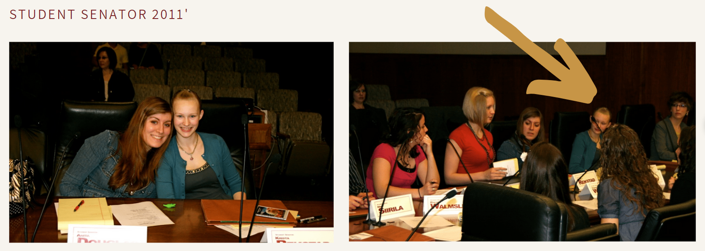

Slide 13
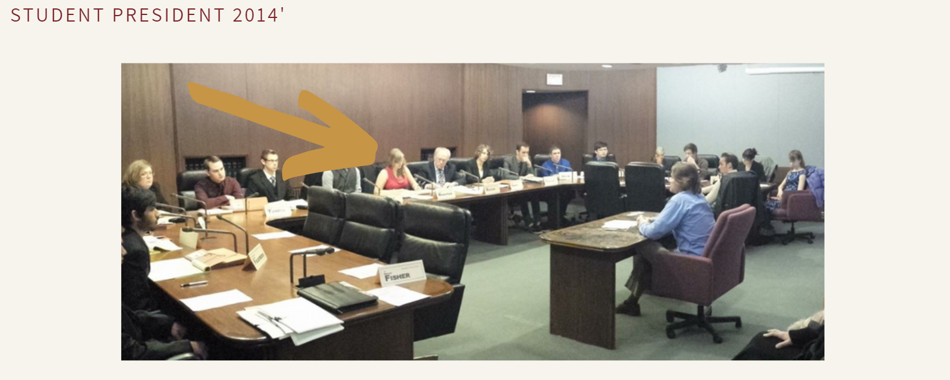

Slide 14
What I learned from SSAA
Gained self confidence in academic and professional environments
Research in key in all facets of life
How to have respectful political discourse
Leaderships skills and balance task delegation
"You get out of life what you put into it."

Slide 15
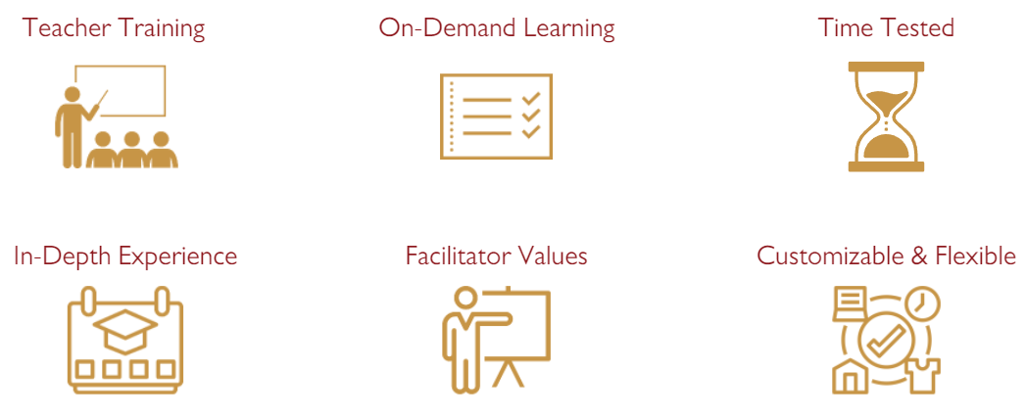
Benefits of Student Senates Across America

Slide 16
How to bring SSAA to your school
Details

Slide 17
Included
Complete plug-and-play LMS
Semester program with lesson plans
Teacher training
Student leadership training
On-demand student learning modules
Assignments and IA Questions
Legislative simulation sessions
Full technical support

Slide 18
How To Get Started
Sign the School Services Agreement
SSAA Sets up teacher and student accounts
Start your Student Senate

Slide 19
Cost per School Year
Teacher Access
$139/teacher
Student Access
10-50 Students = $99/student
51-99 Students = $89/student
100+ Students = $79/student

Slide 20
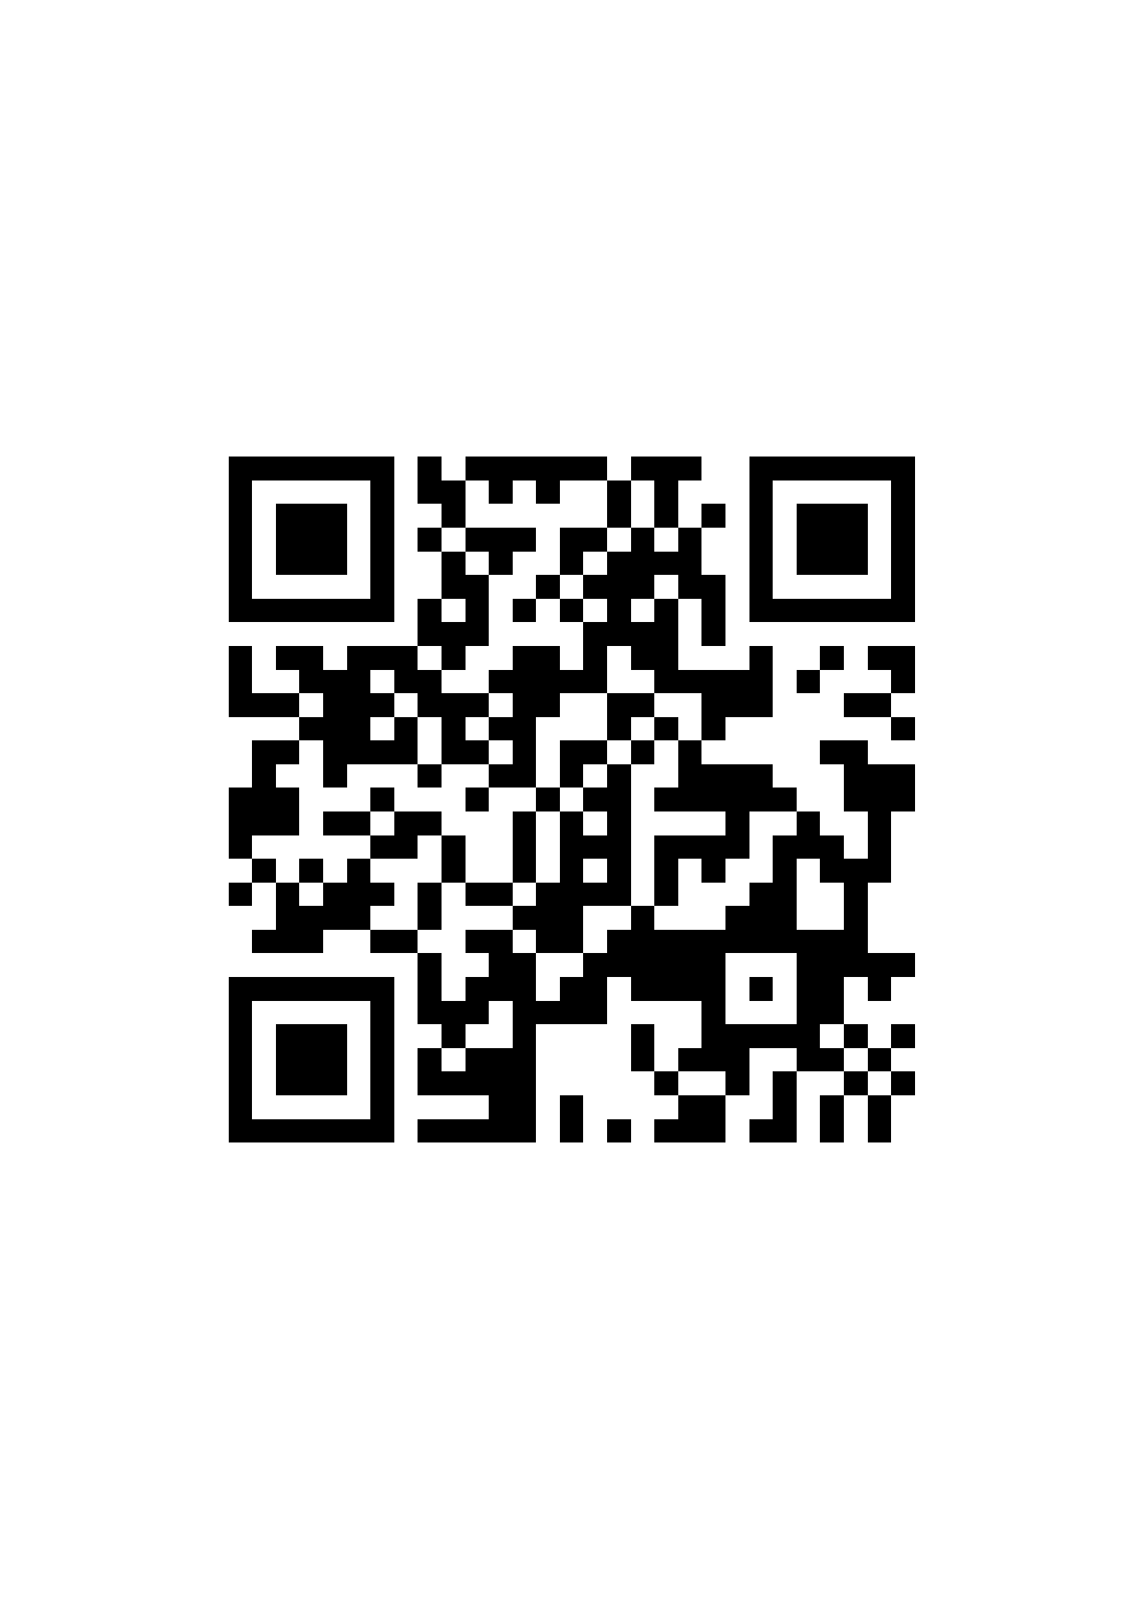
Preview the Curriculum with this try before you buy

Slide 21
Thank you for your time
…from the staff at Student Senates Across America…

