Slide 1
What Can I Do With This Piece…
A conversation about rebuilding with the Minnesota school safety center
Notes:
Good morning. We are here from the Minnesota School Safety Center.

Slide 2
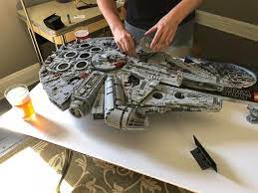
Rebuilding the Lego Land of School Safety
THIS or THAT

Slide 3
Feels like this!

Slide 4
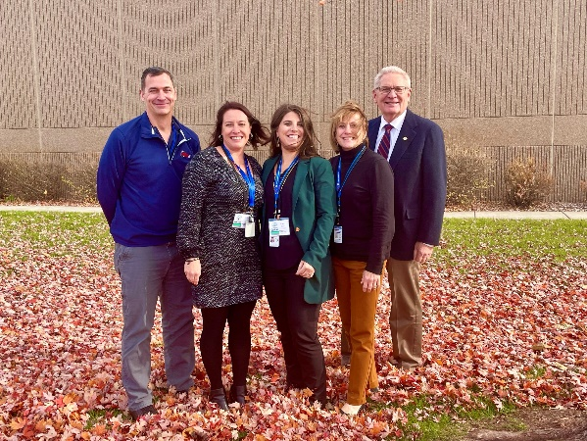
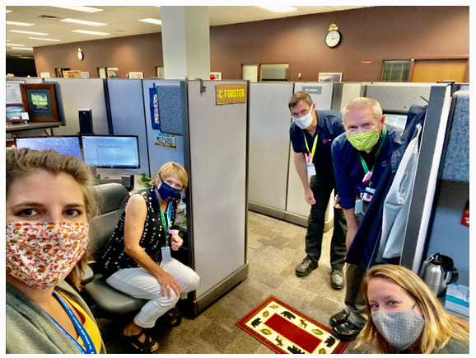
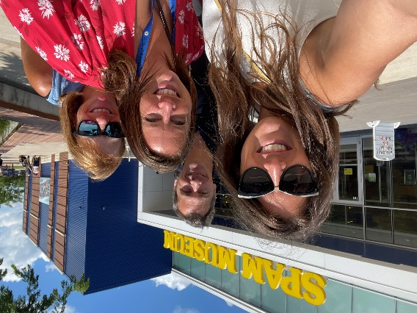
Minnesota School Safety Center
Serve ALL K-12 schools
Non-regulatory
Free – funded by the legislature – not a grant
Cross trained team members from a variety of backgrounds
Housed under the Minnesota Department of Public Safety
Notes:
Introduce ourselves and what we do
Our reality is to understand where you are and give suggestions based on current best practices.
Every school district is unique and every school in the district is unique
It is not a one size fits all model but school communities can develop procedures that are similar to others and follow best practices while still appropriate for their demographic (age of students etc)

Slide 5
Today’s Objectives
Learn what concerns you – what has changed?
Share ideas for next steps in emergency planning
Review hazards and threats – what are you most likely to face?

Slide 6
School Safety Risk Grid
High Risk
Low Frequency
High Risk
High Frequency
RISK
Low Risk
Low Frequency
Low Risk
High Frequency
Notes:
There is risk around us every day and we manage risk in many ways. Let’s review
HRLF – active shooter
HRHF – transportation accident
LRLF – food born illness
LRHF – social media threat

Slide 7
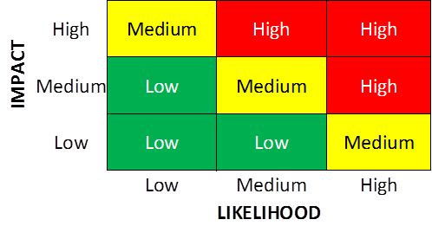
Emergency Situations
Active “Shooter”
Transportation Accident
Food Born Illness
Social Media Threat
Severe Weather
Utility Emergency
Staff/Student Death

Slide 8
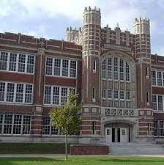
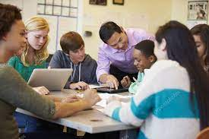
Multi-faceted & Ongoing
PEOPLE
POLICIES
PHYSICAL STRUCTURE
Notes:
They all need to work together. One does not function/work in a silo
Each school district is unique as is each school within the district.
It is everyone’s responsibility.
You can put all the bells and whistles in your building but if people prop doors it is a mute point
You have great polices but people are not trained-same thing
People want to lock doors but the locking mechanism or communication systems do not work…and the list goes on.
Do people feel safe

Slide 9
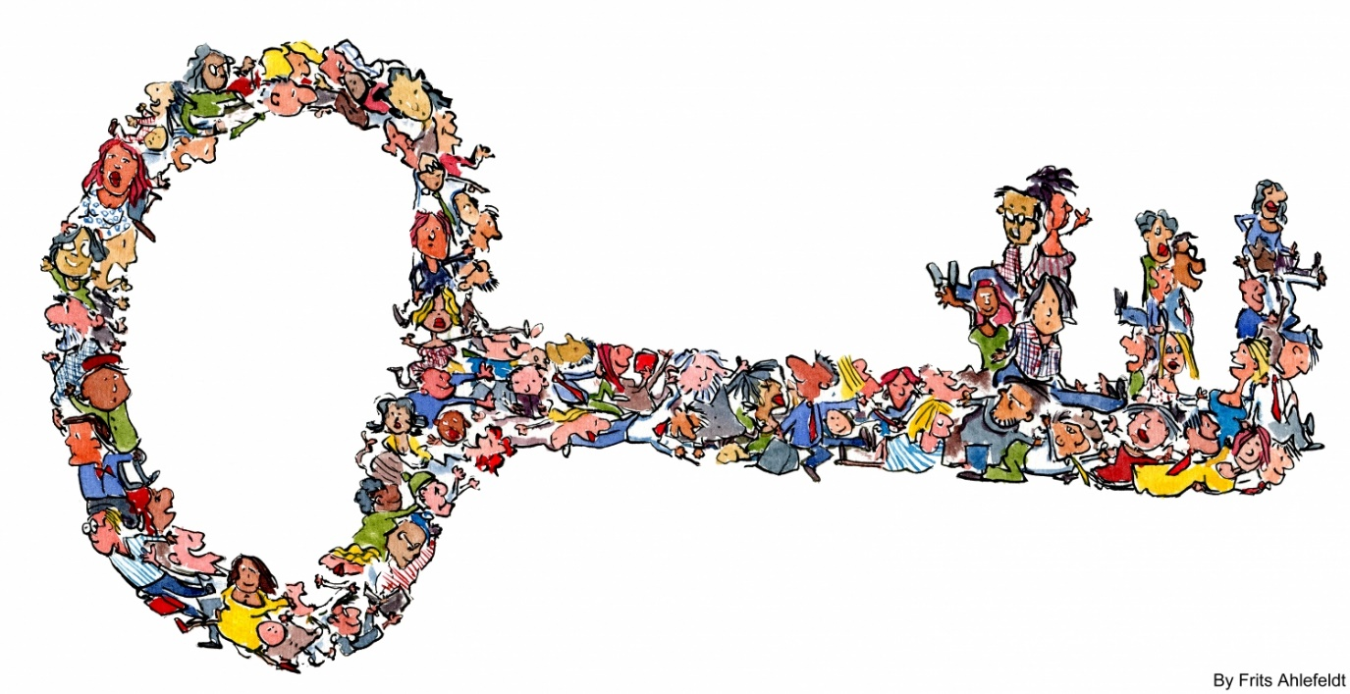
People
Staff
Students
Community
Partners
Notes:
Do you need to re-focus on staff training? Have you experienced turnover? Even if you haven’t, now is the time to make changes and re-train, we have forgotten how we used to operate in many ways.
What about contracted employees, food service, construction workers and other people

Slide 10
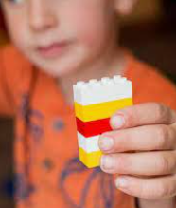
People
Trust in Yourself and Others
Situational Awareness
Keys and ID’s
Set Examples
Use appropriate access point
Keep your door locked
Communicate

Slide 11
The Power of Hello
Notes:
Simply saying “hello” can prompt a casual conversation with unknown individuals and help you determine why they are there.

Slide 12
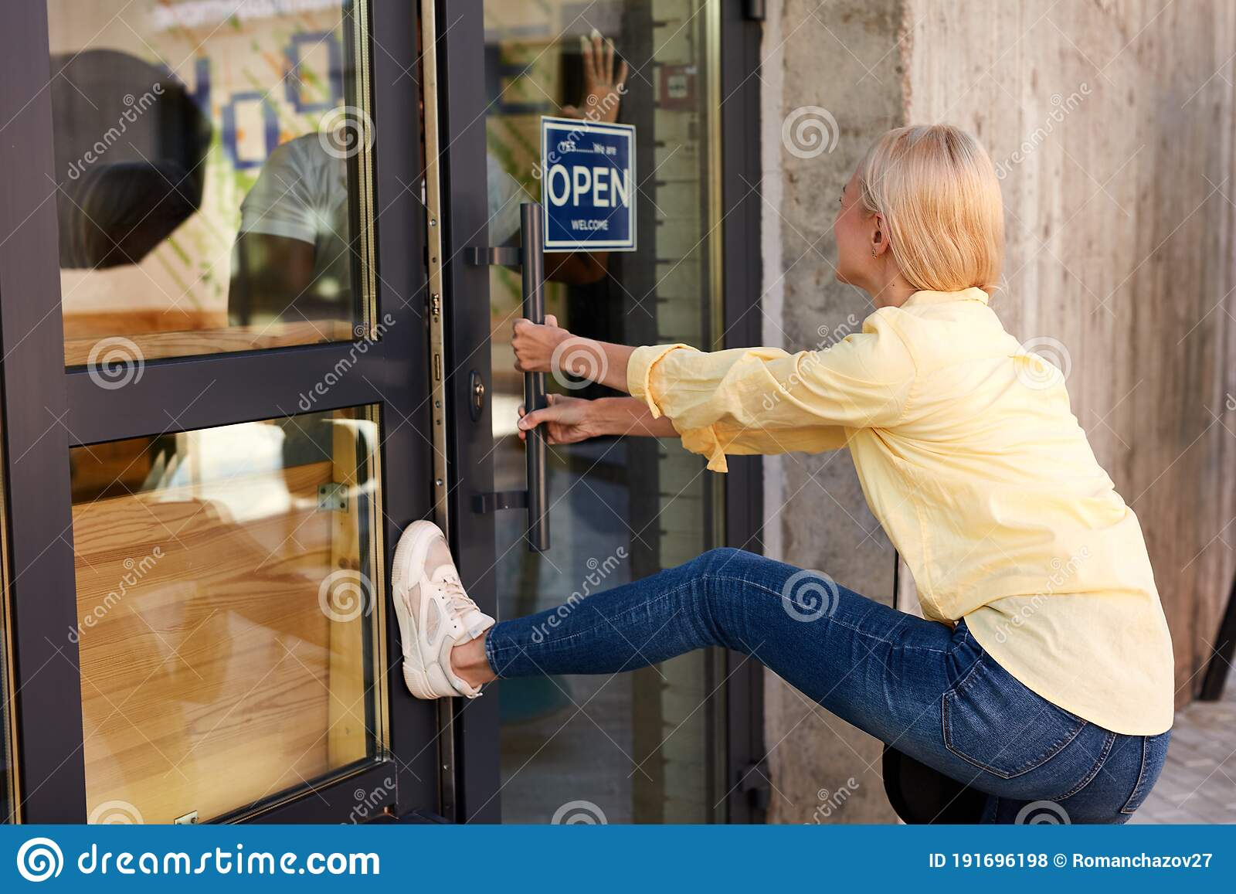
The Power of No
Notes:
We limited access and visitors in so many public places, are you back to “normal”??

Slide 13
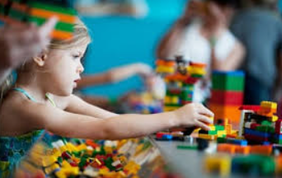
Property / Physical Space
Physical Boundaries – External and Internal
Target Hardening Improvements
Sightlines – Visibility Out
Glass
Doors
Locks
Alarm Systems
Communication Devices

Slide 14
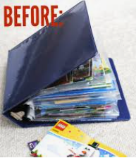
Policies / Procedures
Emergency or Crisis Plan
Threat Reporting
Emergency Communications
Internal
External
Train, Share, Aware
Notes:
Movement to universal language and adding more steps to ACTIONS – I love you guys foundation
This also includes your EOP and any functional annexes you now have
Do you have a new policy for severe weather? Do you students get “snow days” any more or do you just transition to distance learning options?

Slide 15
Policies / Procedures
Hold
Secure
Lockdown
Evacuate
Shelter
Communication
Notes:
Movement to universal language and adding more steps to ACTIONS – I love you guys foundation
This also includes your EOP and any functional annexes you now have
Do you have a new policy for severe weather? Do you students get “snow days” any more or do you just transition to distance learning options?

Slide 16
Hold
Something happening in the hallway or common area
Notes:
Keep students in classroom
Wait for all clear
Teach on

Slide 17
HOLD
Keep students in classroom
Wait for all clear
Teach on

Slide 18
Discussion “HOLD”
What about class changes?
Kids/bathrooms?
Notes:
What about class changes?
Kids in bathrooms

Slide 19
Secure
Something happening outside, maybe on school property or nearby.
Notes:
Bring everyone inside
Increase awareness
Consider shades
Teach on

Slide 21
SECURE
Bring everyone inside
Increase awareness
Consider shades
“Teach on”

Slide 22
Discussion “Secure”
What if you see something?
What if you are missing a student?

Slide 23
Lockdown
Something happening inside the building – dangerous or threatening.
Notes:
Lock door
Lights out/out of sight
Consider shades
Maintain silence

Slide 24
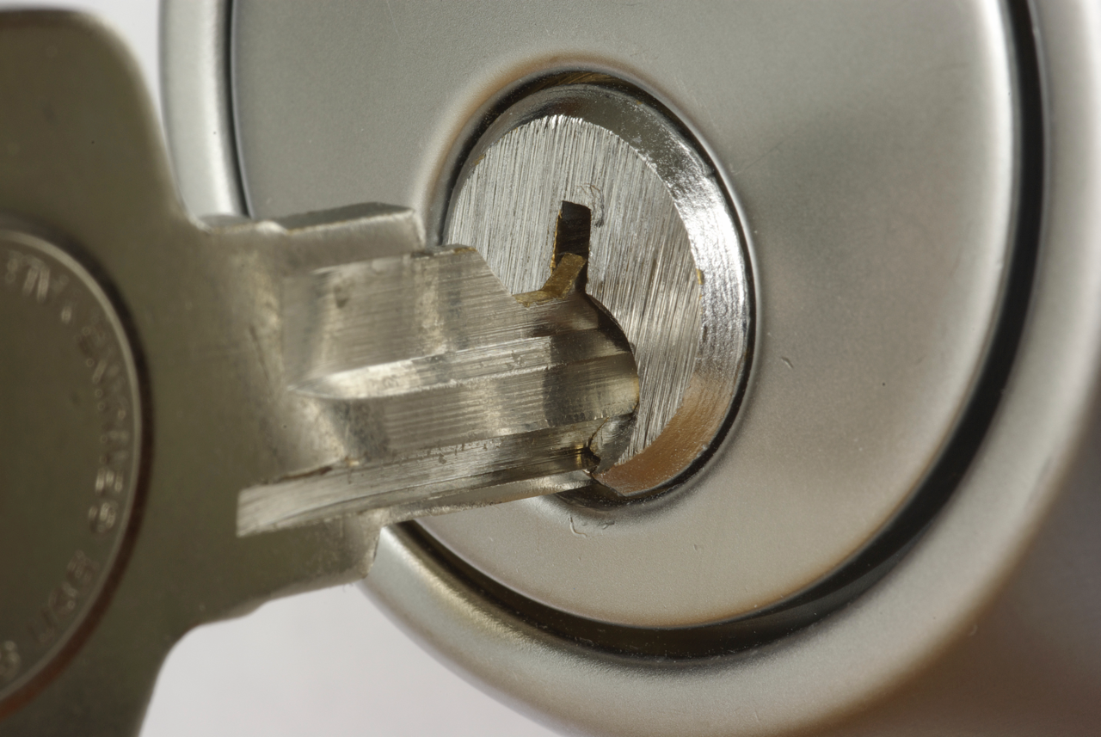
Lockdown
Lock door
Lights out/out of sight
Consider shades
Maintain silence

Slide 25
Discussion “Lockdown”
What if you are outside?
What if students are in the hallway?
What if you are missing a student?
What if alarm sounds?

Slide 26
Evacuate
Moving away or leaving the area.
Notes:
Lead with confidence
Leave “stuff” behind
Take attendance
Follow instructions
Bring phone/radio or go bag.

Slide 27
Evacuate
Lead with confidence
Leave “stuff” behind
Take attendance
Follow instructions
Bring phone/radio or go bag.

Slide 28
Discussion “Evacuate”
Where do you go?
What if you are missing a student?
What about mobility issues?

Slide 29
Shelter
Action for a hazard or severe weather.
Notes:
Lead with confidence
Take attendance
Follow instructions
Be prepared for unexpected
Bring phone/radio
.

Slide 30
Shelter
Lead with confidence
Take attendance
Follow instructions
Be prepared for unexpected
Bring phone/radio

Slide 31
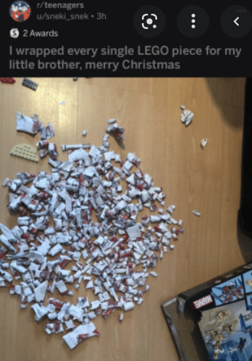
First Step - Size Up the Situation
What information do you have
Who/what is around you
How can you respond
Communication

Slide 32
Monitor and Adjust
Secure
Lockdown
Evacuate
Hold
Shelter
Communication

Slide 33
Scenario
You are in your classroom with students.
You smell gas.
What would you do?

Slide 34
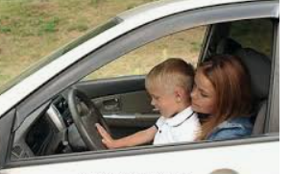
Scenario
A parent arrives to pick up her child
She seems to be intoxicated
She has a toddler with her

Slide 35
Scenario
You are in the office
A parent signs his student in
The parent follows the child into the building
You follow the parent and ask him to go back to the office to sign in
He becomes upset and refuses to follow you
There is another group of students coming down the hallway

Slide 36
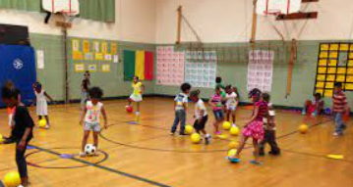
Scenario
You are in the gym with your students when you hear “lockdown” over the PA

Slide 37
Scenario
An agitated parent arrives and wants to see his/her 8 year old child
You have heard rumors that the parents are involved in a legal dispute over custody of the children
There are 6 other children in your area

Slide 38
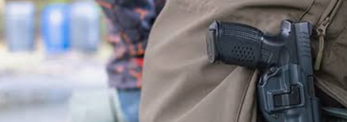
Scenario
An adult wearing a visitor badge walks by you in the hallway
You notice a handgun on his belt

Slide 39
After Action Report
Successes
Challenges
Verbal / written
Act
Notes:
Example: Door broken in N. St. Paul…

Slide 40
Emergencies/Crisis
Can happen anywhere
Transference of skills
Preparation is key
Notes:
Just like public safety personnel…no two days are the same
You are masters of adaptation-you just need to transfer these skills
We will focus on what you can do to improve your level of preparedness
Keep an open mind-it is not all violent intruder

Slide 41
NEXT STEPS
Notes:
So you are in a good place – what is next in the school safety world?

Slide 42
Safety Committee
Convene a Safety Committee.
Meeting regularly
Cross section of staff
Developing a safety/training plan
Set schedule and goals/objectives
Outside of regular meetings
Convene ASAP during emergency
Convene after emergency to do AAR

Slide 43
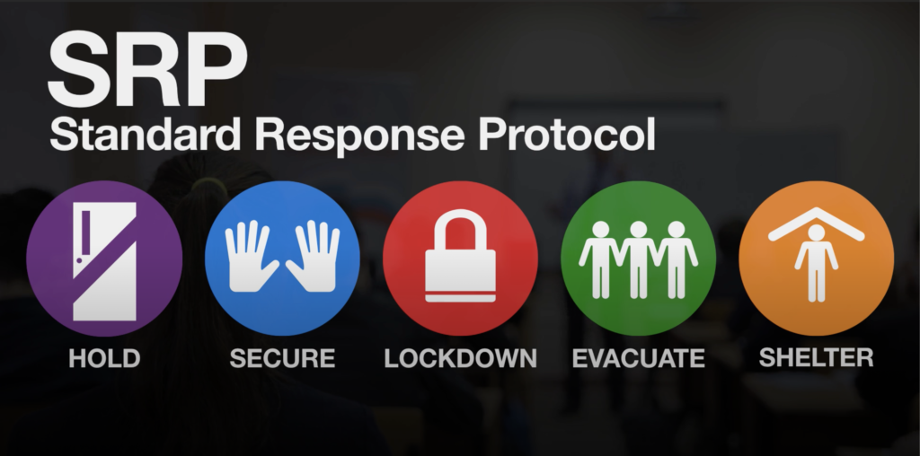
Updating Universal Procedures
Follow new guidelines for ACTIONS
Communicate new plans
Posters
Information to parents
Practice

Slide 44
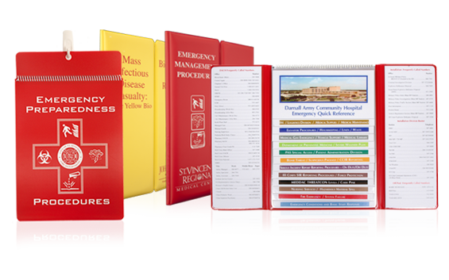
Emergency Operations Plan Review
We ASSIST in updating your current plan
We can give templates to those starting from scratch
The process of doing is invaluable
Assess hazards from multi-disciplinary view

Slide 45
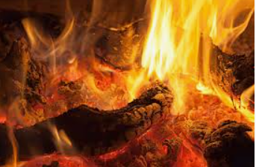
Hot Topics
What are we seeing & hearing?

Slide 46
Threat Assessment
Increasing number of threats
How do we respond
Received electronically of social media
Defined Threat Assessment Process
School day or after school event
Treat all threats as legitimate, until dismissed
Work with law enforcement
Bureau of Criminal Apprehension (BCA)
Reintegration of student

Slide 47
Social Media and Bullying
Pressure “Outside…In”
Bullying
Self harm
“Installing Guardrails”
School device safeguards
https://education.mn.gov/MDE/dse/safe/bprev/

Slide 48
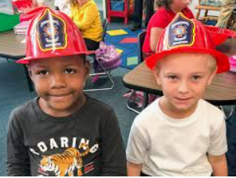
Student Trauma/Mental Health
Concerns regarding safety drills
Age and content appropriate
Consider pre-existing trauma
PTSD
Monitor post-safety drill
Students and staff impacted
NASP resources; https://www.nasponline.org/

Slide 49
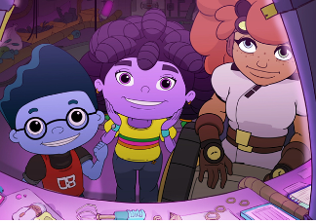
Exploitation of Students
What to look for in grooming behaviors
Sextortion
Hoax Threats
Internet Safety
http://www.netsmartzkids.org/
https://www.fbi.gov/how-we-can-help-you/parents-and-caregivers-protecting-your-kids

Slide 50
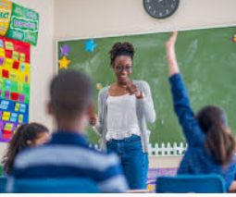
Staff Turnover
Schools
Support Services
Public Safety Partners
Impacts
Updating Plans
Training

Slide 51
What Concerns You?
Notes:
Has anything changed POST COVID? Think back to BEFORE, when it comes to planning for emergencies are these concerns NEW or are they the SAME
What we are hearing – lots of staff turnover in key roles, how does this affect my emergency response? Staff shortages? How does this effect my emergency response? Kids/staff are still getting back into the swing? Where do I pick up where I left off, do I need to go backwards?
Change of demographic – new families, new kids due to COVID

Slide 52
Minnesota School Safety Center
Notes:
Questions of the MnSSC or of the ACC safety committee or leadership?
Next Steps for us and for you……

Slide 53
Minnesota School Safety Center
Randy Johnson: randy.johnson@state.mn.us
Jenny Larrive: jennifer.larrive@state.mn.us
Kasey Cable: kasey.cable@state.mn.us
Connie Forster: connie.forster@state.mn.us
Jon Jorgensen: jonathan.jorgensen@state.mn.us

