Slide 1
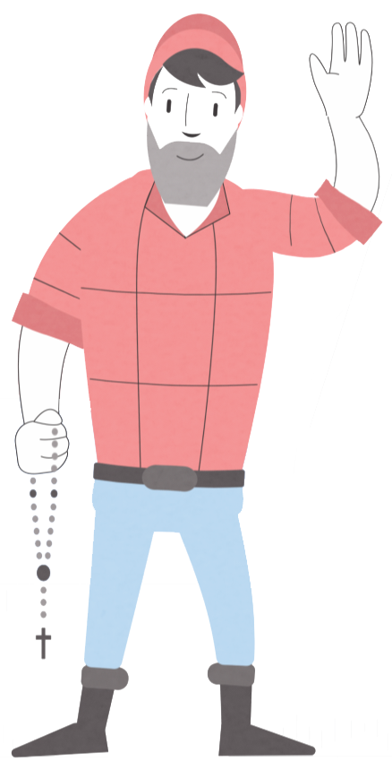
Working with Public Officials to Help Your School
Jason Adkins Executive Director & General Counsel Minnesota Catholic Conference MNSAA Conference November 4, 2022

Slide 2
General Principles

Slide 3
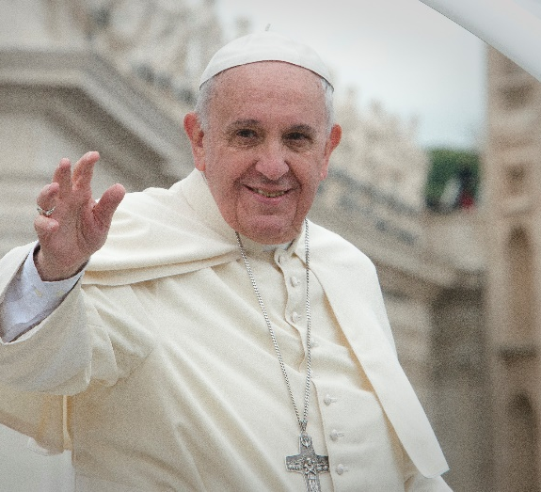
General Principles
“Politics is one of the highest forms of charity because it serves the common good.”
-Pope Francis

Slide 4
General Principles
“A good Catholic meddles in politics.”
-Pope Francis

Slide 5
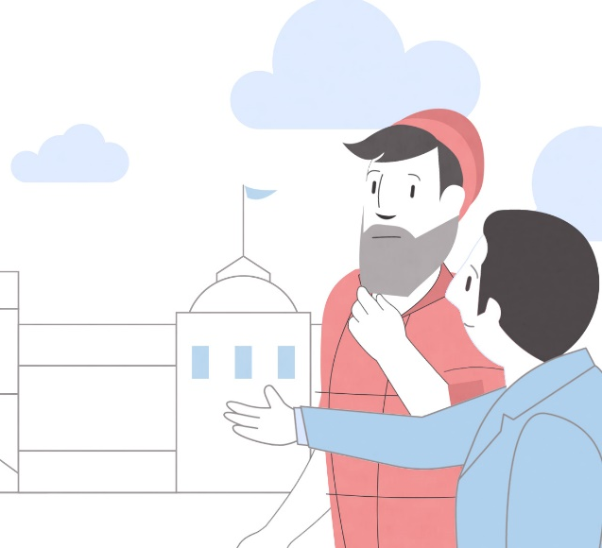
General Principles
Your elected officials need and want to hear from you.
They need you as a resource and a friend.
Notes:
“cultivate civic friendship”

Slide 6
General Principles
No “rules” without relationship
Notes:
Harder to dehumanize when there is relationship—foster the politics of encounter

Slide 7
The “Dos”

Slide 8
The “Dos”
Get to know your elected officials – all of them
Notes:
Don’t forget about local officials; they actually have the potential to have the most impact on your parishes

Slide 9
The “Dos”
Identify ways of partnering for the common good
Notes:
You can’t always be asking for stuff—sometimes you need to be a resource

Slide 10
The “Dos”
Communicate with them about issues impacting your school community
All politics is local
Look to MCC and MINNDEPENDENT for resources and guidance on state and federal matters
Put together a legislative action/social concerns team that includes a phone/email tree

Slide 11
The “Dos”
Put a human face on issues of concern; facts tell, stories sell; win the story wars

Slide 12
The “Dos”
Ask for specific things and needs; they expect that.

Slide 13
The “Dos”
Develop relationships with elected officials at all levels; they have different forms of jurisdiction and authority.

Slide 14
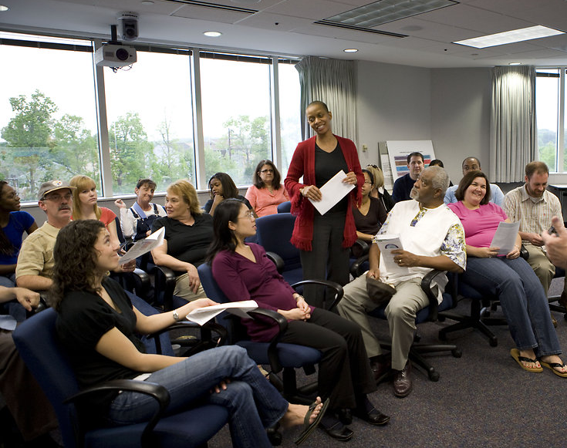
The “Dos”
Invite them to your school
Invite them to your school festival
Host a town hall

Slide 15
The “Dos”
Remember that, ultimately, it’s a relationships business

Slide 16
The “Dos”
Pray for them!
Notes:
Includes thanking them when they have done well

Slide 17
The “Don’ts”

Slide 18
The “Don’ts”
… Assume that you will not make a difference
… Demand things as though you are entitled to them; propose, don’t impose
… Assume anything about them by partisan affiliation
… Expect that you will convert them to your idea on the first sitting. Put yourself in their position; persuasion takes time.
Notes:
Remember, politics is about showing up—overcome apathy and engage; at the state level, even five callers makes a difference—translate that to a local context

Slide 19
Electioneering Communications
Notes:
Guidelines formulated at the intersection of IRS regulations and pastoral prudence

Slide 20
Electioneering Communication
You can:
Host a candidate forum where all are invited
Host educational events related to issues that do not contain voter guides
Advocate for or against ballot initiatives such as constitutional amendments
Advocate for or against legislation

Slide 21
Electioneering Communication
You can:
Distribute materials related to specific issues that do not reference candidates or parties
Participate in non-partisan voter registration efforts or get-out-the-vote drives
Organize issue-specific letter writing campaigns or lobby day events
Sponsor public voter education forums on specific issues

Slide 22
Electioneering Communication
You should NOT:
Prepare or distribute campaign literature and materials that favor or oppose a specific candidate or political party
Use Diocesan or parish bulletins and websites to support, promote, endorse, or oppose any political party or candidate
Give Church money or support to candidates for political office or to office holders
Allow partisan electioneering on school grounds

Slide 23
Guidelines for Parish Political Activity
www.MNCatholic.org
“Educational Resources” tab

Slide 24
Catholic Advocacy Network
Encourage your parish to join the Catholic Advocacy Network!
www.MNCatholic.org

Slide 25
Questions?
Jason Adkins
JAdkins@MNCatholic.org

