Slide 1
Developing and Maintaining the School Strategic Plan
Andrew Hilliker
President, Stella Maris Academy – Duluth, MN
MNSAA Board Treasure and Team Chair
Andrew.Hilliker@stellamaris.academy

Slide 2
Goals
What is a Strategic Plan
Why is the Strategic Plan Important
Strategies for Developing the Strategic Plan
Timeline
Quality Strategic Plan Requirements
Required Structure of Strategic Plan
Example Strategic Plan
Maintaining the Strategic Plan
Post Onsite Visit

Slide 3
Disclaimer
Every school’s governance, environment, and community functions differently.
Be mindful that there are multiple routes from “HERE” to “THERE” – keep your mission, students and stakeholders in sight at all times when considering the ideas presented in these slides.

Slide 4
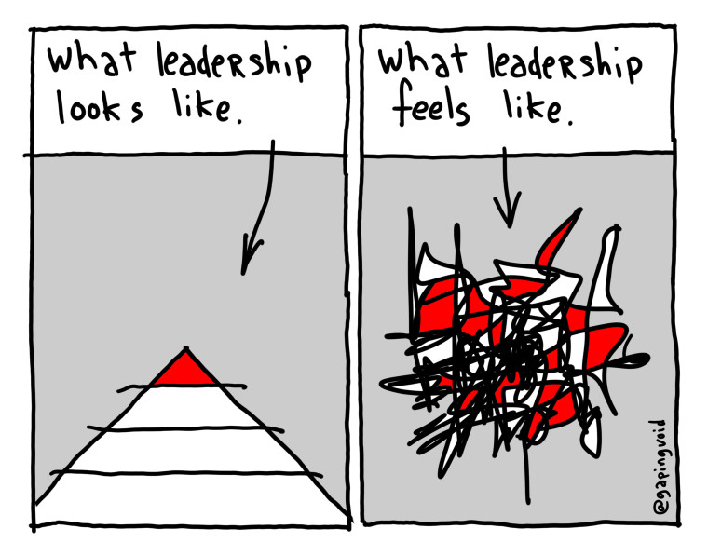
What is the School Strategic Plan and Why it is Essential
A visionary roadmap of objectives, strategies and action steps that takes your school from ‘now’ to ‘future’
Where your school wants to be and how you are going to get there
To avert the feeling of chaos in our work as administrators / teacher leaders and provide a plan to make our school’s future bright(er) for the kids we get to serve.

Slide 5
Process for Development
Define School’s Current Reality
Strengths and Challenges from MNSAA Self-Study
Analyze Annual Surveys of Stakeholders (parents, donors, students, staff, and anyone else who values your mission and function)
Develop Community Support, Understanding, and Buy-In
Integral to have a Steering Committee comprised of a variety of members (respected staff, board members, donors, students?, parents)
Communicate, Seek Input, and Respond
Create School Strategic Plan and Share
Does it meet MNSAA Standards for a Quality SSP?
Has your school community been made aware of the final draft of the SSP?

Slide 6
Suggested Timeline for
SSP Development
Share Strengths and Challenges with Stakeholders and accept feedback for consideration.
Consider: Listening Sessions, Meetings, Video Presentations, Etc. to share.
Utilize Steering Committee to draft objectives and action steps that are student driven, reflect school’s current reality, and reasonableness considering human resources and available means.
Complete final editing and begin promoting final draft to stakeholders
(parents, committees, donors, appropriate public entities, website parishes / congregation etc.)
Invite your Onsite Visiting Team in to validate your Self-Study and your School Strategic Plan.
Use your Team Chair!
Analyze Strengths / Challenges from Self-Study and Stakeholder Surveys
Fall
2023
November
2023
December
2023
January
2024
Spring
2024

Slide 7
A Quality SSP Is:
Valid
Connected
Supported
Does SSP reflect current reality of school?
Seek outsiders (principal’s, community members) to check your tunnel vision.
Are the challenges in your self-study addressed?
Review, review, and re-review your self-study; highlighter investment.
Do all those that care for and support your school know the initiatives within the SSP?
Think about who your school will need to accomplish the goals within SSP.
Visionary
Reasonable
Focused
Does your SSP take you into the future?
Avoid the to-do list.
Are you and your team able to accomplish the goals in the SSP
Challenge yourself, but don’t set up for failure.
Are students at the heart of improvement?
Ask, “Will this objective benefit the kids I get to serve everyday?”

Slide 8
Required Components of SSP
Objectives
“End Result”
Far reaching statement of where you want to be as a school.
Can this really ever be attained?
Does this objective require numerous accomplishments to be attained?
Strategies
“The Recipe”
Concise statement that works to accomplish the objective.
Start with a verb!
Requires defined action steps to come to fruition.
Action Steps
“The Ingredients”
Indicate who is doing what and when to reach the strategy
The finite roadmap for the Objective.
Steps are chronological and sequential

Slide 9
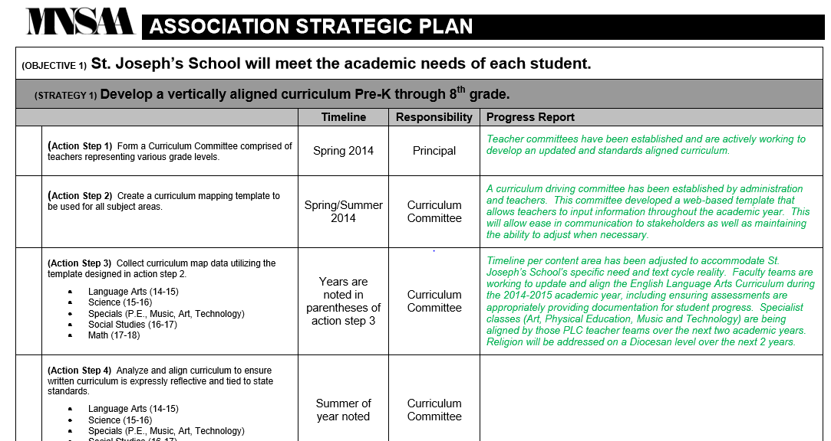
Example of SSP

Slide 10
Maintaining School Strategic Plan
Structured Maintenance
Intrinsic Value
Ideas
Annual Progress Report
(completed in June and submitted to MNSAA APR Review Team)
Road map for leadership (bigger than one person or position)
Make part of board/advisory/donor meetings, State-of-School Report, and development plans
Directs resources to an agreed upon plan and purpose that will support students
Print, Laminate,
Post, Mark-Up
Living Document to meet unexpected realities of school
Stability for inundation of ideas presented to leadership of school
Make part of Evaluation of self and/or governance

Slide 11
After Your On-Site Visit
Onsite Team Visits School
Chair Meets with Administrative Team
Team’s Report is received by MNSAA Director for review
MNSAA Board responds to Team’s Report
Responding to Team and Board Actions
(Accredited Status)
Bring your Steering Committee back together to review the feedback and report from MNSAA
You will respond to MNSAA’s Team Report and possibly have a timeline of evidence to provide pending visit.
Amend SSP if necessary
Share with your community and stakeholders

Slide 12
What’s Clear? What’s Not? Other Thoughts?

