Slide 1
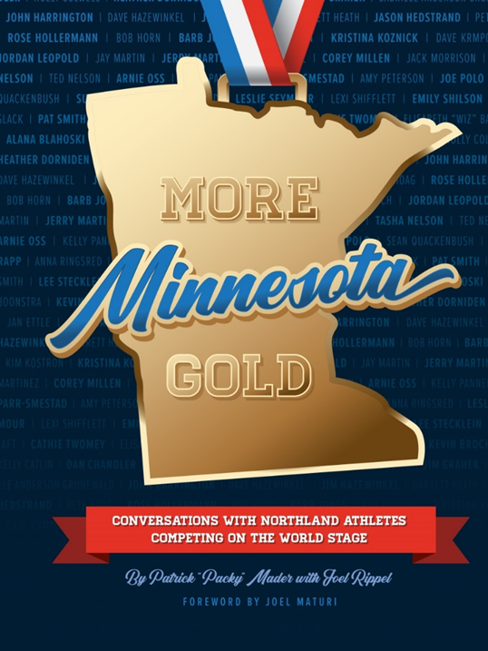

Slide 2
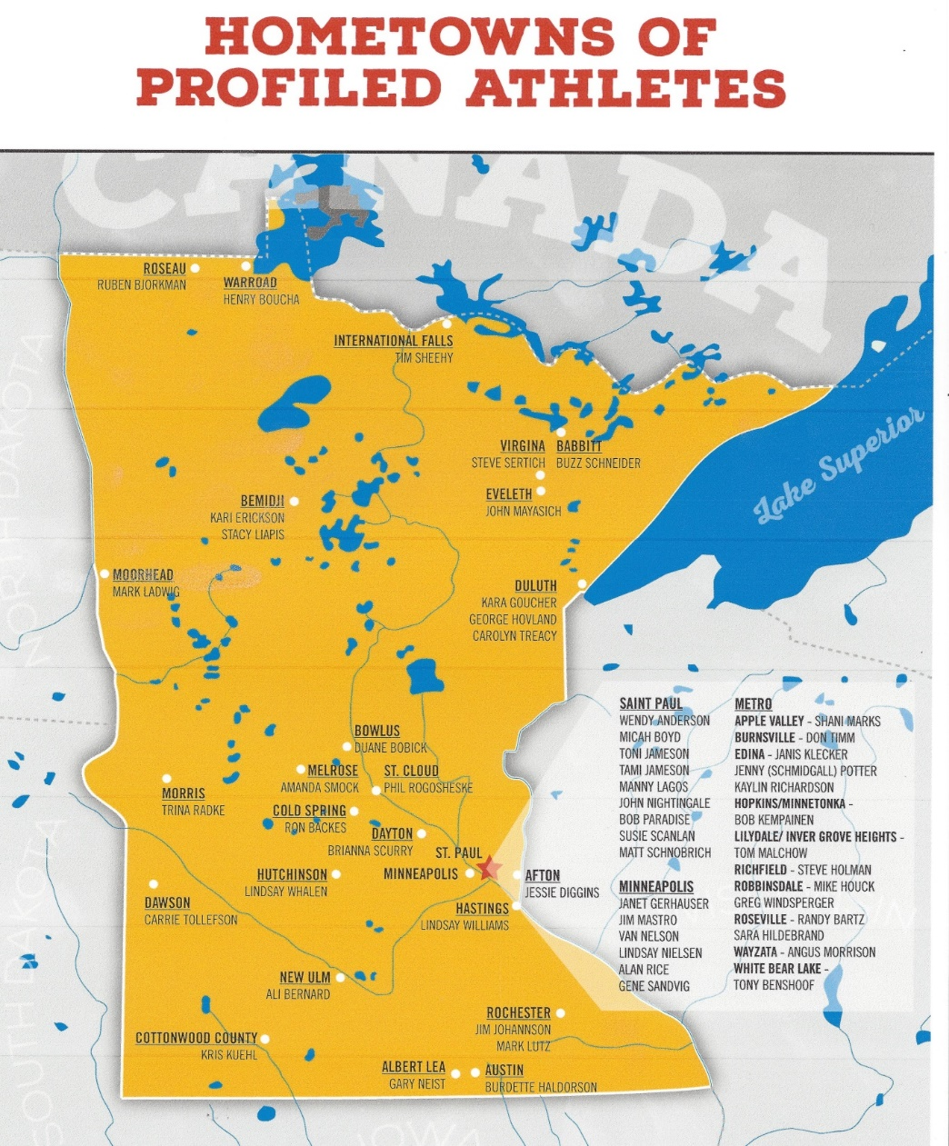
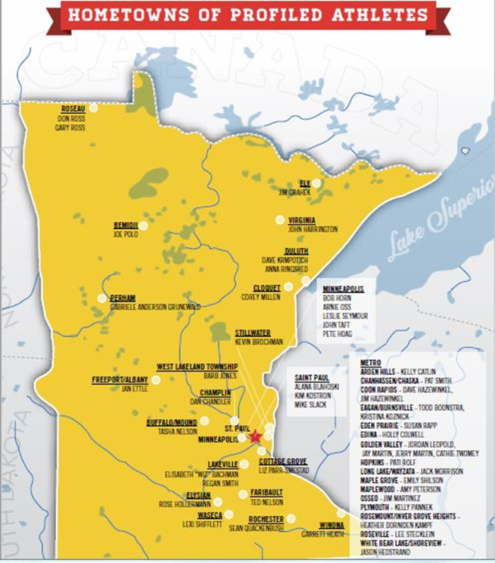

Slide 3
At the Olympics
About 350 living people who spent their formative years in Minnesota have competed in the Winter and Summer Olympics
More have been hockey players than any other sport, then wrestling, speedskating, and curling is coming on like gangbusters!
There were no Olympics in 1940 and 1944 because of World War II (the Olympics happen every 4 years). The winter and summer Olympic Games were held in the same year through 1992.

Slide 4
Olympian Qualities
Self-directed
Dream big; inspired
Perseverance, determination
Time management skills
Balance in life
Motivation, dedication, love of sport
Intelligence
Modesty
Athletic talent, gifts

Slide 5
Olympian, Paralympian Qualities
And . . .
“Give back” to the sport, community, and school

Slide 6
At the Olympics

Slide 7
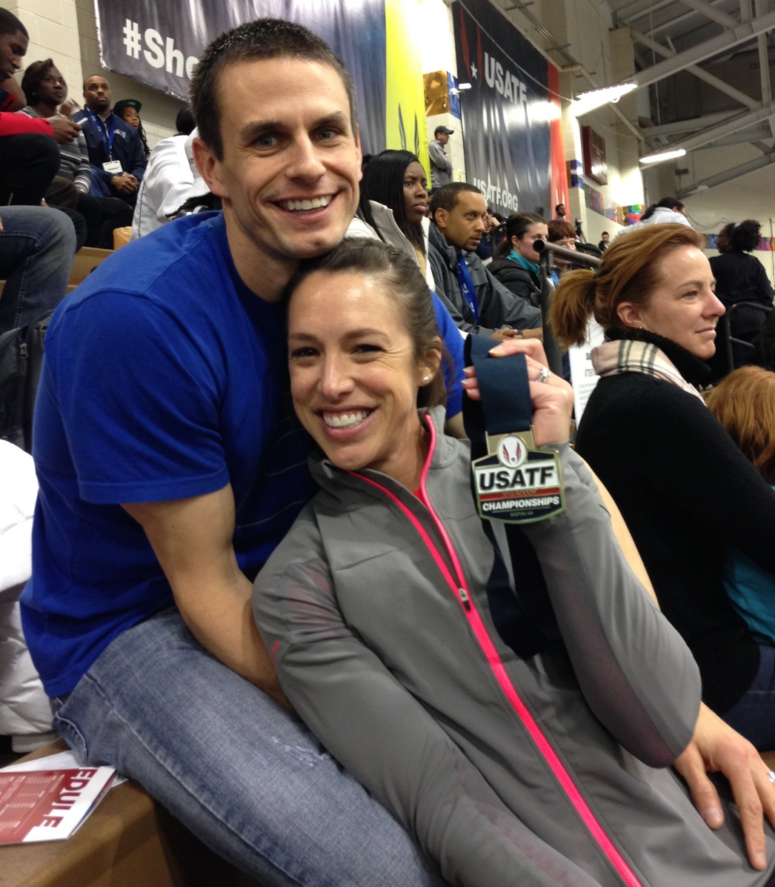
Amanda Smock
A national champion in the triple jump in both 2014 and 2015, Amanda Smock is now training for the 2016 Olympics hosted in Rio de Janeiro, Brazil.
She obtained a doctorate in exercise physiology at the University of Minnesota.

Slide 8
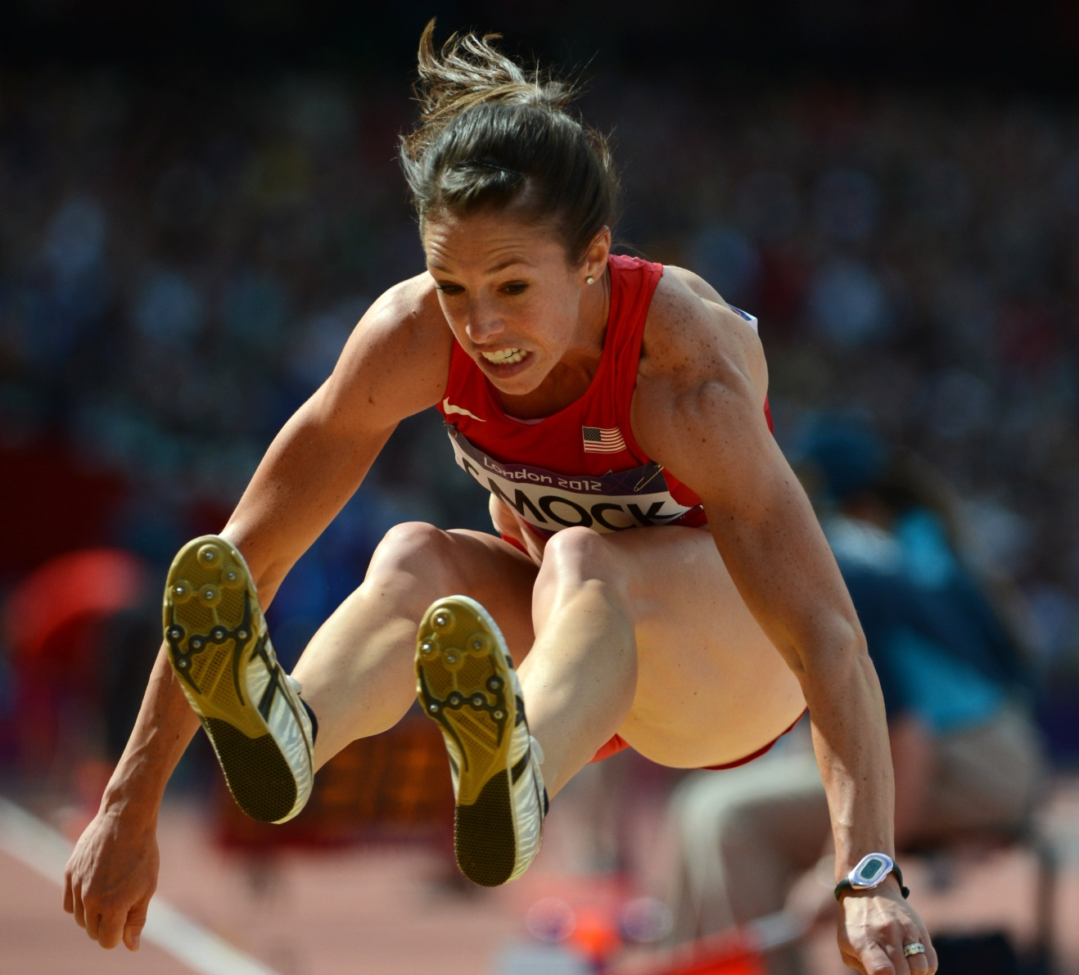
Perseverance Payoff Is London Flight
Amanda Smock, from Melrose, competed in the triple jump and finished 27th at the 2012 Olympics in London, England.
She starred in gymnastics in high school and then attended North Dakota State University.

Slide 9
Happy in Hockey, Happy in Politics

Slide 10
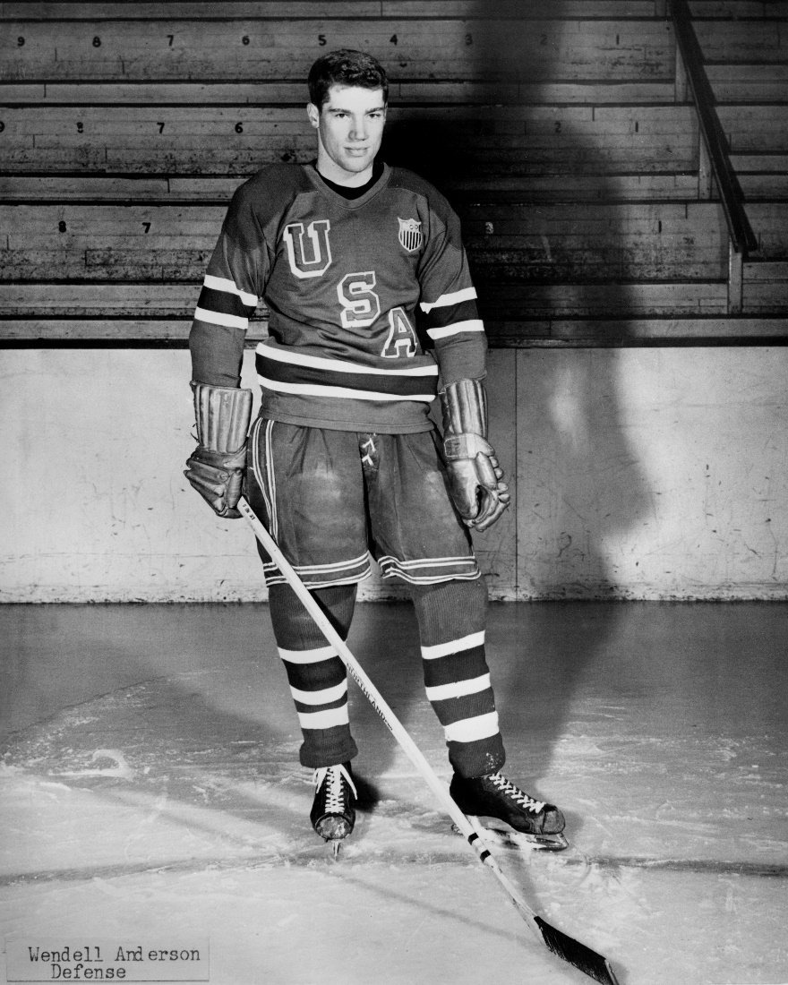
Wendy Anderson
Wendell “Wendy” Anderson of St. Paul was an Olympian on the 1956 hockey team.
Wendy later became a state legislator and finally served as the nation’s youngest governor from 1970-76.
He continued to play hockey throughout his lifetime.

Slide 11
The Governor Like Minnesota Gold!

Slide 12
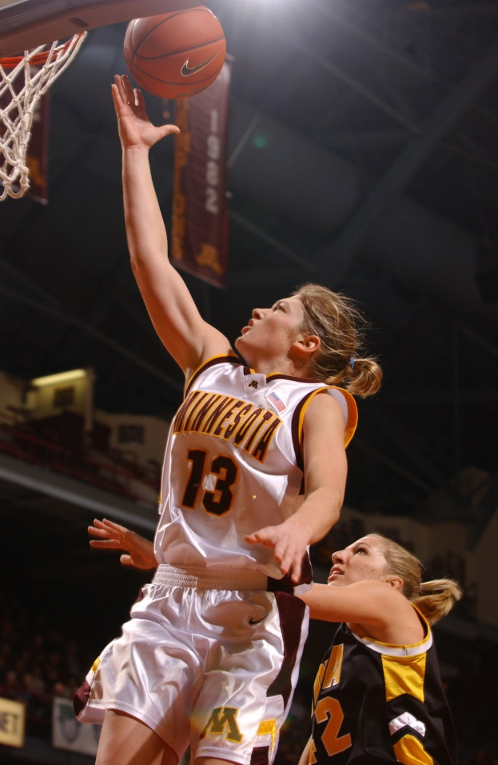
Minnesota’s Hometown Olympian
Announcing itself as Minnesota’s Hometown, Hutchinson is proud to have a close relationship with Lindsay Whalen, perhaps the most known female athlete in Minnesota.
A four-year starting point guard and two-time All-American at the University of Minnesota, Lindsay averaged over 20 points per game during her collegiate career.
Attendance increased nine-fold at women’s basketball games from 2000-04.

Slide 13
Lindsay Whalen
Originally drafted by the Connecticut Sun, Lindsay has played professional basketball for over ten years and never missed a start through the 2014 season since her second game in the WNBA.
Lindsay played for the Minnesota Lynx from 2010-18 and led the team to four WNBA Championships.
She was the leading scorer in the gold medal-winning 2016 US Olympic women’s basketball game and served as the U of M women’s head for 5 years.

Slide 14
The Right Formula: World Record and Gold Medal
After winning seven individual state high school swimming titles as a student athlete at St. Thomas Academy, Tom Malchow accepted an athletic scholarship to the University of Michigan.
He obtained a degree in business and is now successful in orthopedic sales in the Pacific Northwest.

Slide 15
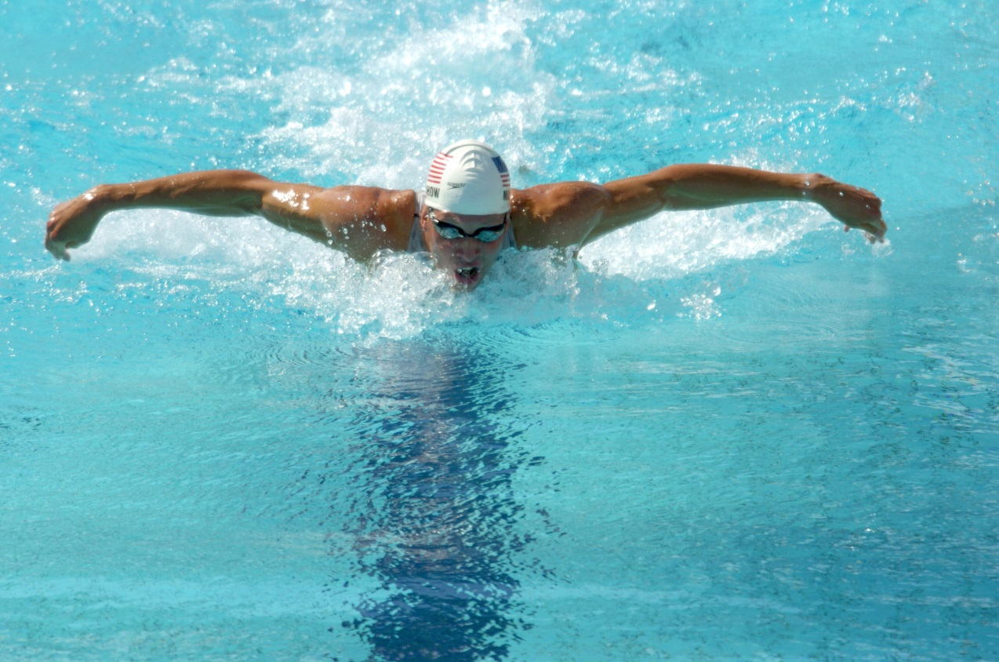
Tom Malchow
Tom Malchow is a three-time Olympian; he won a silver medal in the 200-meter butterfly at the 1996 Olympics and a gold medal in the same event at the 2000 Olympics.
With his first ribbon—”It could have been gold”.
Notes:
https://www.youtube.com/watch?v=ZhtEyNeDWxg

Slide 16
Inspiring a Whole New Generation of Little Girls
Briana Scurry, a graduate of Anoka High School, is a three-time Olympian and helped the U. S. to two gold medals as the team’s goalkeeper.

Slide 17
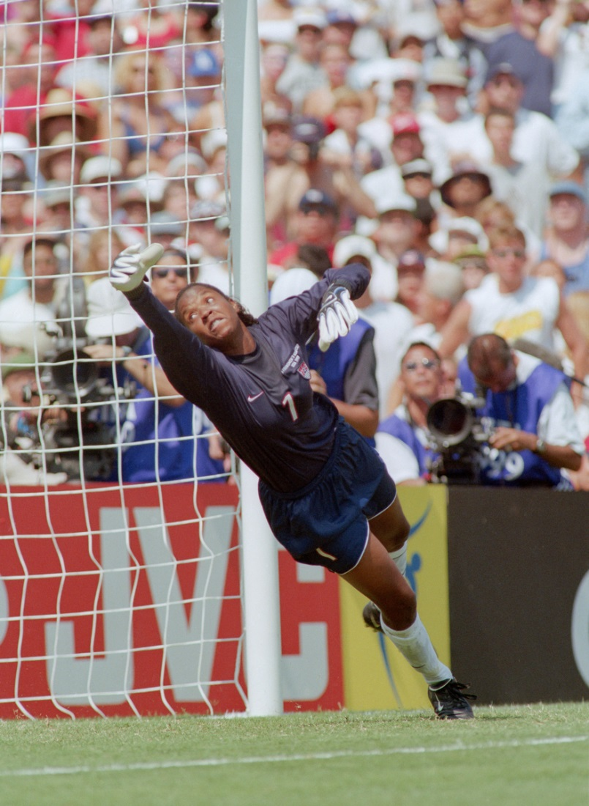
Briana Scurry
Quick, athletic, focused, and possessing great jumping ability and spectacular balance, Briana Scurry, received a full athletic scholarship to the University of Massachusetts—Amherst.
She is making a successful recovery from a traumatic brain injury.

Slide 18
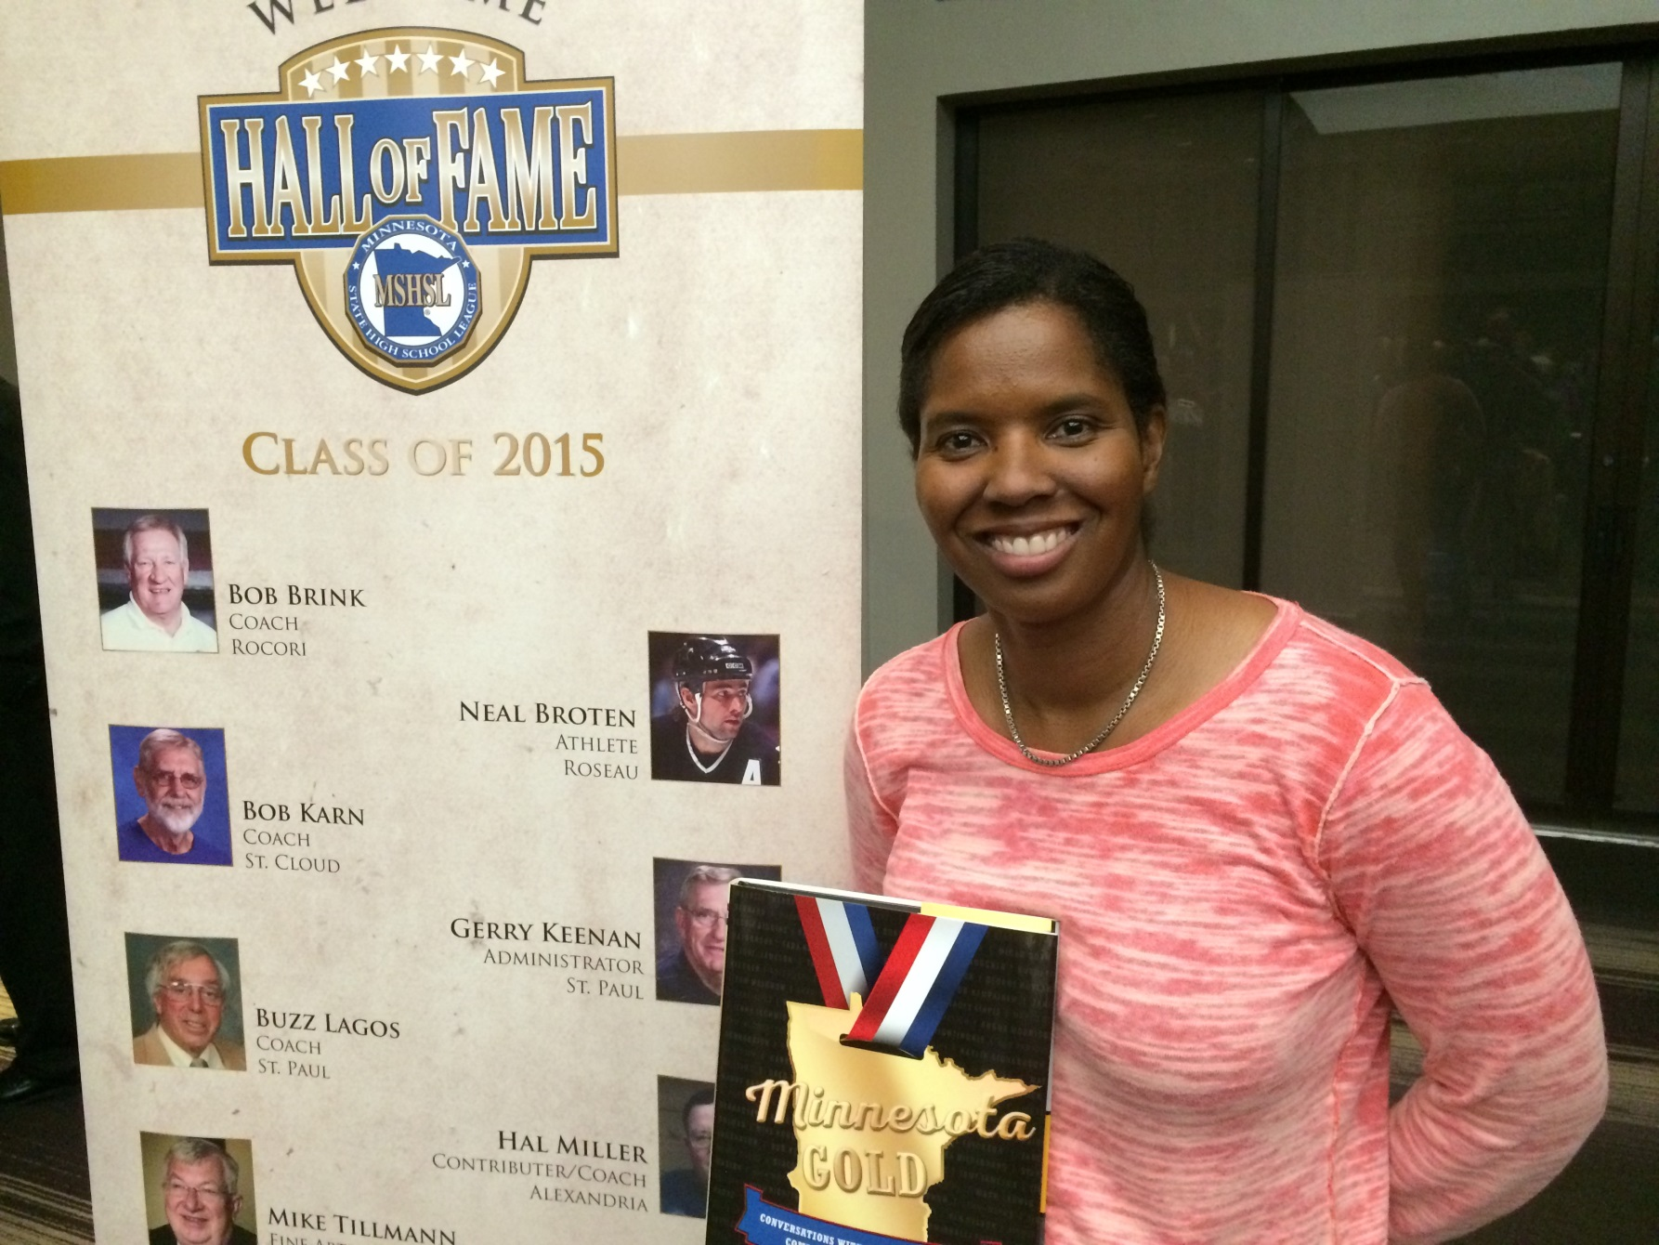
Briana Scurry Likes Minnesota Gold!

Slide 19
Still Skating Along Famously
Janet Gerhauser took a streetcar to ice arenas for figure skating practice as she attended Minneapolis Washburn High School.
She thought of her skating partner, John Nightingale, as an older brother. John attended Cretin High School. Both later graduated from the University of Minnesota.
They placed 6th in the 1952 Olympics figure skating pairs. Janet was one of only 13 women on the US Olympic team.

Slide 20
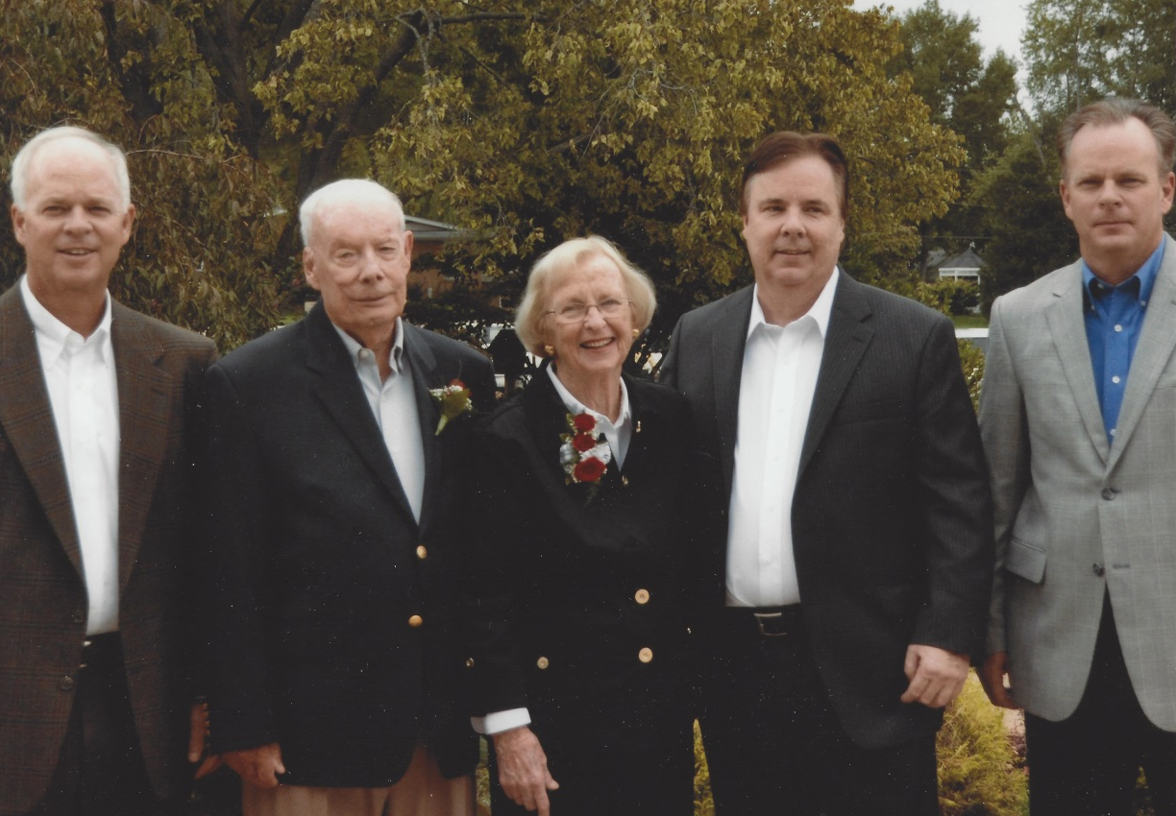
Janet Gerhauser and John Nightingale
Janet Gerhauser became an international figure skating judge.
John Nightingale had a lengthy military service career.

Slide 21
Hockey Connections
Known as the “Babbitt Rabbit” and “Iron Lung” while a prolific scorer at Babbitt High School, Buzz Schneider was an Olympian on both the 1976and 1980 “Miracle on Ice” teams.
On the 1980 team, he played on a high-scoring line with John “Bah” Harrington (Virginia) and Mark Pavelich (Eveleth)

Slide 23
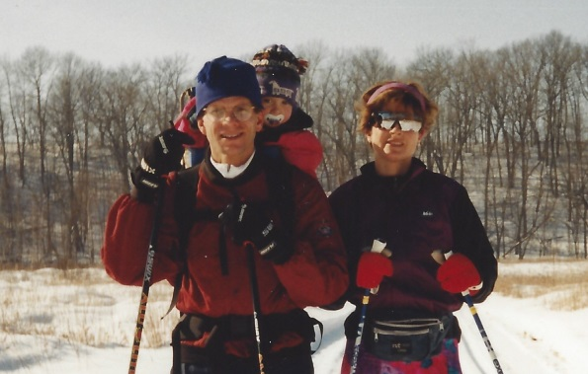
It Takes a Village
Here is a woman who cross country skied in the 2014 Olympics in Sochi, Russia.
Jessie Diggins is from Afton, Minnesota, and won the state cross country championship in 9th grade!

Slide 24
Jessie Diggins Today

Slide 25
Embracing Ojibwe Heritage
Because it was not considered cool, Henry Boucha ignored his Ojibwe heritage during his youth (two of his grandfathers were chiefs).
An outstanding athlete, Henry is famous in high school hockey lore and graduated from Warroad High School and was then drafted into the US Army.

Slide 26
Henry Boucha
An integral part of the 1972 Olympic hockey team, Henry was drafted by the Detroit Red Wings and launched a professional career in the sport.
A devastating and brutal injury forced him into retirement at age 25. He has been involved in numerous professions including real estate, Indian Education, coaching, and the author of a book. He later embraced his heritage until his death in 2023 .

Slide 27
Henry Boucha in 2018

Slide 28
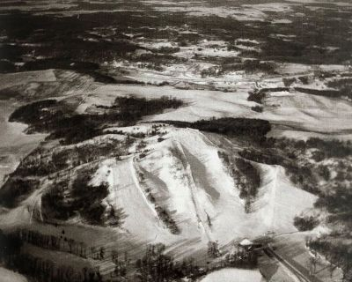
Buck Hill
With a 309-foot vertical drop, Buck Hill is located on 45 acres in Burnsville.
It opened in 1954. This is a picture from 1963.
World Cup champions Lindsey Vonn and Kristina Koznick learned to ski here as well as Olympians Tasha Nelson and Paula Moltzan.

Slide 29
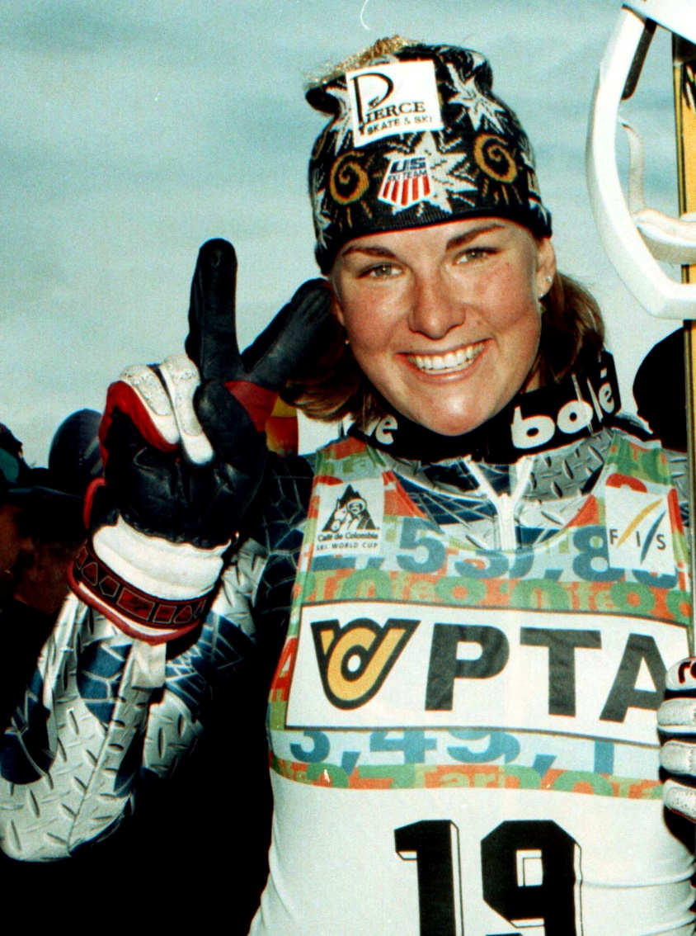
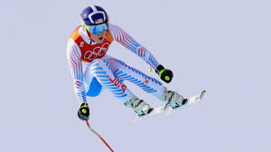
Lindsey Vonn and Kristina Koznick

Slide 30
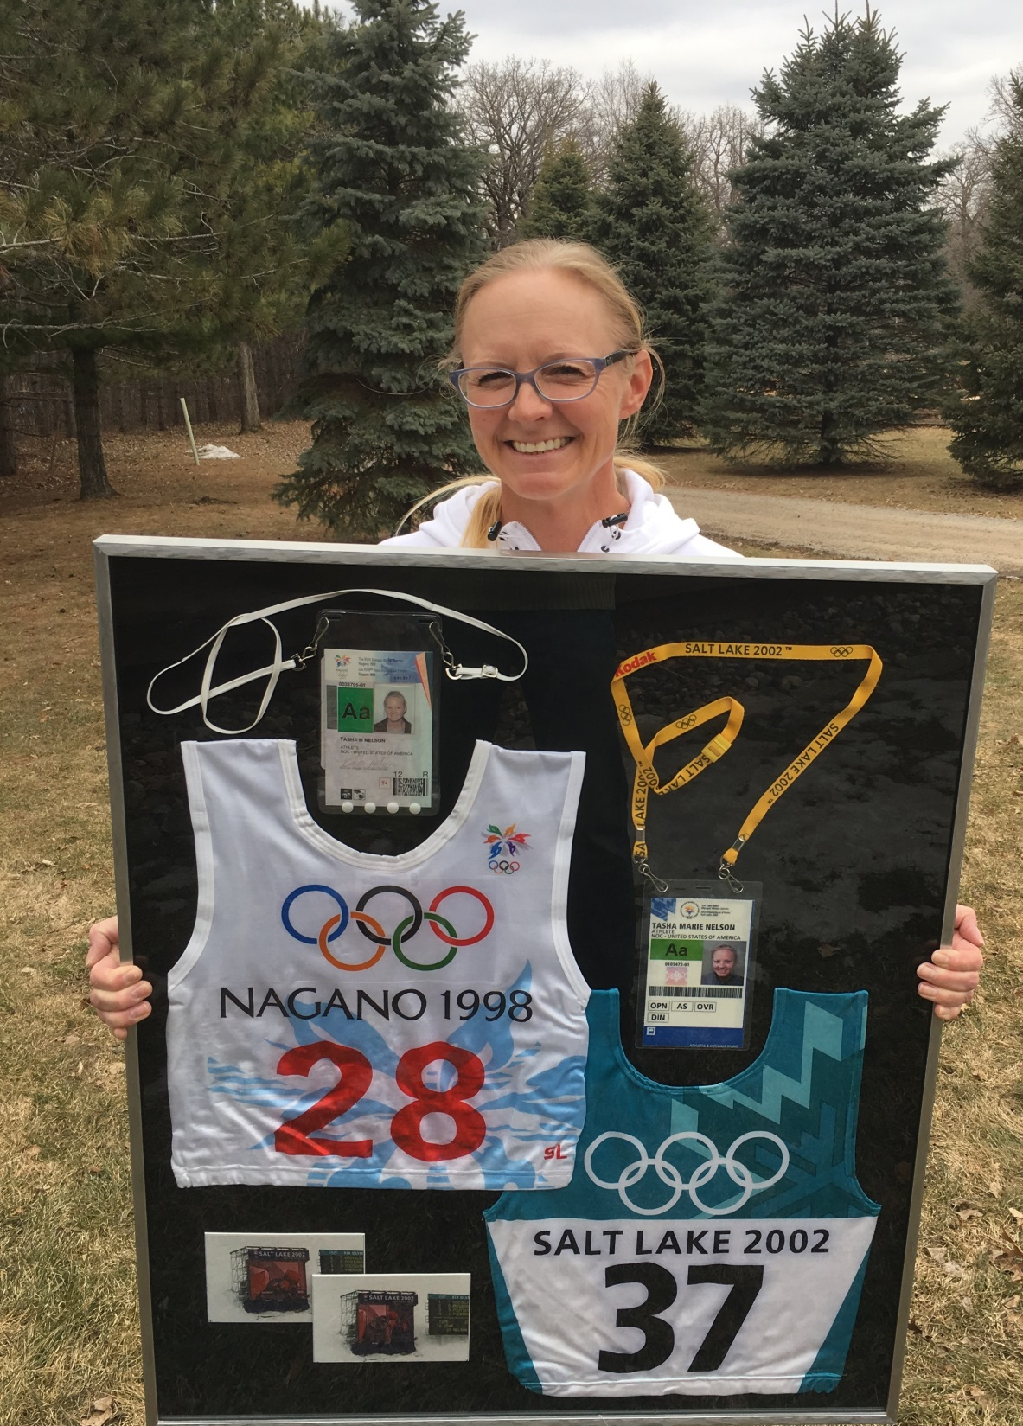
Tasha Nelson McCrank is originally from Buffalo, Minnesota, but now lives in rural Prior Lake.
A two-time Olympian, Tasha began alpine skiing at Buck Hill as did Olympians Lindsay Vonn and Kristina Koznick.

Slide 31
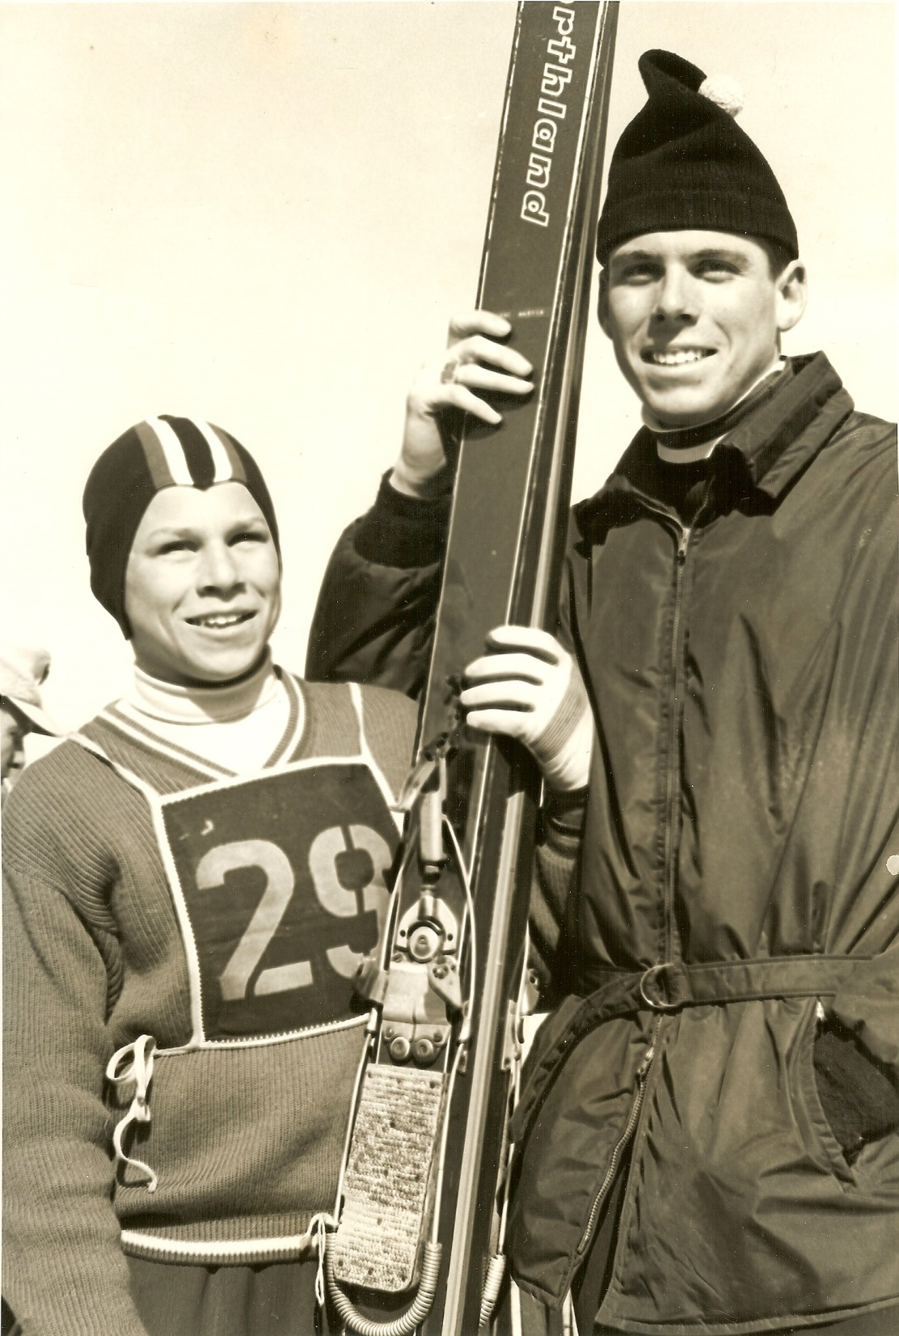
Jerry and Jay Martin began their ski jumping careers at Theodore Wirth Park. Both are graduates of Golden Valley High School.
Jerry was a 1976 Olympian; Jay made the 1964 and 1968 Olympic teams

Slide 32
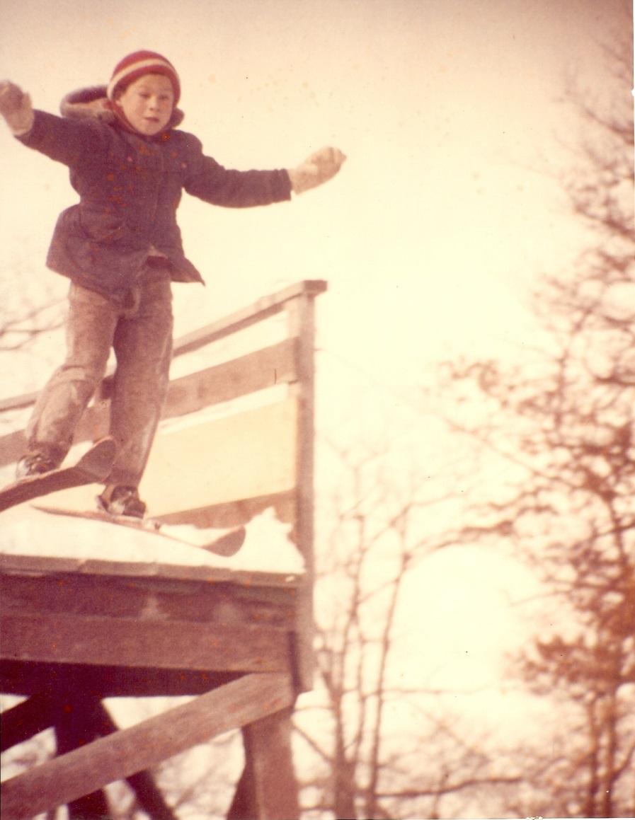
Jerry Martin takes a leap off the Theodore Wirth Park ski jump.
Jerry won the US National Ski Jump Championship 3 months after becoming blind in one eye.

Slide 33
Regan Smith
Regan Smith is a 21-year-old swimmer from Lakeville who has participated in the World Championships and the Olympics. She is very intelligent—she attended Stanford University in California.
She won three medals in the Summer Olympic Games: a silver in the butterfly, a bronze in the backstroke, and a silver on a relay team.

Slide 34
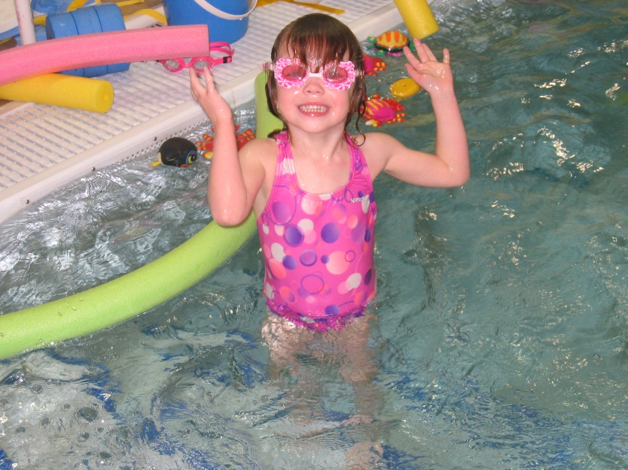
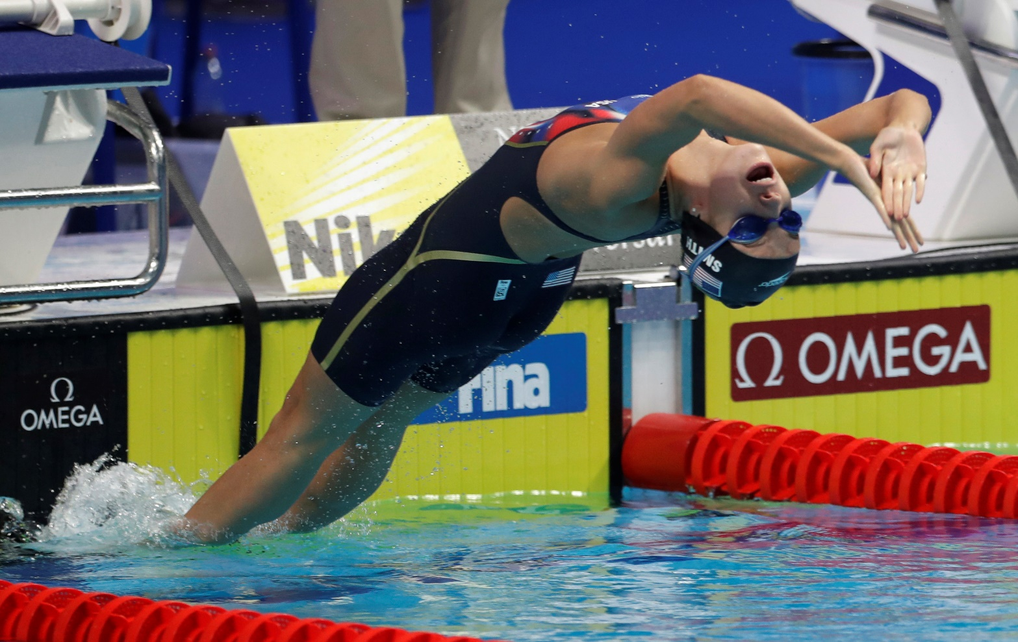

Slide 35
Life Is Now Paradise
Surviving a hardscrabble childhood that included living in an orphanage for two years, Bob Paradise was a multi-sport athlete (football, hockey, baseball) at Cretin High School in St. Paul.
He played hockey (outdoor rink) and baseball at St. Mary’s College in Winona before starting a career as an English teacher at Hill High School.

Slide 36
Bob Paradise
A physical defenseman, Bob Paradise played on the 1968 Olympic team co-captained by Herb Brooks.
He then played professional hockey in the NHL from 1971-79. His son is married to Kelly Brooks, daughter of Herb and Patty Brooks.
Bob and his wife, Maggie, now own and operate a property management company.

Slide 37
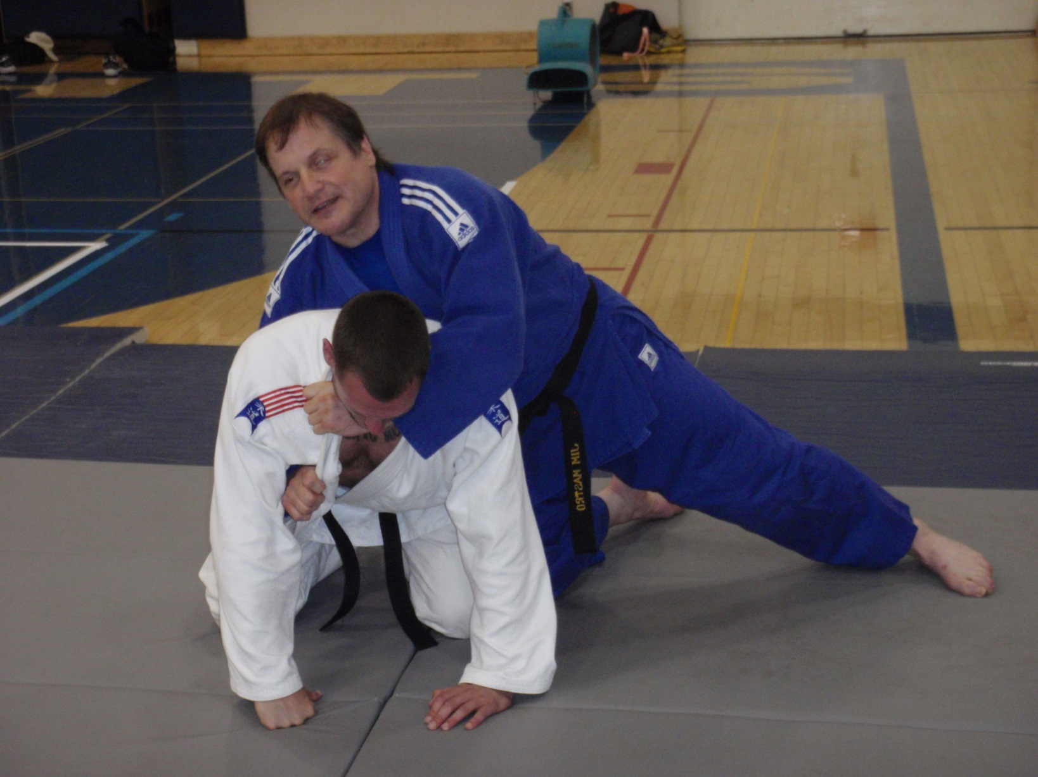
Having a Vision
Jim Mastro (in blue) is a college professor at Bemidji State University.

Slide 38
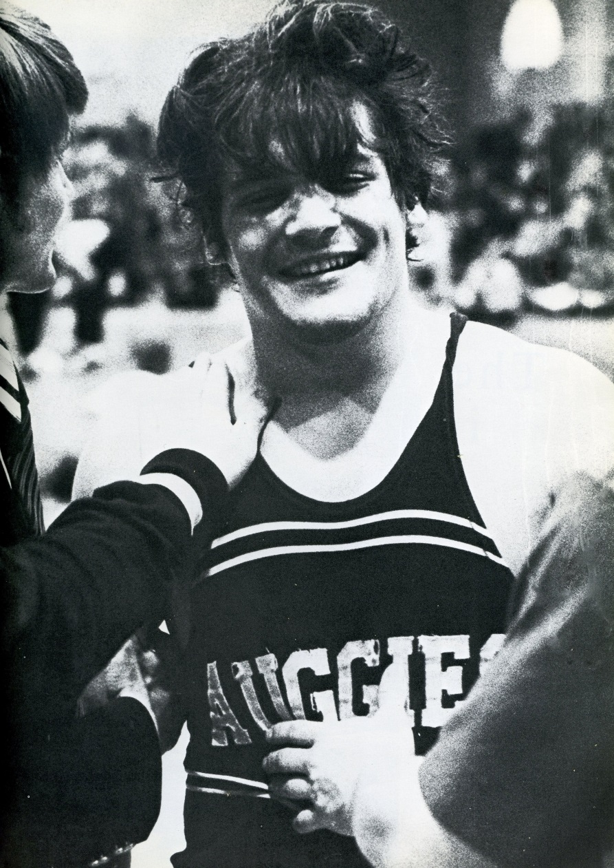
Meet … Jim Mastro
Jim Mastro was born blind in one eye and when playing with a friend, he got poked in his good eye by sharp metal from a curtain rod and went blind in that eye also.
He was an alternate in wrestling for the 1976 Olympics and was a Paralympian many times and won several medals.

Slide 39
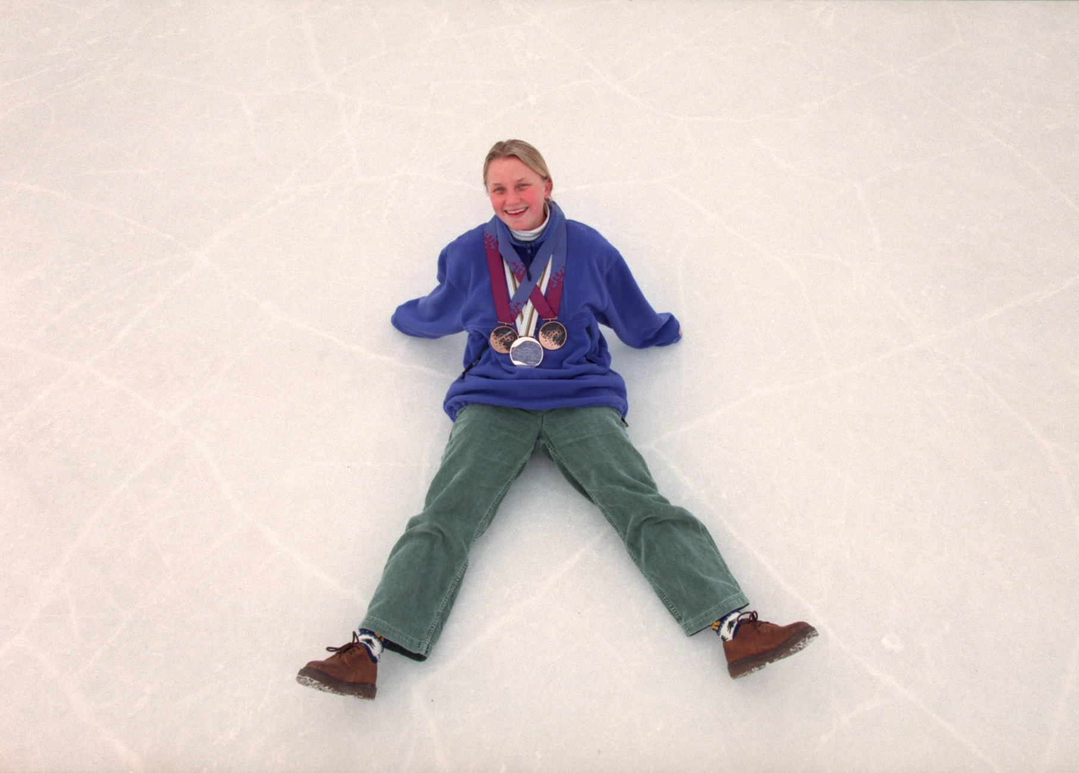
Amy Peterson, Five-Time Olympian

Slide 40
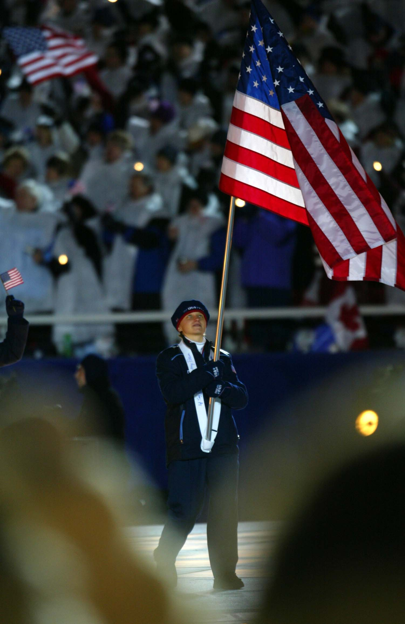
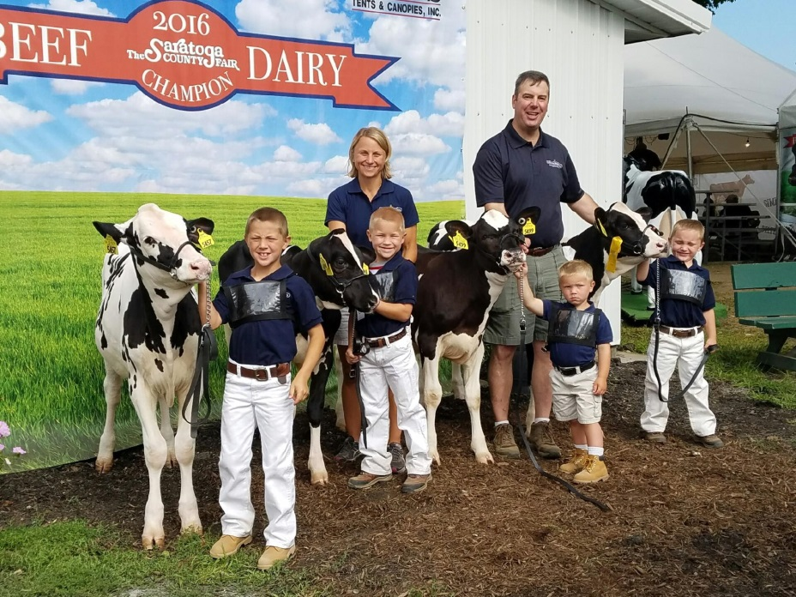
Amy Peterson of Maplewood was chosen by her fellow Olympians to be flag bearer at the 2002 Olympics.
Amy won 3 Olympic medals and today lives and works on a large dairy farm in upstate New York.

Slide 41
Here is a man who played for the United States hockey team in the 1948 Olympics in Switzerland
Ruben Bjorkman was from Roseau, Minnesota, and played for the University of Minnesota

Slide 42
Ruben gained fame at the state hockey tournament as “The Masked Marvel”

Slide 43
Ruben Bjorkman Today

Slide 44
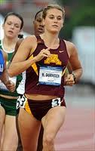
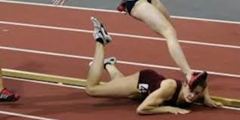
What do you do when you fall flat on your face?
Heather Dorniden of the University of Minnesota in the Big 10 Indoor Track Championship

