Slide 1
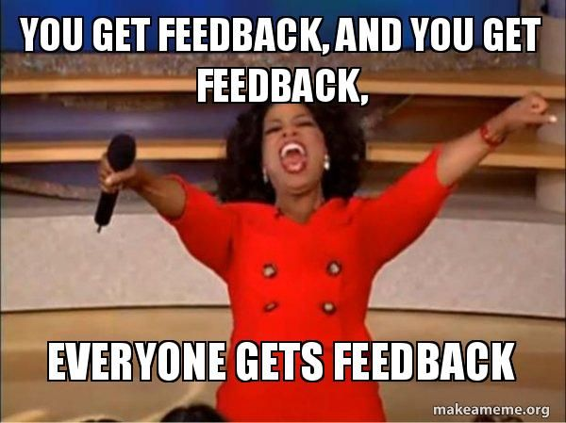

Slide 2
Mom & Wife

Slide 3
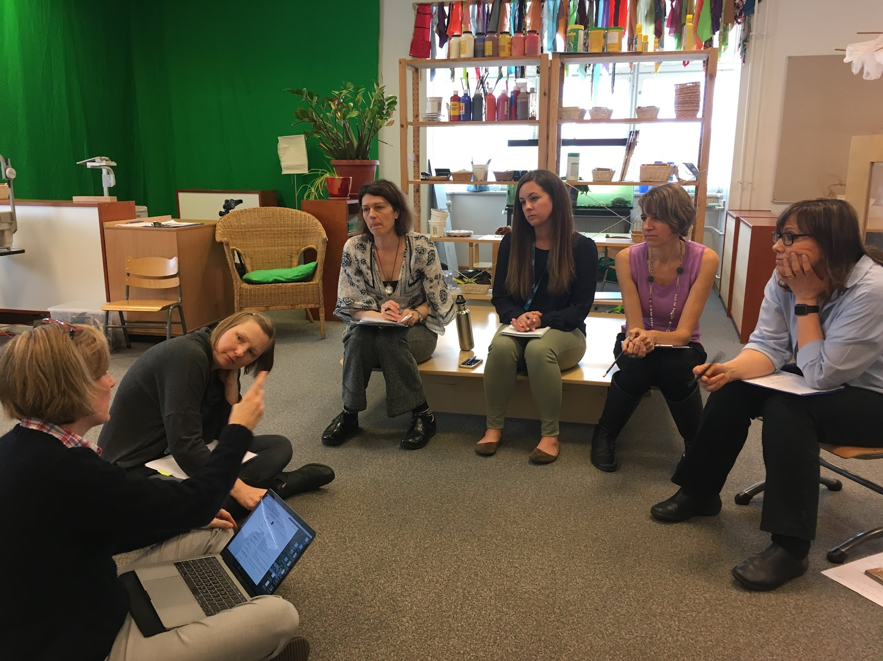
Curriculum Leader
Consultant
Coach

Slide 4
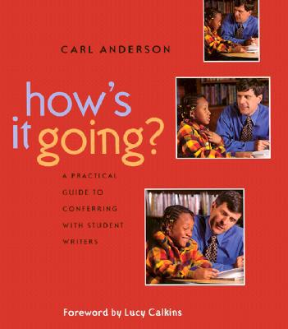
Goals for Today...
Build our knowledge of how to deliver teaching points that meet individual needs & move students forward
Understand the student role (to build agency) in this process

Slide 5
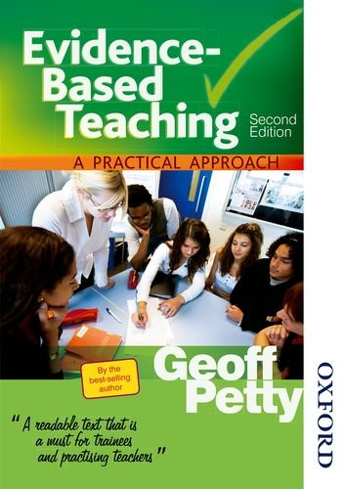
1,200 meta-analyses...
feedback has one of the greatest impacts on learning.

Slide 6
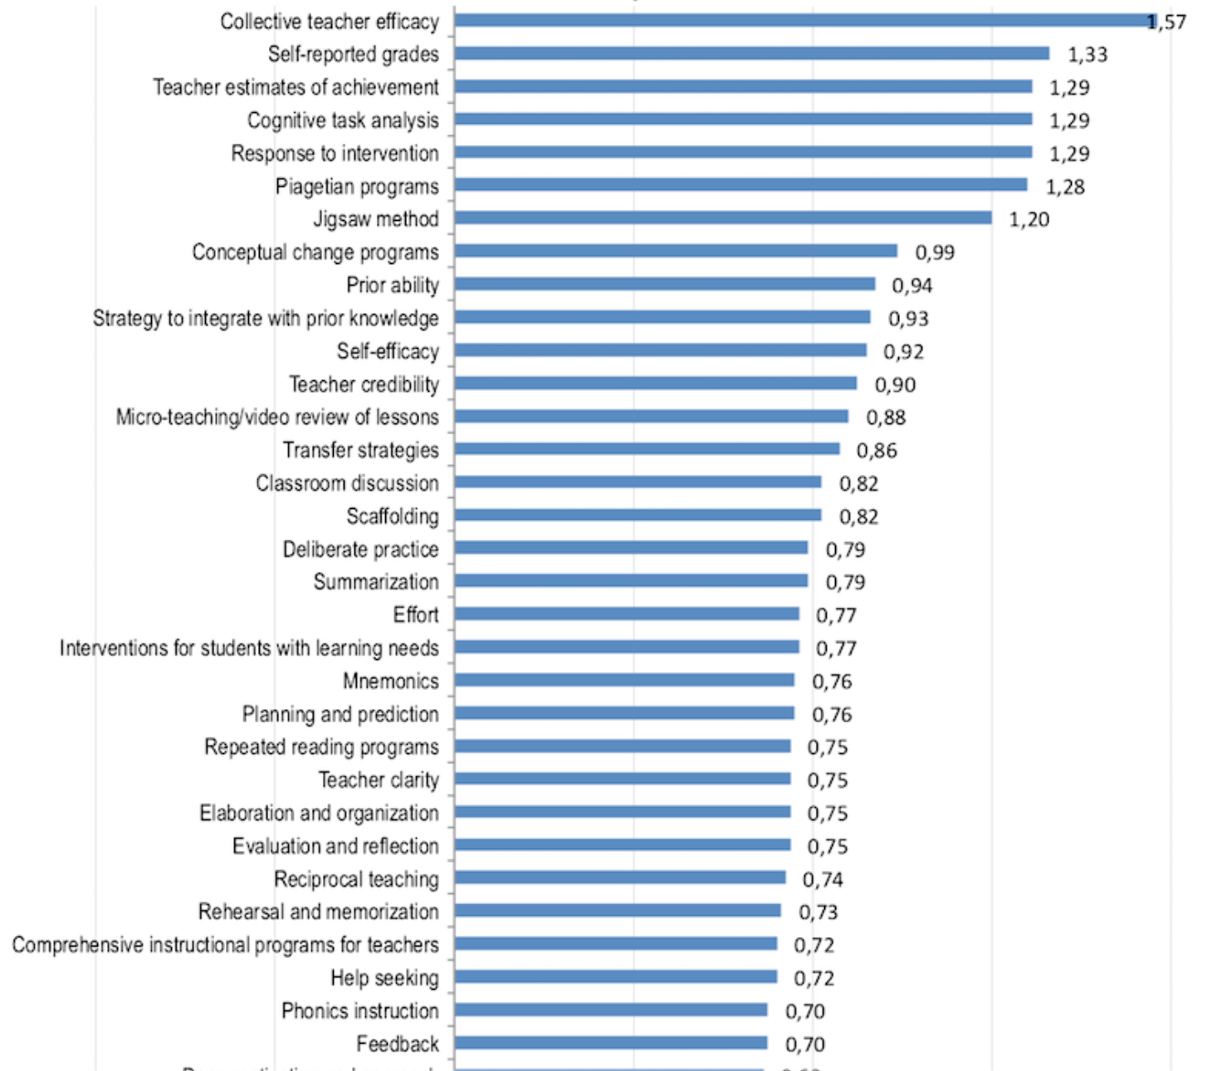
Teacher & Student Efficacy
Prior Ability
Deliberate Practice
Teacher Clarity
Hattie Ranking: 252 Influences And Effect Sizes Related To Student Achievement

Slide 7
feedback

Slide 8
You are skilled, experienced, accomplished, savvy...
What did you do to get to this level?
Notes:
Teachers talk - 10 minutes

Slide 9
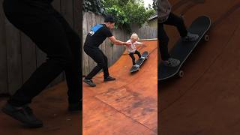

Slide 10
Conferring is a lot like yoga, those who are good at it seem to be performing magic.
- Conferring with Readers

Slide 11
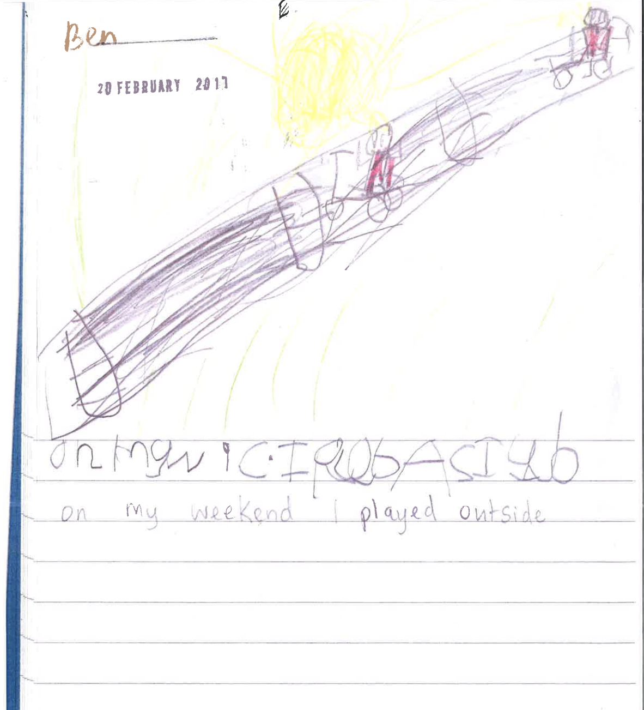

Slide 12
Purpose...
To get to know students and to teach them to be better writers/readers/mathematicians...
Goal...
To create writers… who can do the work we teach them on their own in future pieces of writing.

Slide 13
First the student is in the lead role...
Student:
Sets agenda by describing her work.
Teacher:
Listens carefully.
Asks clarifying questions.

Slide 14
Students need to know their goal…
mini-lesson
trying it out from mentor text
process- oriented (revising, editing…)
building from prior lesson
new idea/discovery
...and then articulate it.

Slide 15
I AM WRITING A STORY ABOUT WHEN I PUT THE FISH IN THE TOILET AND THEN THE FISH SWAM AROUND IN THE TOILET….
I’M WRITING AN OPINION PIECE.
DON’T LET THE PIGEON JUST NAME HIS WRITING.
NO, DAVID, NO!

Slide 16
Set the agenda by talking as a writer...
Well, I’m revising by adding detail to this section. I added, “Human malaria parasite molecules share key gene segments with chimp, gorilla malaria parasites…”
I’m trying to show the passage of time.

Slide 17
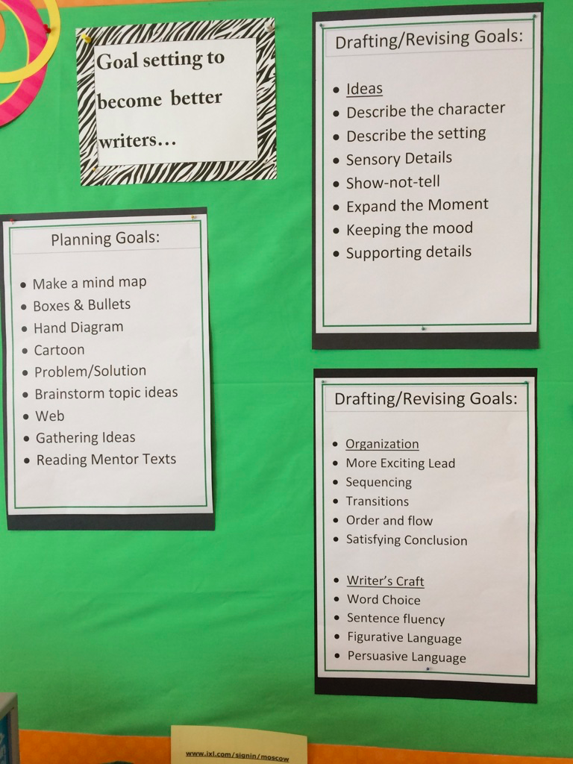
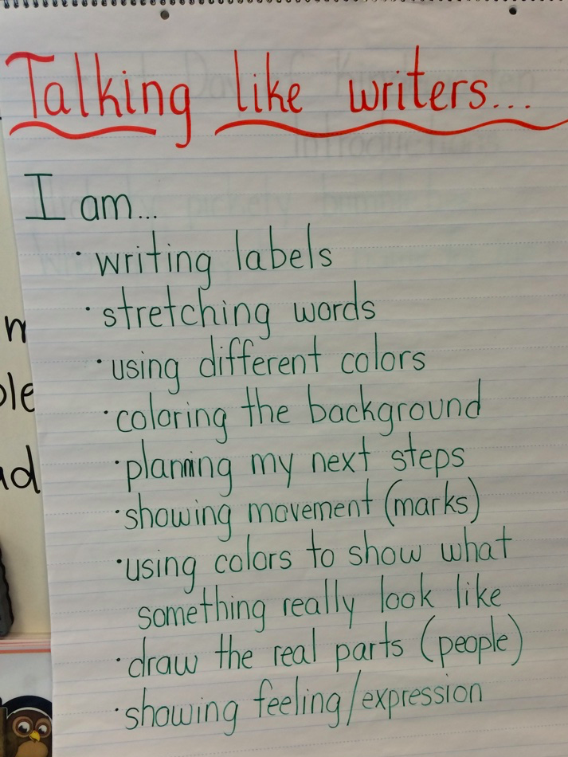
Charts help students determine their focus and goal...

Slide 18
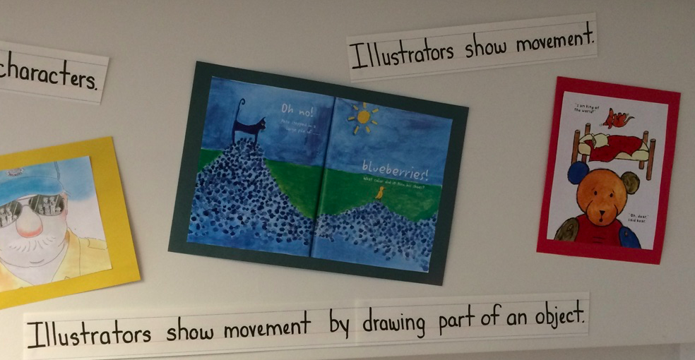
Visuals help students determine their focus and goal...

Slide 19
Teacher’s Role
Ask student, How is it going? What are you working on as a writer?
Gain knowledge about the student’s writing (work) by asking research questions
decide what to teach
Notes:
At your table brainstorm all the possible teaching points you have used in a conference.
Group those in some way.

Slide 20
Empowering...
+
by teaching the writer, not the writing.
Notes:
Thinking back to our image of child and writing, we believe students come with knowledge, that they are being thoughtful of their purpose...

Slide 21
How do we know what to teach...
what we have learned about the student so far in the conference (as well as previous conferences with the student)
what we know about writing/reading/math (standards)
what we know about the processes
what we know about how children grow and develop as writers, readers, mathematicians
-Carl Anderson, How’s it Going
Notes:
At your table brainstorm all the possible teaching points you have used in a conference.
Group those in some way.

Slide 23
 |  | K-5 Writing Continuum
 |  |  |  |  | End of Kinder |  | End of grade 1 | End of grade 2
 |  | Preconventional | Emerging 1 | Emerging 2 | Emerging 3 | Developing | Beginning | Expanding Early
Students as Writers | Concepts of Print | Begins to make distinctions between a letter and symbol | Begins to make distinctions between letters and words. | May or may not write left-to-right, top-to-bottom Begins to grasp directionality (e.g. left to right, top to bottom) | Begins writing with a sense of directionality (e.g. left to right, top to bottom) | Writes from top to bottom, left to right, and front to back consistently
 | Existence of print and drawing | Represents meaning in pictures Draw pictures in book format | Uses a combination of drawing and dictating Write own first name | Uses a combination of drawing, dictating, and writing | Uses a combination of drawing, dictating, with more writing | Uses a combination of drawing and writing with more detail (may be shown with multiple sentences) | Writes at least 1 full page of text or 4 pages of 3 or more sentences per page
 | Stamina | Has other interests during writing time | Has little attention to writing | Begins to focus on writing during writing time (attempts to try, may include telling, drawing, lines…) | Writes in short spurts | Writes with greater concentration | Writes for a sustained period of time (about 20 minutes) | Writes for a sustained period of time (about 25 minutes)
Text Types And Purposes | Narrative | Uses a collection of pictures that may or may not be representational to convey meaning | Draws pictures that may or may not be connected to each other Copies signs, labels names and words (environmental print) | Draws pictures and words that are all related to a single topic or event but may not yet be sequential | With support or intention narrates an event or events in chronological order with a beginning, middle and end With support includes details to stretch out story. May include: dialogue, feelings, sensory words. | Narrates an event or events in chronological order with a beginning, middle and end. Includes details to stretch out story, which may include: dialogue, feelings details, sensory words. | Write narratives in which students recount two or more appropriately sequenced events, include some details regarding what happened, use temporal words to signal event order, and provide some sense of closure. using temporal words like “first”, “next” or “last” Includes details to stretch out story with a combination of: feelings, or sensory words | Write narratives in which they recount a well-elaborated event or short sequence of events, include details to describe actions, thoughts, and feelings, Use temporal words to signal event order, and provide a sense of closure
 | Informative (facts may or may not be derived from research) | Uses a collection of pictures that may or may not be representational to convey meaning | Draws pictures that inform | Draws pictures and writes words that may or may not relate to one topic | Uses a combination of drawing, dictating, and writing to compose informative texts specifically naming the topic and supplying some information about that topic *With support includes: Facts Text features | Writes with pictures and words that relate to and inform about the topic Includes a beginning Includes at least one fact related to the topic *Includes at least one text features, | Write informative/explanatory texts in which they name a topic and supply some facts about the topic. Writes with pictures and words that relate to and inform about the topic Includes a beginning and some sense of closure *Includes text features, like labels, captions, or a diagram linked to the topic **Begins to use “specialist” vocabulary, particular to the topic **Also part of knowledge of language/ vocabulary acquisition and use standards | Write informative/explanatory texts in which they introduce a topic, use facts and definitions to develop points, and provide a concluding statement or section.
 | Opinion |  |  | Begins to share an opinion or preference | Makes opinion clear and with guidance and support, gives a reason | Clearly states opinion and attempts to give a reason to support it Makes an opinion clear and attempts to give a reason to support it Focus remains on topic Includes a beginning or some sense of closure | Clearly states opinion and gives at least one reason to support it Includes a beginning and sense of closure With support, begins to elaborate on reasons Begins to include words based on mode (ie:most, best, worst) Begins to use linking words/phrases | Introduce a topic and state an opinion Provides beginning and concluding statement or section Elaborates on their reasons Includes words that match mode Uses linking words to connect reasons

Slide 24
Teaching next steps…
Consider student’s focus
Provide a teaching point
Clearly state what to do
Show example/model/think back
Nudge
Exit strategy

Slide 25
Reminding, telling, correcting are not teaching points.

Slide 26
Teaching…
When writers introduce their story they might do so in a few different ways. They can describe the setting, open with a character saying something...
So you said you are working on making predictions, one way you can predict is to also think about the genre. We know in fairy tales there is a lesson to be learned, think about how
When readers come to a word they don’t know, they can do a few things to help them read that word…
When reading a word problem, one thing that mathematicians do is to reread the problem and name what you are looking for. Let me show you what that looks and sounds like.

Slide 27
Exiting the conference…
Oral telling
Watch them get started
Tell their neighbor
Check in

Slide 28
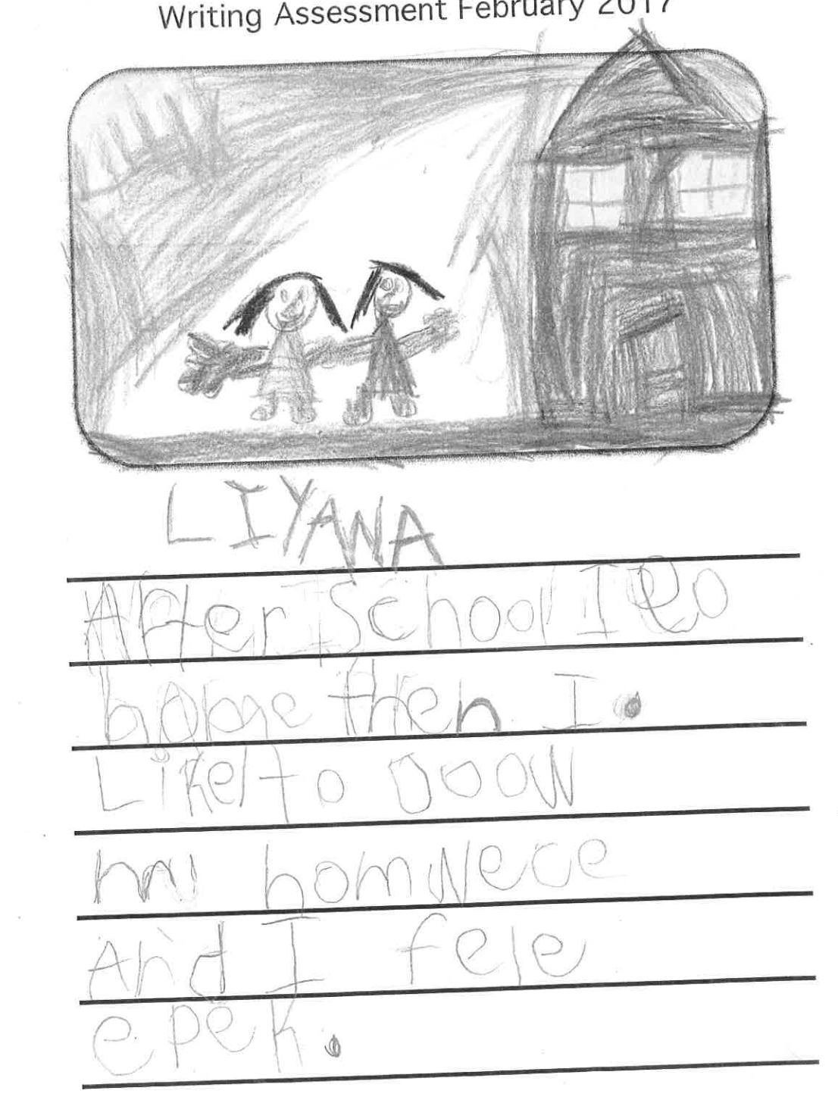

Slide 29
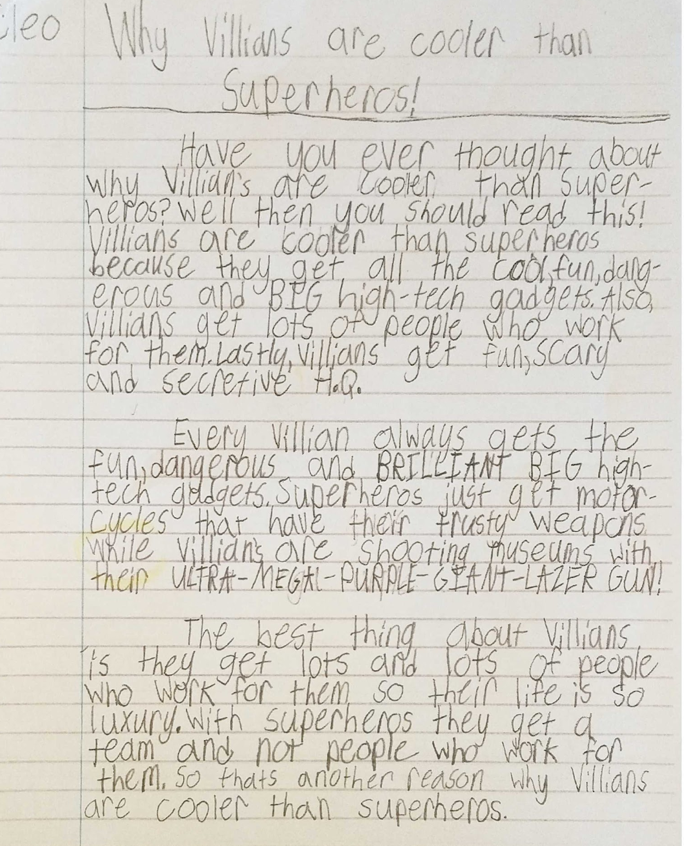

Slide 30
Teach process not just content…
What to do when stuck?
What to do when distracted?
How to get ideas?

Slide 31
Exiting the conference…
Oral telling
Watch them get started
Tell their neighbor
Check in

Slide 32
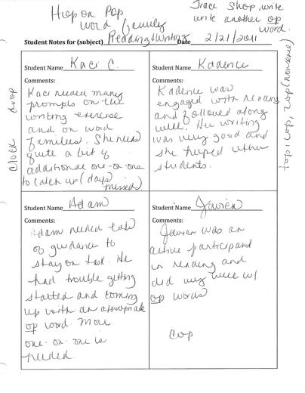
Link
make explicit expectations
student knows goal
take notes yourself
Notes:
Go back to your conference between Carl Anderson and Becky. See if you can find the role of the teacher points.

Slide 36
1173

Slide 37
Teaching students about their role...
Demonstrate writer’s talk in mini-lessons.
Celebrate when students use writer's talk.
Lead a discussion about conferences.
Fishbowl conferences in front of the class.
Direct mini-lessons on student’s role in conferences.

Slide 38
How should we respond to a look, a piece of blackberry pie, a kiss, a death in the family, a joke, to the sneaky warm of the winter sun when it touches a hand? As a human being. There can be no way—no single, correct, preconceived way—for one human being in the dynamic, ever-changing context of a human interaction to respond to another human being.
-Donald Murray

Slide 39
