Slide 2
PART I
PART II
PART III
What is culture?
What changed?
What can you do?

Slide 3
Notes:
Culture is the behaviors, artifacts, values, and beliefs of groups of people. Individuals can act out culture, but not have culture on their own. Groups have culture, and when you are a part of a culture, you have a sense of community, belonging, and a sense of being part of something greater than yourself. Culture in organizations not only dictates people’s behavior. It also make it so that they are willing to put in hard work when it’s necessary and allows them to feel like they have a sense of belonging.
Researchers Margaret Brinig and Nicole Stelle Garnett found: https://press.uchicago.edu/ucp/books/book/chicago/L/bo17607504.html

Slide 4
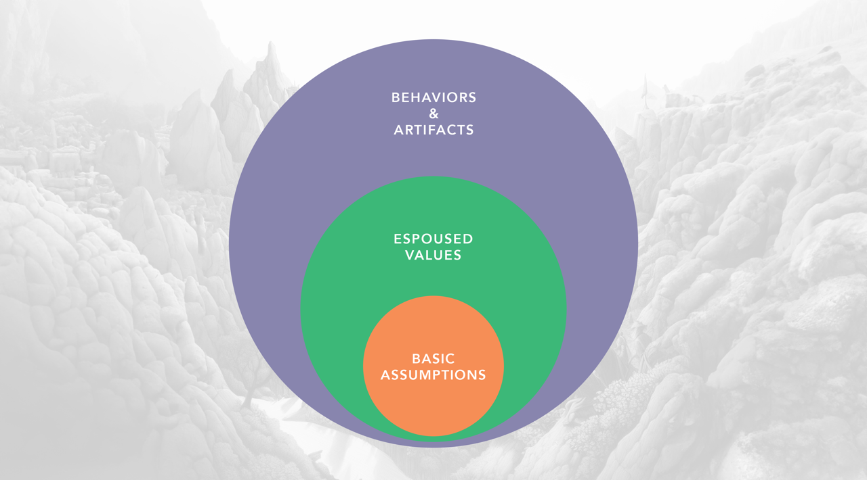
Notes:
The collective experiences that shape the distinct behaviors of individuals and groups are what culture expert Edgar Schein calls 'Basic Assumptions’. If you’re familiar with the work of Chris Argyris of Yale and Harvard, his term for Basic Assumptions was Theories-In-Use. If you’ve heard of mental models, those are also fundamentally the same as Basic Assumptions.

Slide 5
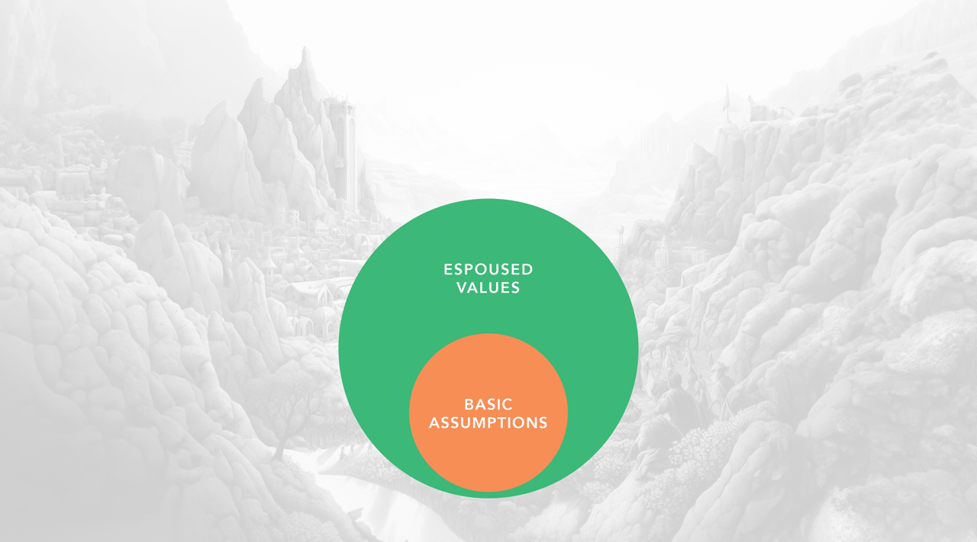
Notes:
Atop the foundation of Basic Assumptions lie the Espoused Values. These represent the principles you vocally advocate for and uphold.

Slide 6
Notes:
At the 3rd level, you get to what we see and feel in our everyday experience. That is Behaviors and Artifacts. These are the visible manifestations of culture.

Slide 8
Notes:
In 1999, Thomas L. Friedman published his book "The Lexus and the Olive Tree".

Slide 9
Notes:
In the year 2000, Robert Putnam published "Bowling Alone", spotlighting the increasing isolation being experienced by Americans.

Slide 10
Notes:
Step into a café, a bar, or any bustling hub of humanity such as for example a school lunch room. What do you witness? A sea of together-aloneness.

Slide 11
Notes:
Studies show that we actually interact virtually the most with the people closest to us. https://www.networkworld.com/article/3189620/survey-texting-is-replacing-talking-for-families-with-kids.html

Slide 12
Notes:
The Census Bureau chronicles a curious change: from 1973 to 2014, the average U.S. home ballooned from 1,700 sq ft to 2,700 sq ft. https://www.census.gov/construction/chars/pdf/c25ann2015.pdf
Add to that, PEW Research tells us that households shrunk from 3.2 members to 2.5 over the same timeframe. https://www.pewresearch.org/short-reads/2019/10/01/the-number-of-people-in-the-average-u-s-household-is-going-up-for-the-first-time-in-over-160-years/#:~:text=Note%3A%20There%20are%20two%20ways,a%20household%20with%203.4%20people.

Slide 13
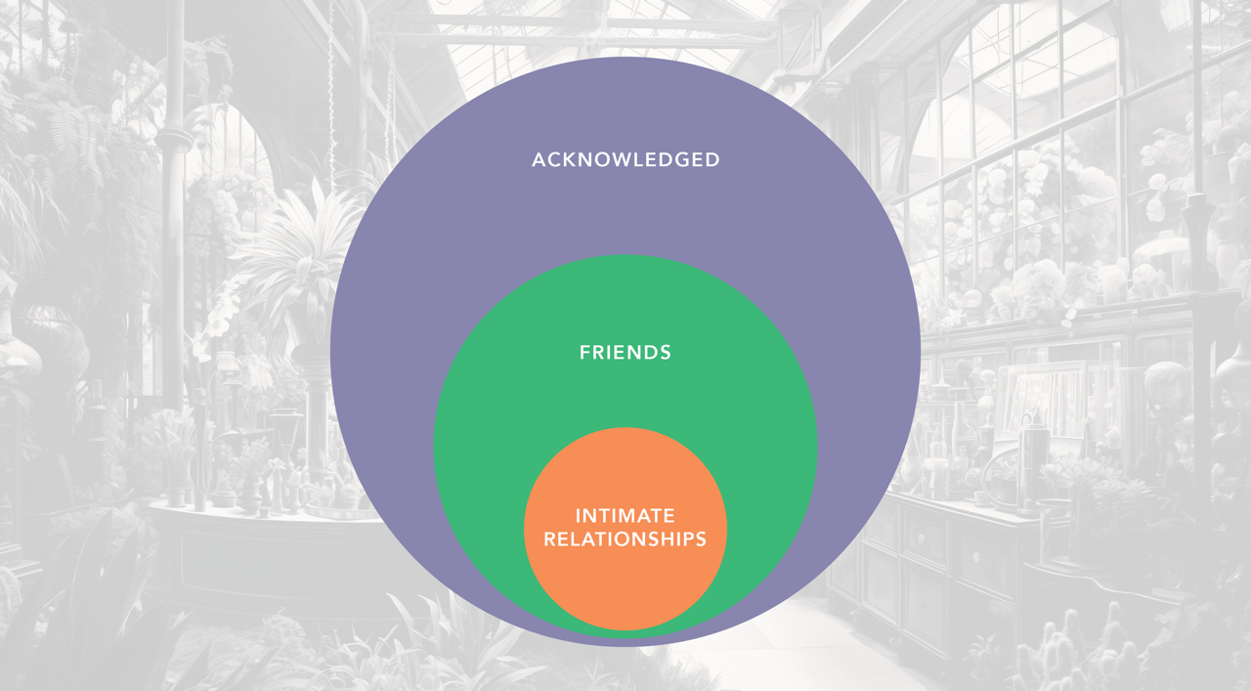
Notes:
Revisiting Edgar Schein, he also defined 3 levels or types of relationships.
In their 2005 book “Promises I Can Keep: Why Poor Women Put Motherhood Before Marriage”, Kathryn Edin and Maria Kefalas mention that nearly ever woman they interviewed for their book over a period of years that they lived in poor communities said that they had no friends. All of this means that there are a substantial number of people for whom there is no one in this first level. https://www.amazon.com/Promises-Can-Keep-Motherhood-Marriage/dp/0520241134

Slide 14
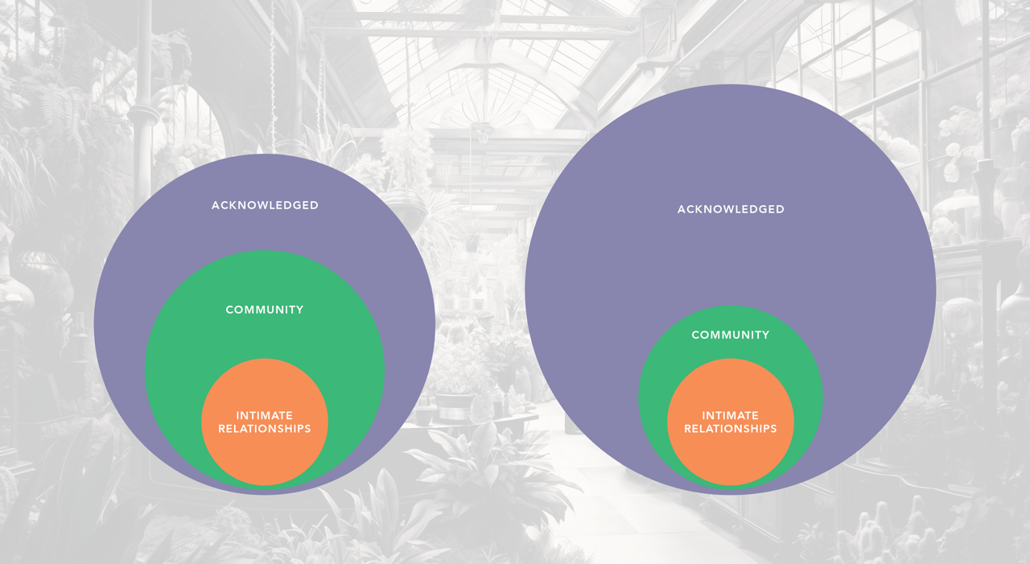
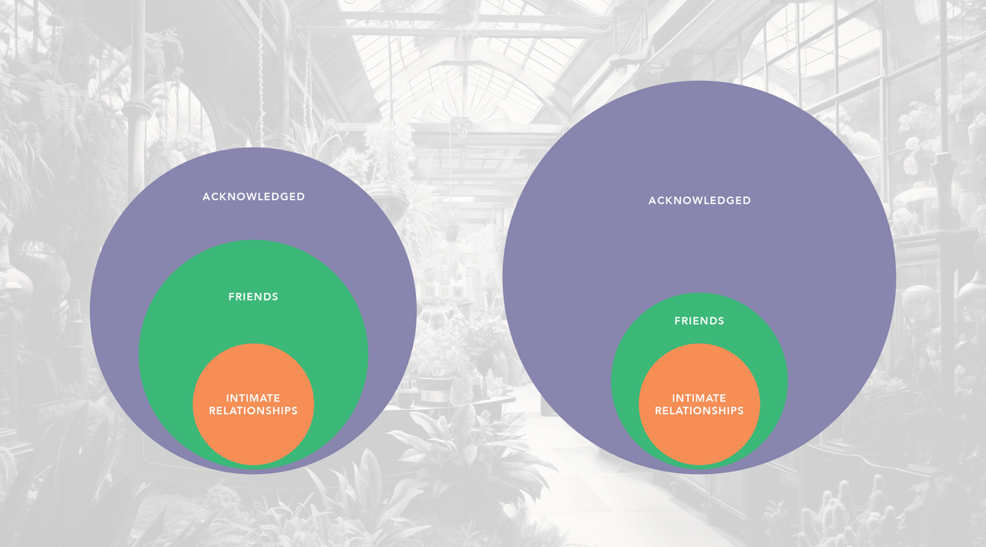

Slide 17
Source: Lawson, University of Liverpool
Notes:
To illustrate this, there is a logical fallacy called the Illusion of Explanatory Depth. https://en.wikipedia.org/wiki/Illusion_of_explanatory_depth

Slide 18
Source: Saturday Morning Breakfast Cereal
Notes:
https://en.wikipedia.org/wiki/Dunning%E2%80%93Kruger_effect

Slide 19
Notes:
So, when the average person is checking Teams or Slack constantly throughout the day, messaging frequently with their close colleagues, and having only the most superficial of interactions with people across the company, you have a recipe for your staff filling in the gaps in their knowledge not with conversation, but rather with stereotypes and caricatures of people’s traits, and none of that inclines people to feeling like they are a part of something meaningful together.

Slide 21
Notes:
The first step to building a healthy culture is that leaders must develop a strong understanding of their organization’s culture.

Slide 22
Rugged individualism
Entrepreneurial spirit
Truth through conflict
Push back and get buy-in
Technical innovation
Work is fun
Do the right thing
He who proposes, does
Individual responsibility
Paternalistic family
Job security
Notes:
You have to be able to map the maze of mutual influences to truly tap into the tapestry of how both spoken and silent standards shape the seen and subtle signs of culture.

Slide 23
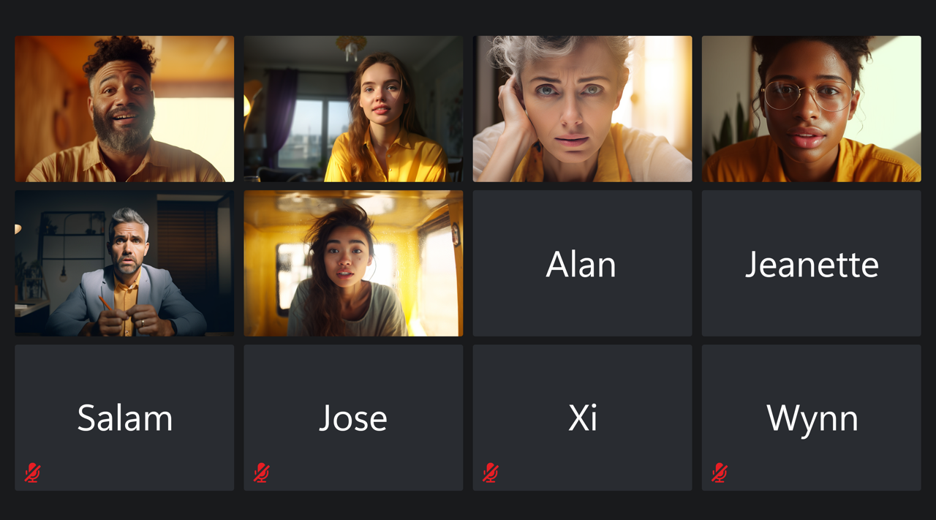
Notes:
Robert Putnam, who I mentioned before, released a study in the early 2000s that found that, the greater the diversity in a community, the fewer people vote and the less they volunteer, the less they give to charity and work on community projects, and the less empathy for and connection to one another they feel. It turns out that–while diversity can make us uncomfortable though–being willing to work with people that are different from us gives us the opportunity to break down barriers and become part of something larger than ourselves. https://onlinelibrary.wiley.com/doi/10.1111/j.1467-9477.2007.00176.x

Slide 24
Notes:
Throughout all of this volatility, uncertainty, complexity, and ambiguity, we are asked to lead organizations and people through immediate challenges toward short- and long-term goals.

Slide 25
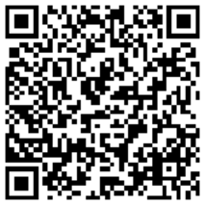
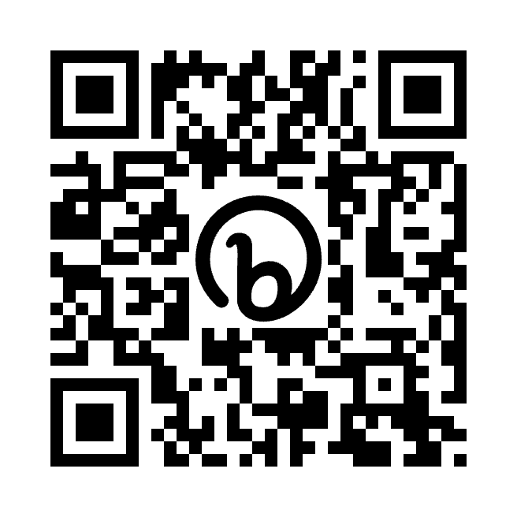
Notes:
Left QR code to connect on LinkedIn. Right to get information on the upcoming coaching webinar.

