Slide 1
Unlock Your Leadership Potential
MASTER THE GROW MODEL
ERIC PRATUM
BIGWIDESKY

Slide 2
“People are generally persuaded more by reasons which they have themselves discovered than by those which have come into the mind of others.”
Blaise Pascal

Slide 3
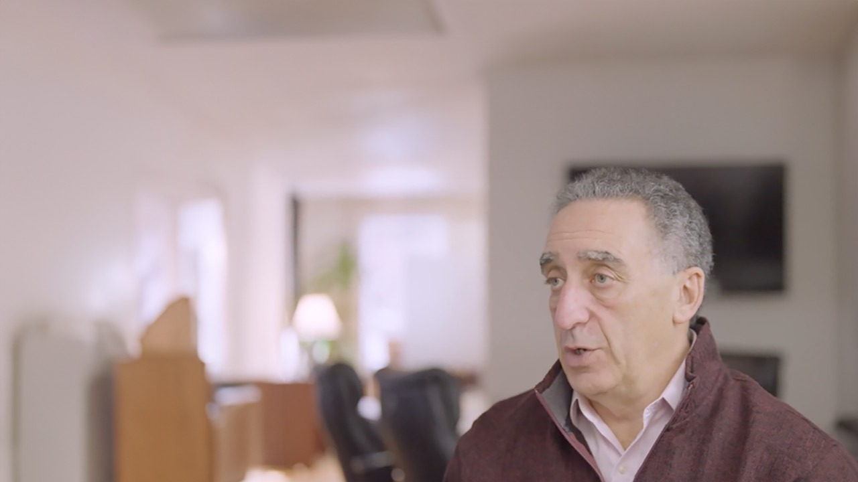
“It’s not knowing what to do that’s the issue, it’s doing what we know.”
Alan Fine

Slide 6
A picture of kids playing a game.

Slide 7
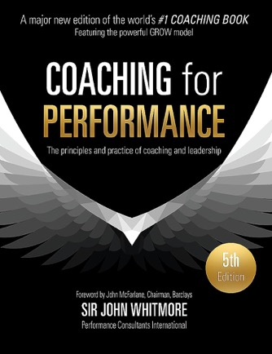

Slide 8
GOAL
REALITY
OPTIONS
WAY FORWARD

Slide 10
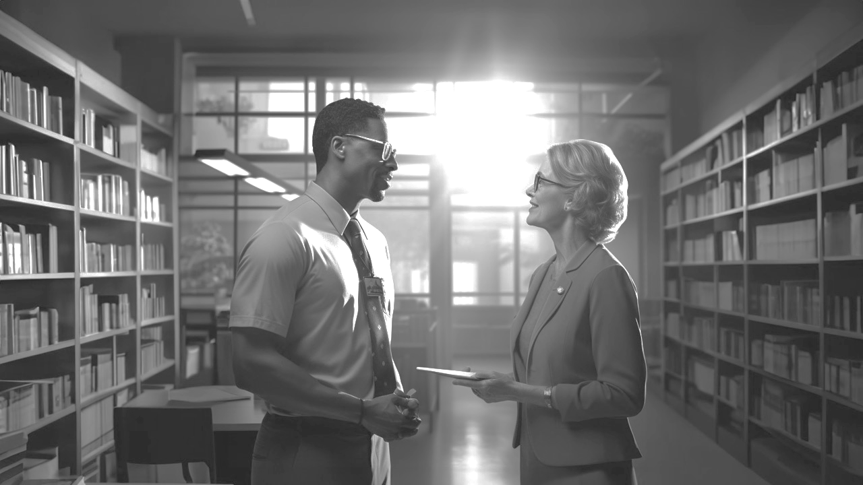
GOAL
REALITY
The goal of the conversation. Not the overarching performance outcome.
An exploration of what’s been happening. The current state of performance.
OPTIONS
WAY FORWARD
Development of options for how to move forward, so the Coachee sees that they have choices.
What’s going to happen next, and when.

Slide 11
GOAL
REALITY
I want ideas for how to make a process more efficient.
Everyone does something different, and nothing is documented as the right way of doing things.
OPTIONS
WAY FORWARD
Team meeting to discuss it
Ask everyone to document best practices and compile a list
Start writing a process manual
A team meeting is the right place to start. I’ll schedule one for next week to give everyone time to plan.

Slide 12
Source: Dailey & Associates

Slide 13
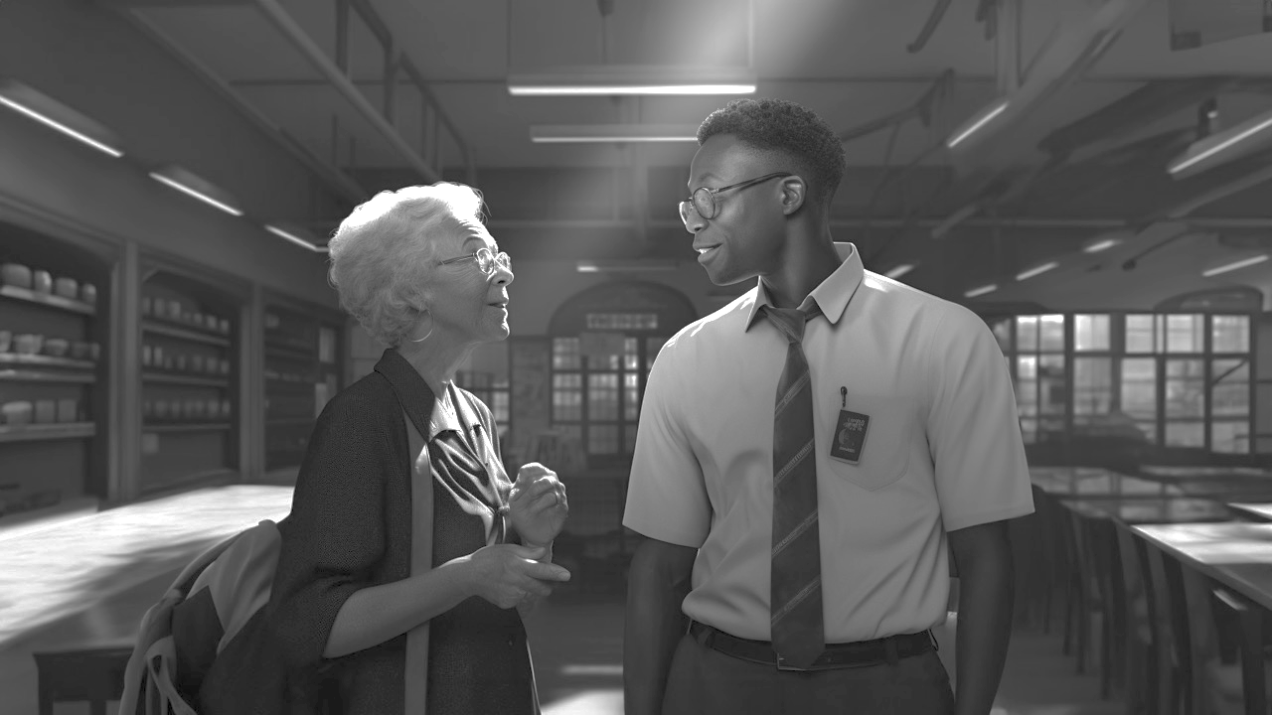
GOAL
What topic do you want to discuss?
What do you want from this discussion?
What are the consequences if you do not reach this goal?
REALITY
Briefly, what has been happening?
What have you tried so far?
What were the results?
What is your sense of the obstacles?
How would others describe the situation?
Is the goal realistic?
OPTIONS
If anything were possible, what might you do?
If others are involved, what would they need to get their attention?
If you were watching this conversation, what would you recommend?
Would you like suggestions from me?
WAY FORWARD
Does one of these options interest you enough to act?
How will you go about it?
What might get in the way?
How might you overcome that?
What and when is the next step?

Slide 14
GOAL
What do you want from this conversation?
REALITY
What’s been happening?
OPTIONS
What might you do?
WAY FORWARD
What will you do and when?

Slide 15
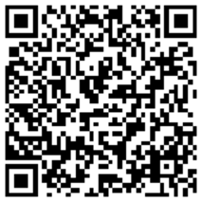
Thank you
ERIC PRATUM
ERIC@BIGWIDESKY.COM
360.306.0889
BIGWIDESKY
WE MAKE BUSINESS MORE HUMAN

