Slide 1
Rethinking Homework
2023 MNSAA Conference

Slide 2
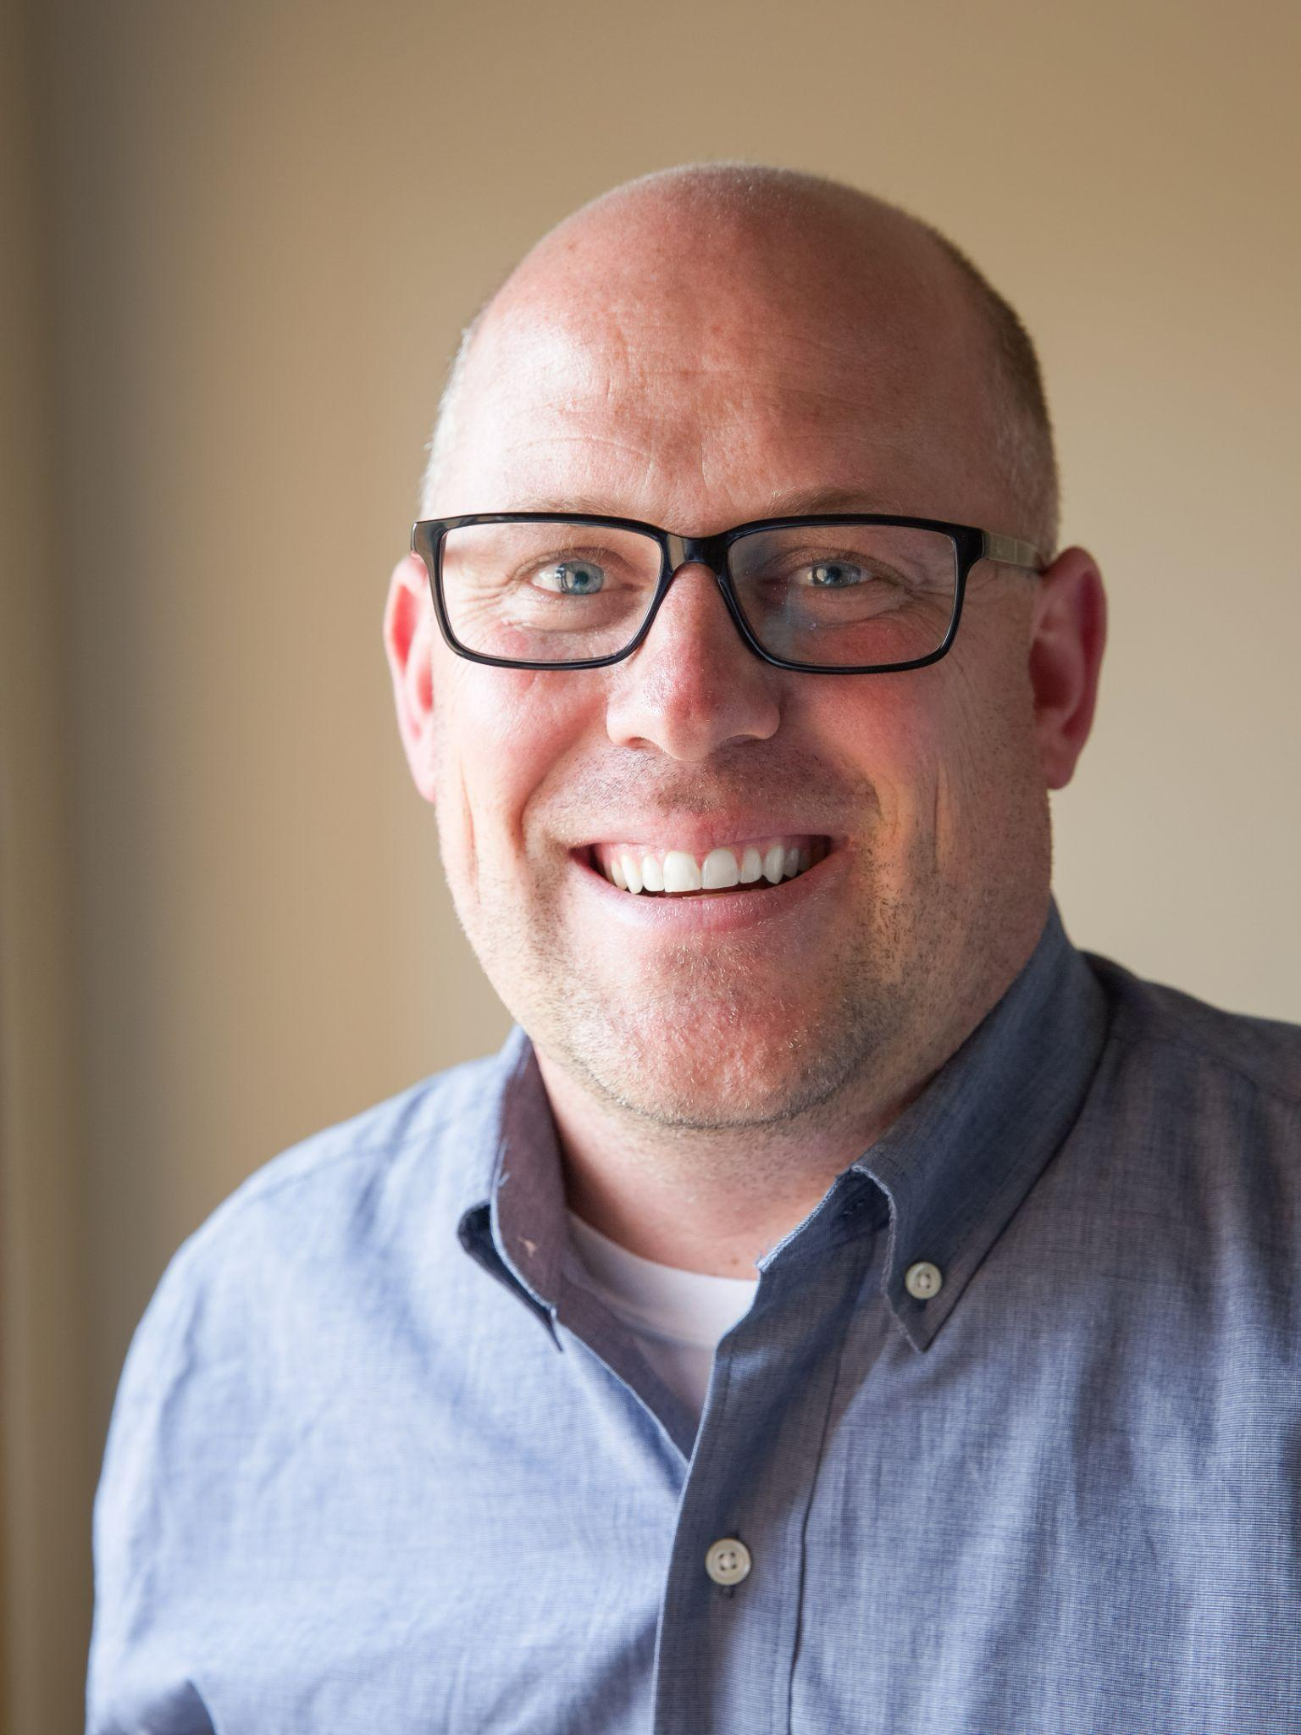
Introductions
Introduction:
Sean Slaikeu
2006 - first teaching job
PE teacher
MS coordinator
Assistant Principal
Principal
Why did you become a teacher? Admin? Other?
Share with someone close to you.
Why did I………..???
Notes:
Tell the story of when we were at the Minndependant conference talking as principals and Bonnie and others said how important it was to finish this research

Slide 3
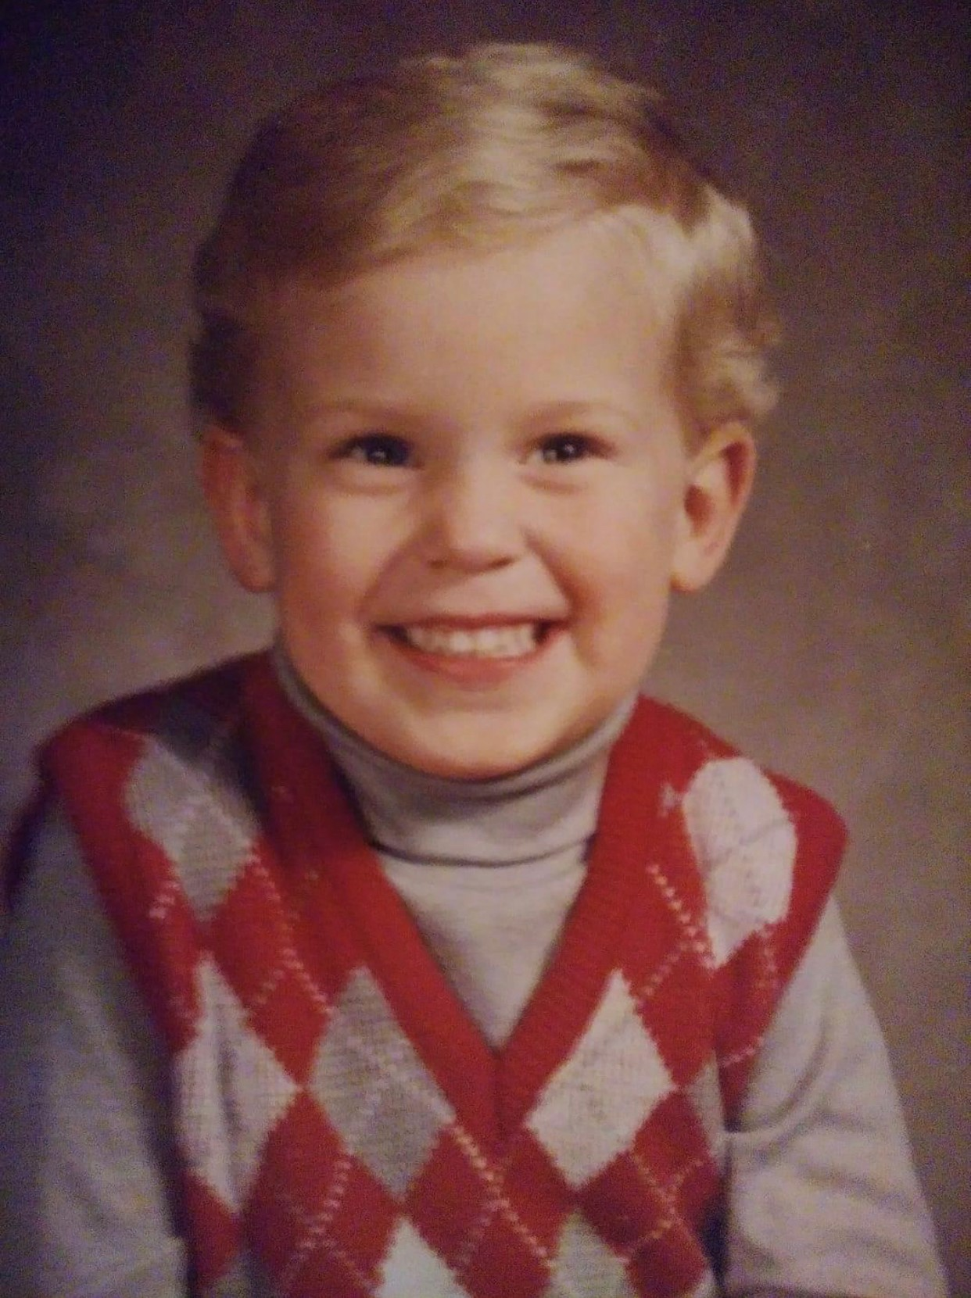
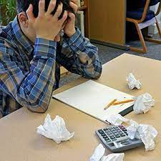
What is my why!
Why should we care about Homework?
And/or should we care just a little less?
Notes:
Story about my childhood struggle - looking out for the student that just “doesn't get it”, or the one that doesn't have the support at home…..
Story about Austin - Struggles, might need more motivation, but doesnt have the father figure in his life…….every little success is a huge milestone for him…..homework struggle
Teachers - do what they have always done because its what they know.

Slide 4
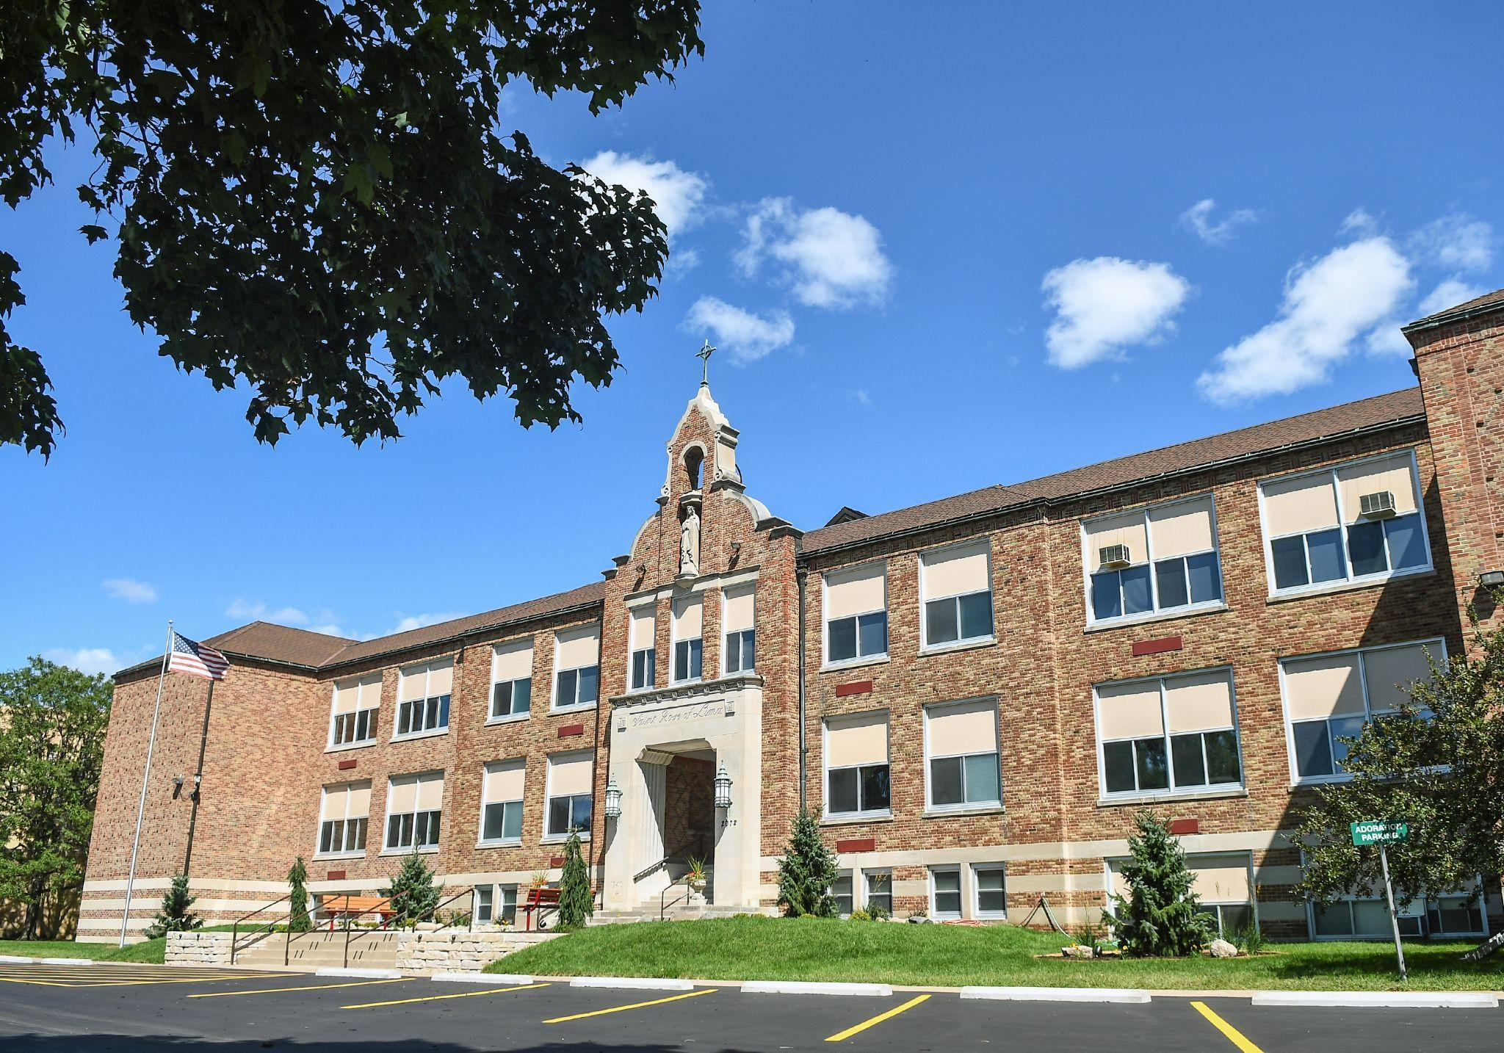
My Current School
Notes:
Small private school - Suburban area - 170 Students PreK to Grade 8
What do you think one of the main complaints is from Students? Parents? Teachers?

Slide 5
So why think about Homework?
Memories from the past
Personal observations as principal
Teacher complaints about homework completion by students
Parent emails/complaints about homework over the years.
Do we need to rethink homework
Ask yourself what's the goal of homework?
Is homework a true measure of what a student knows and can do?
Talk with someone next to you…..
What is the goal of Homework in your classroom or school?
Does your school community feel that homework actually is a defining characteristic of Rigor and student success?

Slide 6
What impacts students abilities to complete/do homework?
Activities
Sports
Religion(Wednesdays
Weekend plans
Baby sitting/watching younger siblings
Time with family
Dinner
Sleep
What we know……
Social emotional well-being
Sleep
Stress/anxiety
We talk about Work-Life Balance as adults……..should we be thinking the same for students?
Notes:
Students in classes 6-8 hours, then homework for X number of minutes/hours?

Slide 7
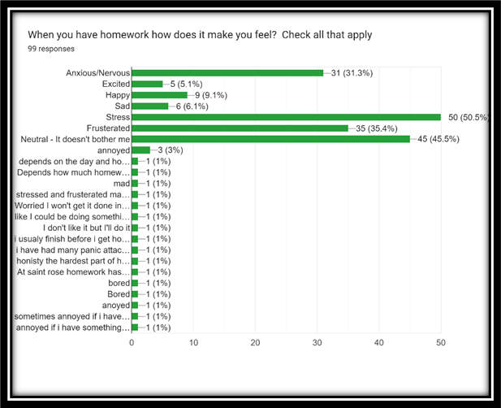
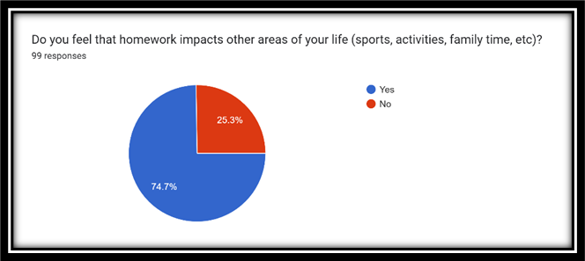
Homework: Brief Data results
Student Key Results

Slide 8
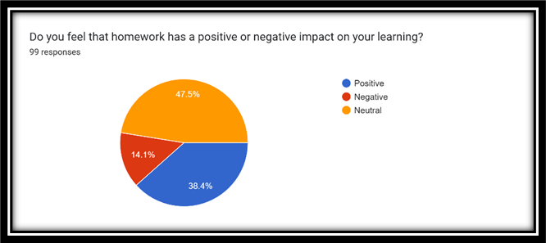
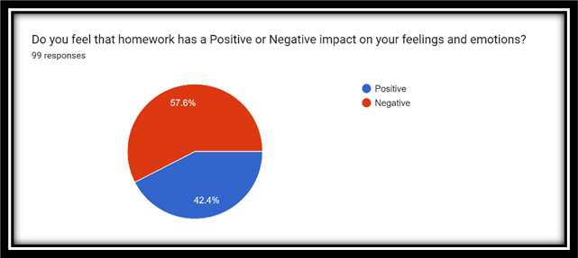
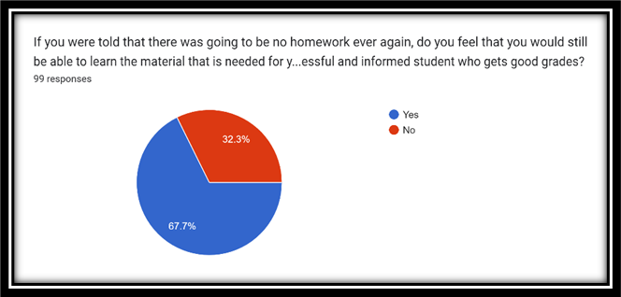
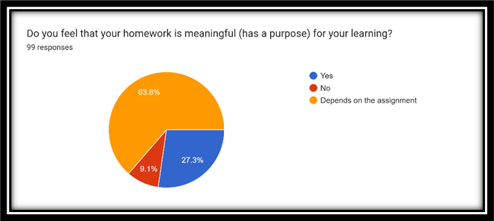

Slide 9
Let’s Discuss:
If we want to make Homework a true measure of what a student knows and can do
what needs to be done?

Slide 10
Cathy Vatterott - Professor at the University of St. Louis-Missouri states the following:
Homework needs to exhibit the following five key elements for it to help enforce learning……..
Purpose
Efficiency
Ownership
Competence
Aesthetic Appeal
https://www.ascd.org/el/articles/five-hallmarks-of-good-homework
Notes:
She is referred to as the “Homework Lady”
Article Five Hallmarks of Good Homework

Slide 11
Homework can have both positive and negative impacts on student learning. It can help build study habits and time management but also cause stress and anxiety. Ultimately, the impact depends on a number of factors.
What do parents have to say about it?
I think it burns them out. They’ve already spent 6 hours in a classroom or in classes, and now they’re doing more at home. I think if we want to reinforce what they’ve learned this could be done in a multi-faceted way in school.
I think homework prepares students to be independent and self-motivated. I believe it teaches them to be responsible for something and it teaches them to reach out when help is needed. In my career I train new people all the time and I think by having homework we are teaching kids skills on how to deal with learning skills in the workplace and reaching out to supervisors when help is needed.
Homework is viewed as "something that has to get done " vs. "an opportunity to learn;" - kids aren't actually learning anything more with it.

Slide 12
I feel anxious and feel like they have major disappointment in me. It makes me feel like I have disappointed my teachers and myself, because of that it also gives me major anxiety.
What Students have to Say about Homework
All it does is stress me out and make me hate the subject, and if I don’t do well, I immediately feel inadequate
It feels nice like fresh air almost because even though this sounds weird it is out of my way and I can spend my time at home doing other things like working out or practicing for sports.
I think homework can help in certain ways but at the same time I think there's too much homework to the point where I don't have enough sleep or even finish it.
It impacts me because I have a life outside of school just like teacher so going out of our way to do it can be annoying also you stay up late a lot when teachers are saying go to bed earlier when you say you are tired also when you do it at home and you didn't understand it at school how are you supposed to understand it when only your teacher explained it well for you to understand
Notes:
Mention - no teacher comments written because of the small sample size however it is overwhelming supported by teachers and they feel the value of homework outweighs the negative implications.

Slide 13
Ask questions
Discuss with others
Review your practices
Don't be complacent
Be the Change
So now what?
As teachers and administrators we should be questioning homework practices and determining if our homework is meeting the goals and objectives of student learning.

Slide 14
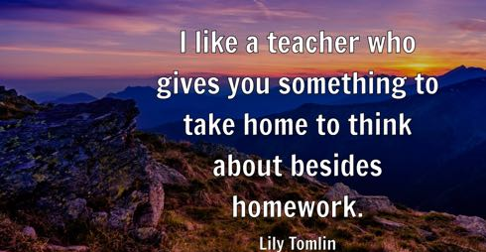
Notes:
What do you remember about your childhood? Do you remember the actual homework, or how it made you feel? Do you remember the lesson or the teacher?
I have a theory that yes there are important things that we need to learn - writing, reading, math facts, etc - But life is filled with experiences that if we can re think homework and have it be more of an experience? maybe we will have more well rounded students

Slide 15
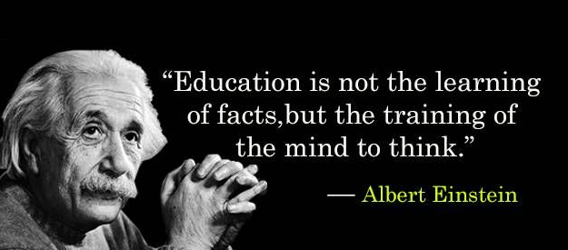

Slide 16
Sean Slaikeu
Saint Rose of Lima Catholic School
sslaikeu@mysaintrose.net
651-646-3832

