Slide 1
The History and Explosive Growth of Girls’ Sports in Minnesota Since the Passage of Title IX

Slide 2
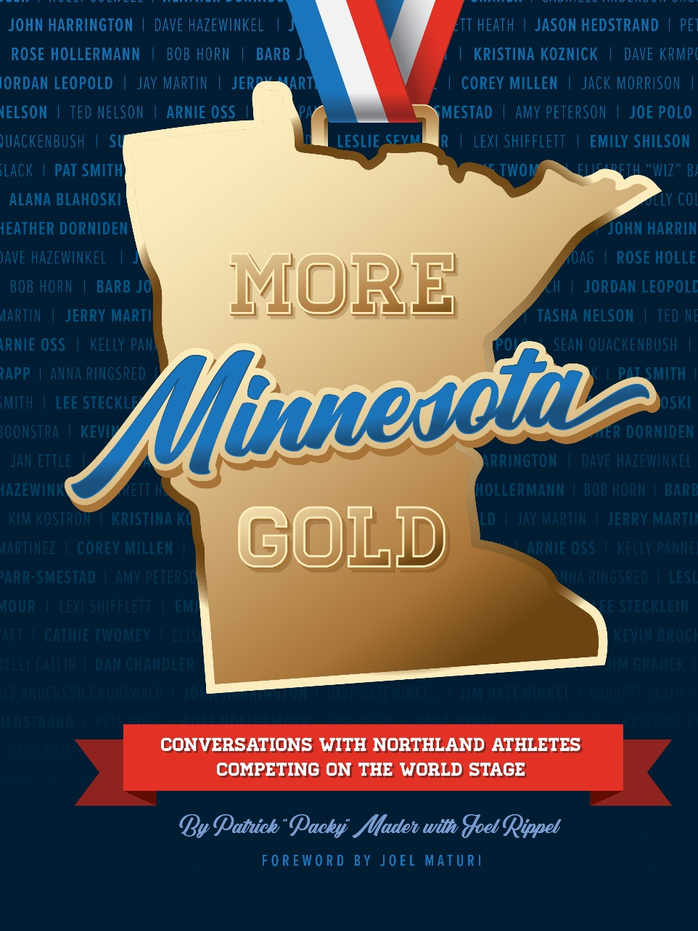

Slide 3
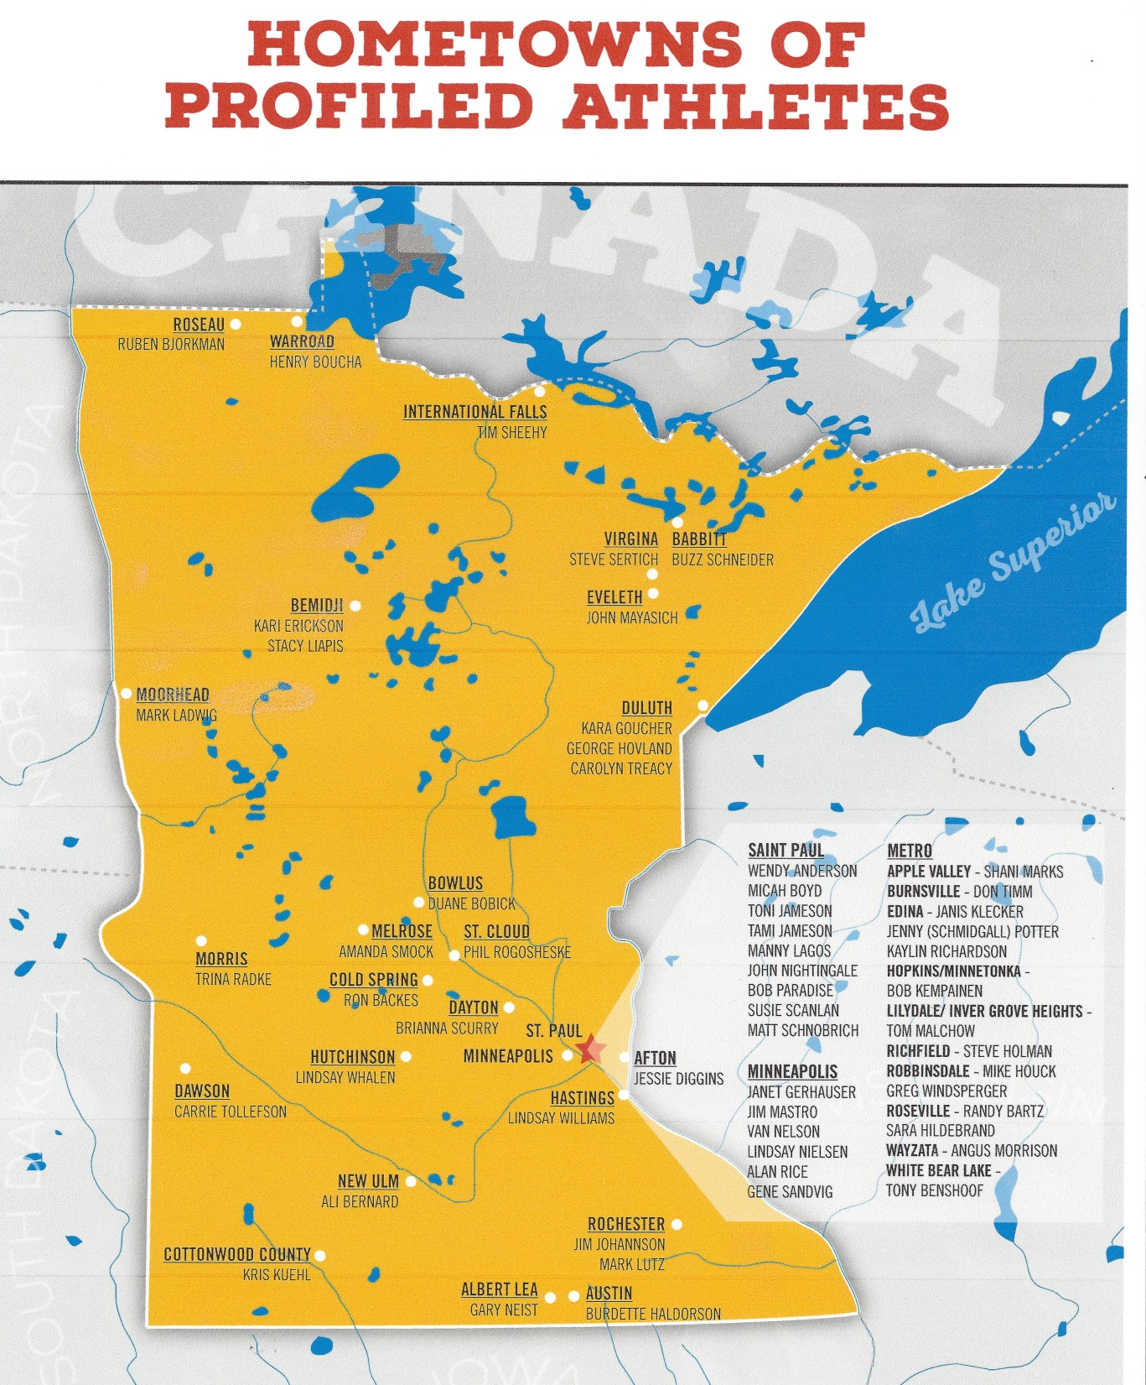
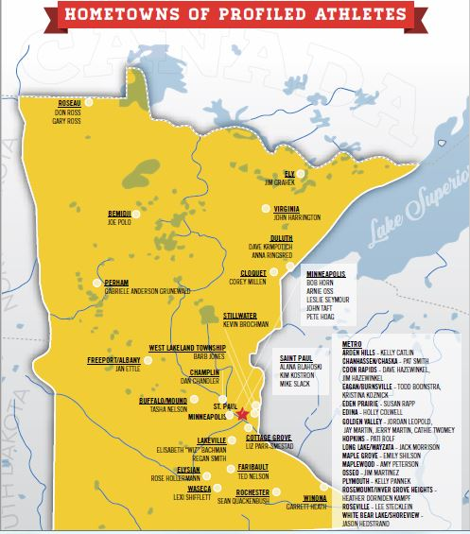

Slide 4
Olympian Qualities
Self-directed
Dream big; inspired
Perseverance, determination
Time management skills
Balance in life
Motivation, dedication, love of sport
Intelligence
Mentally tough
Modesty
Athletic talent, gifts

Slide 5
And . . . Give back to
Their sport
Their community
Their school

Slide 6
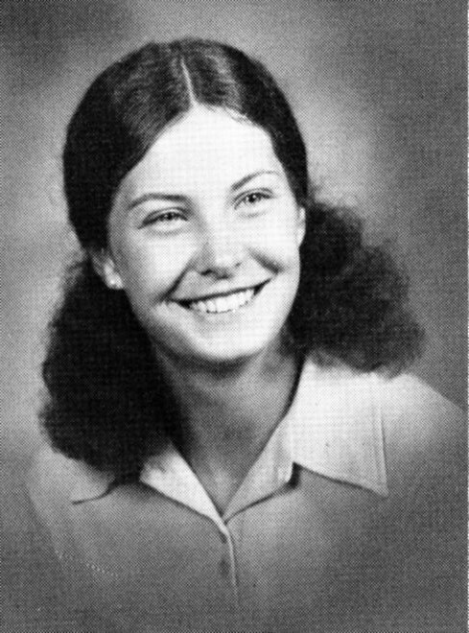
1972: 50 Years Ago
Toni St. Pierre, Hopkins
Peggy Brenden,
St. Cloud

Slide 7
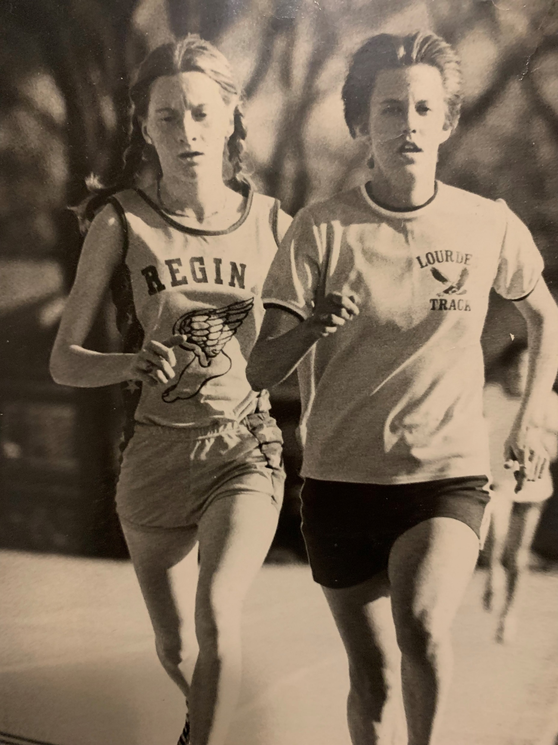
1970s Minnesota Girls High School Athletic Stars
Leslie Seymour of Regina won the first MSHSL girls cross country state championship in 1975.
Donna Gathje of Rochester Lourdes was another dominant runner at the time.

Slide 8
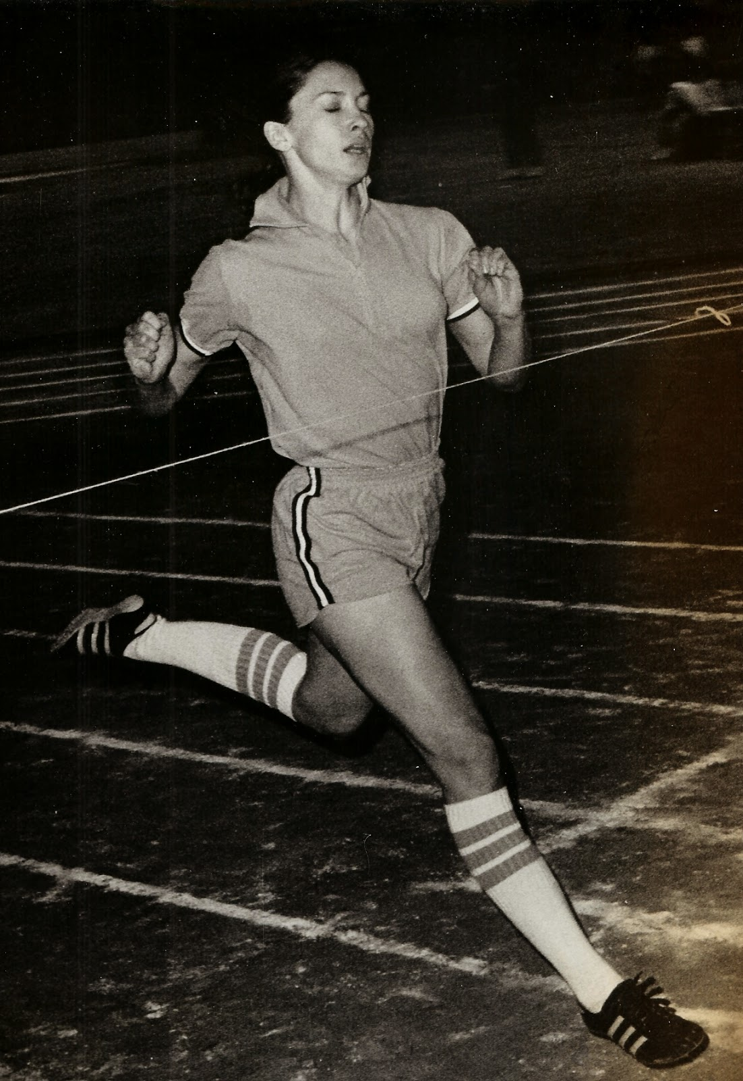
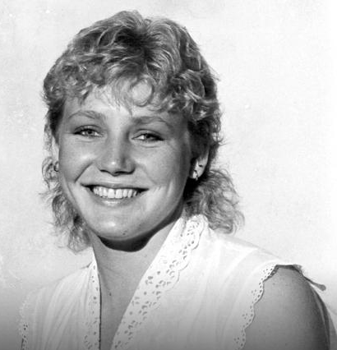
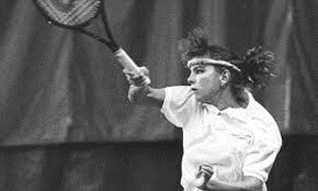
1970s Minnesota Girls High School Athletic Stars
Jennie Moe, tennis
Edina
Jill Halsted, volleyball Robbinsdale Cooper
Jane Oas, sprinter
Mound Westonka

Slide 9
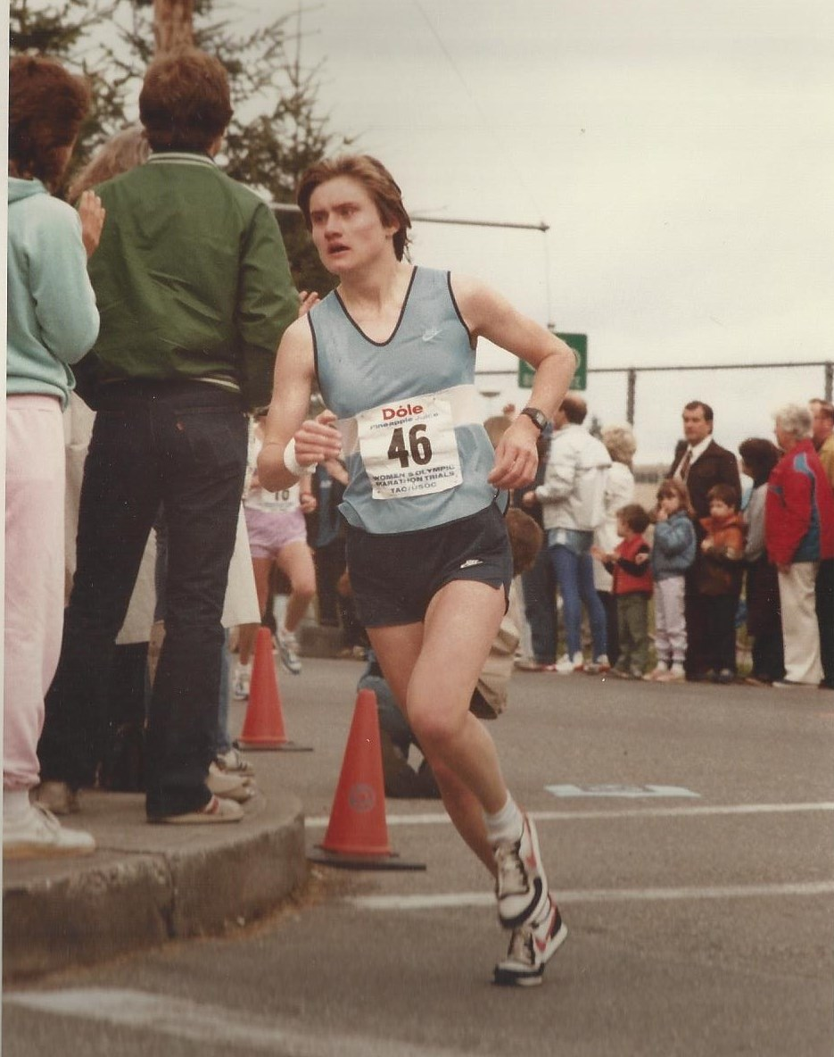
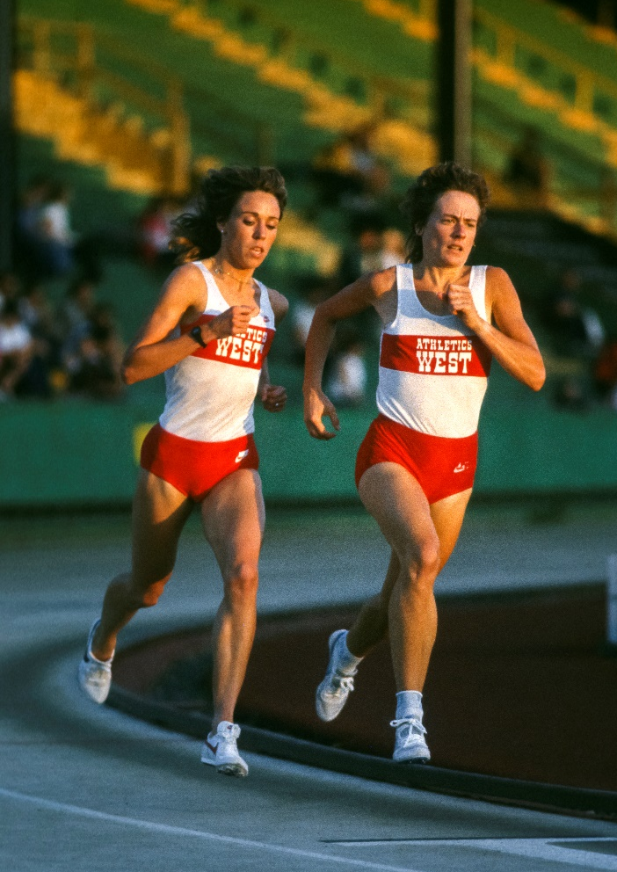
Early high school girls’ teams often changed in public restrooms
Jan Ettle of Freeport (Albany HS) was not able to run cross country, yet she placed 6th in the 1984 US Olympic Trials
Cathie Twomey of Golden Valley paced Mary Decker to a world record run in the 2,000 meters

Slide 10
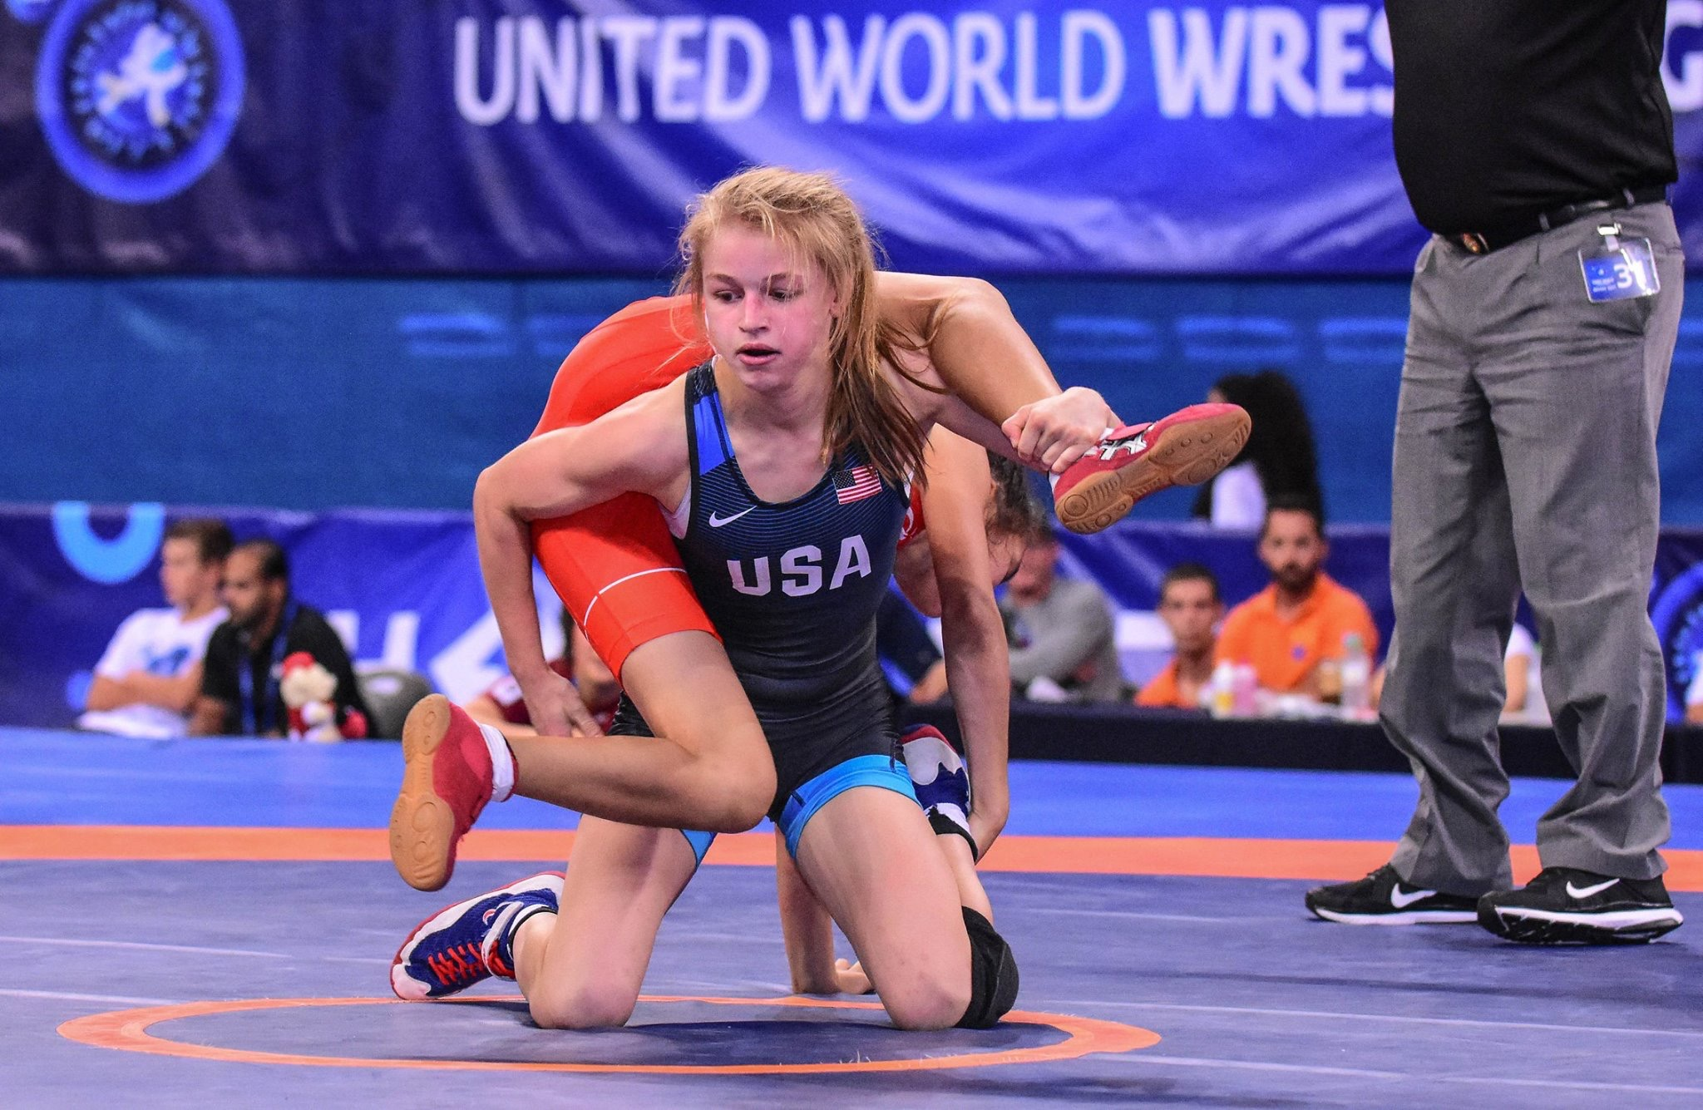
Growth in girls’ wrestling
New Ulm High School graduate and wrestler Ali Bernard credits her coaches, teammates, and community for supporting her while wrestling on the boys varsity team.
Emily Shilson of Maple Grove competed in two boys’ state wrestling tournaments and was an All-American at Augsburg her first year of college.

Slide 11
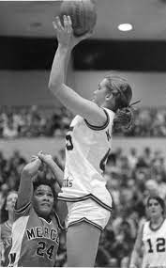
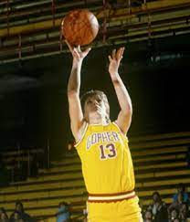
Janet Karvonen led her New York Mills team to three consecutive state Class A championships. A prolific scorer and superb rebounder, Janet scored 3,129 during her high school career.
Debbie Hunter of Cloquet transitioned from a scorer in high school to point guard playmaker for the U of M. She still has the career record for assists and steals.

Slide 12
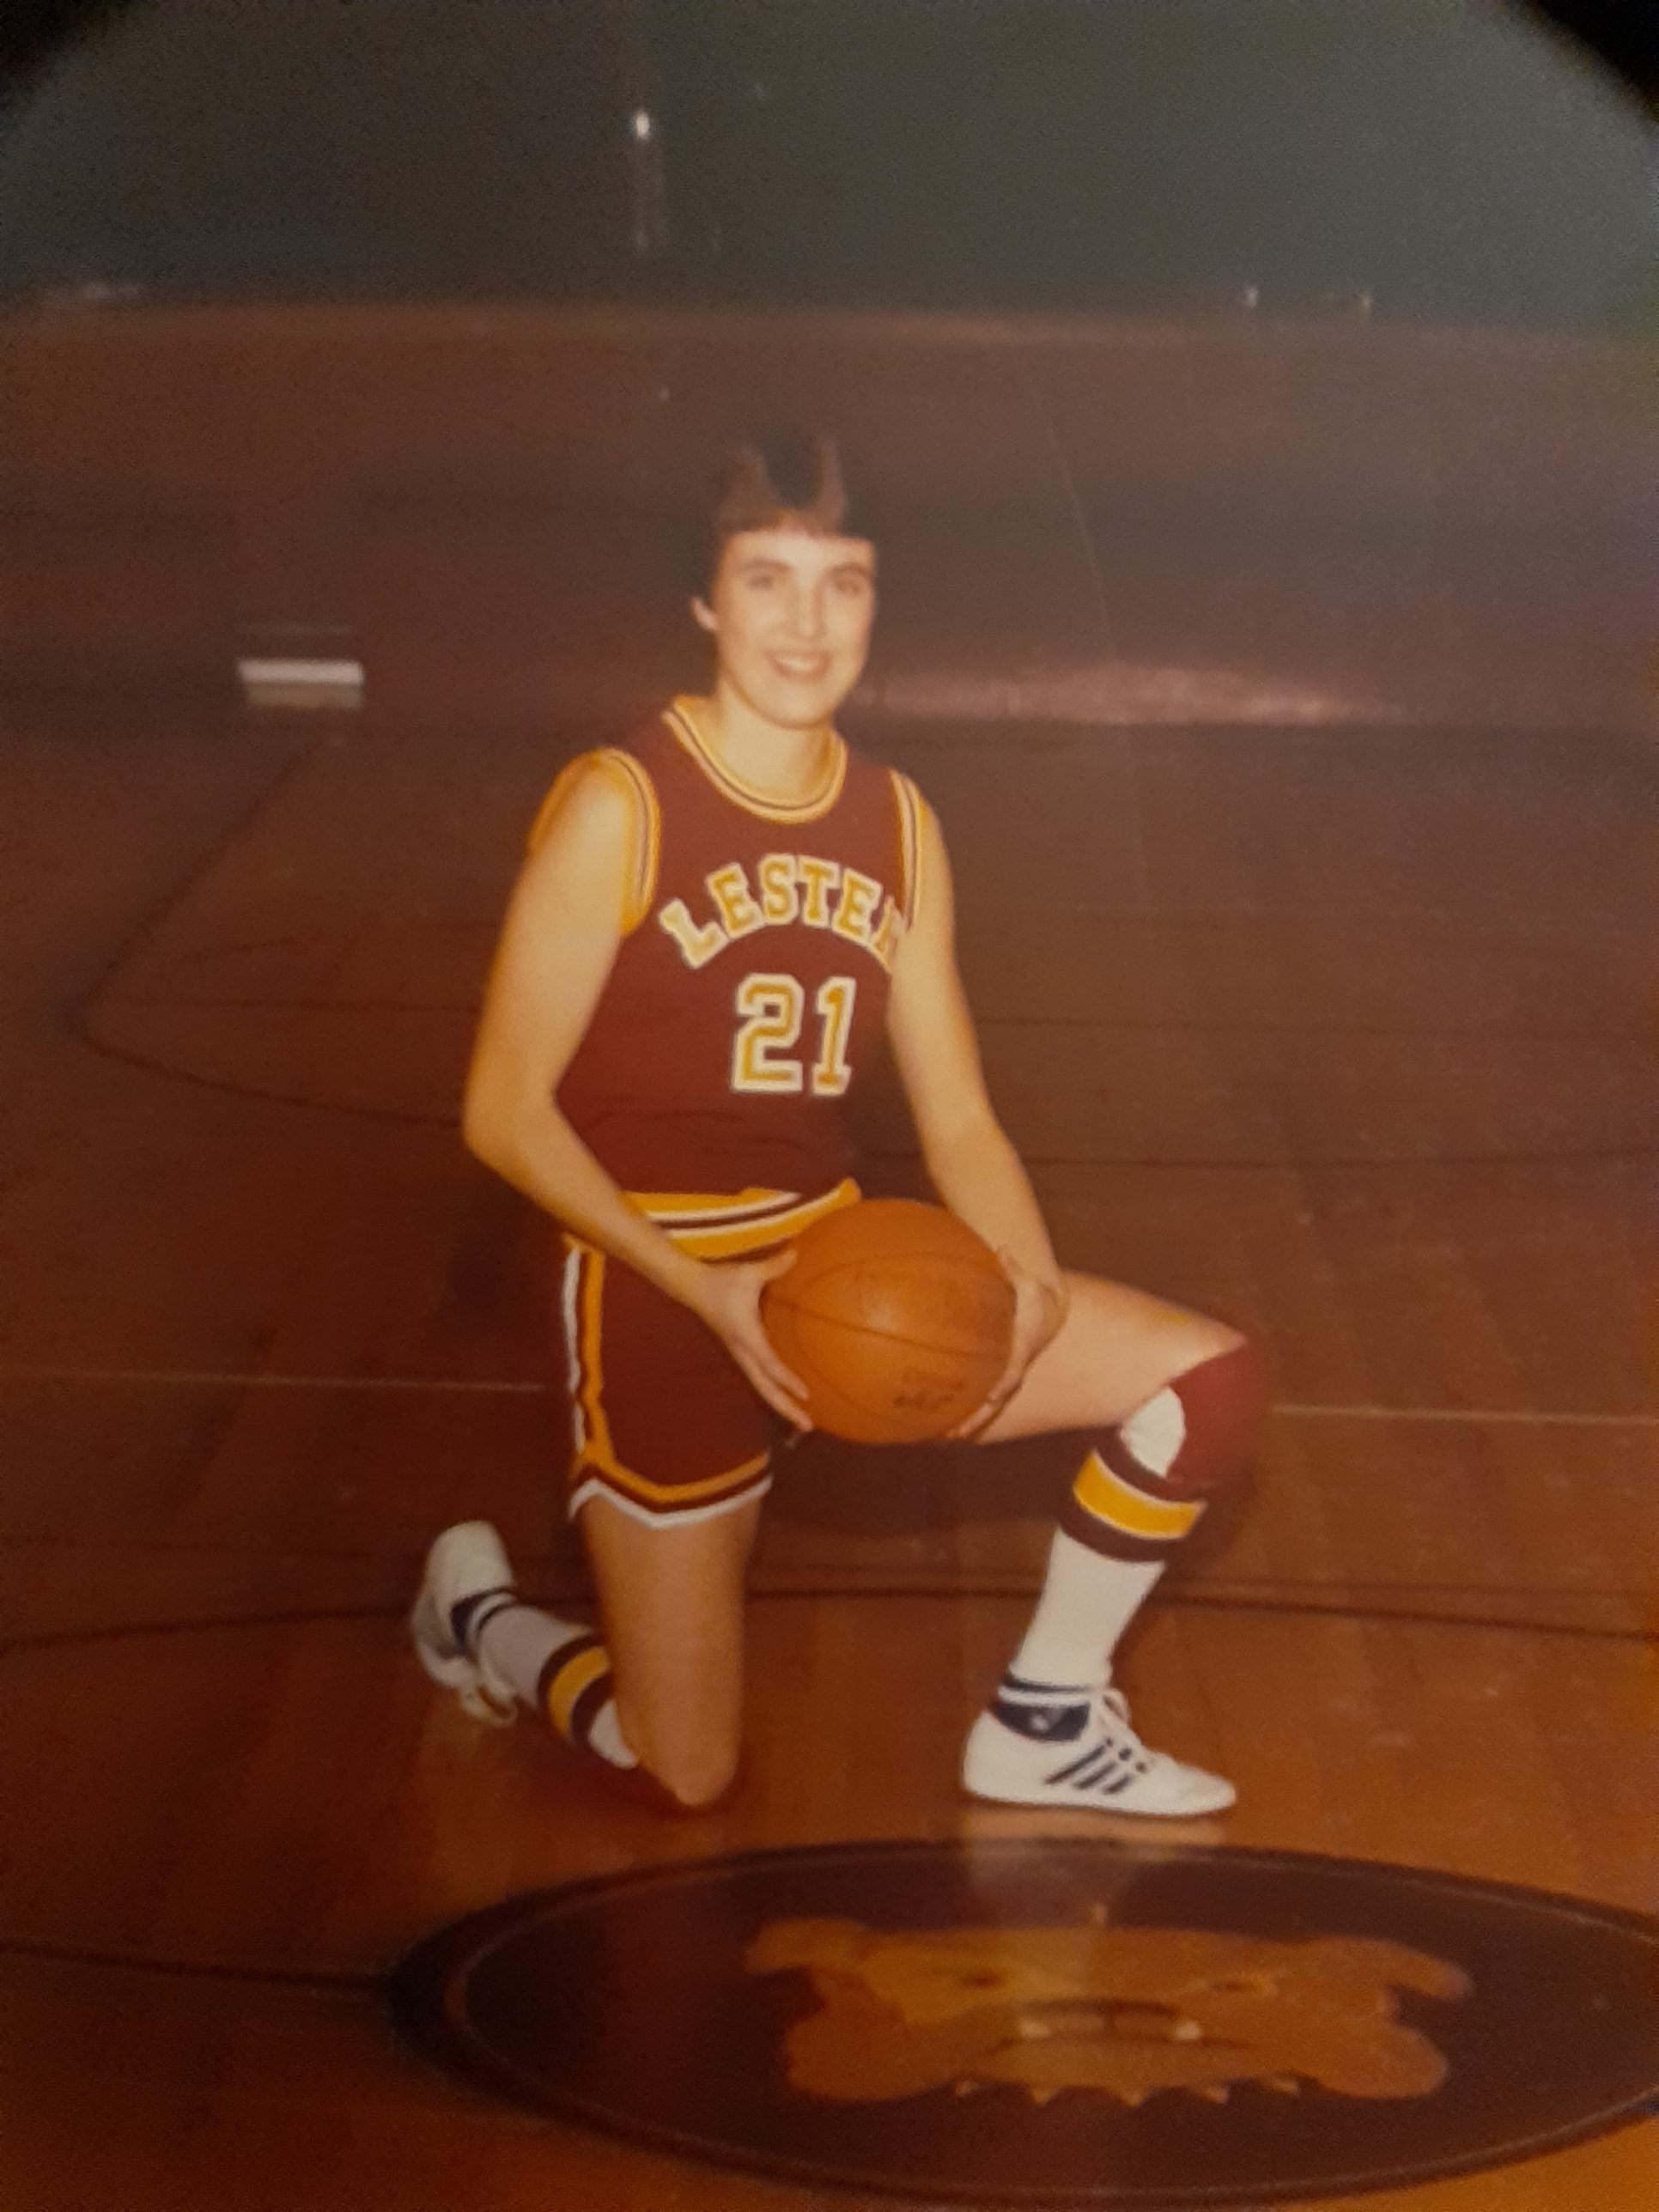
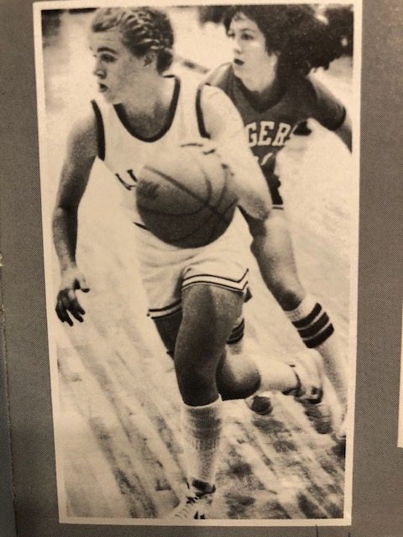
1970s, 1980s Minnesota Girls High School Athletic Stars
Kay Konerza of Lester Prairie played baseball (boys’ team), was a state track champion, and basketball star who scored 2,715 points and became a two-year captain at Louisiana Tech.
Kelly Skalicky of Albany was known for her ballhandling skills and competitiveness. She was Ms Minnesota Basketball in 1981 and played at Louisiana State University until she suffered an injury and then focused on golf at the U of M.

Slide 13
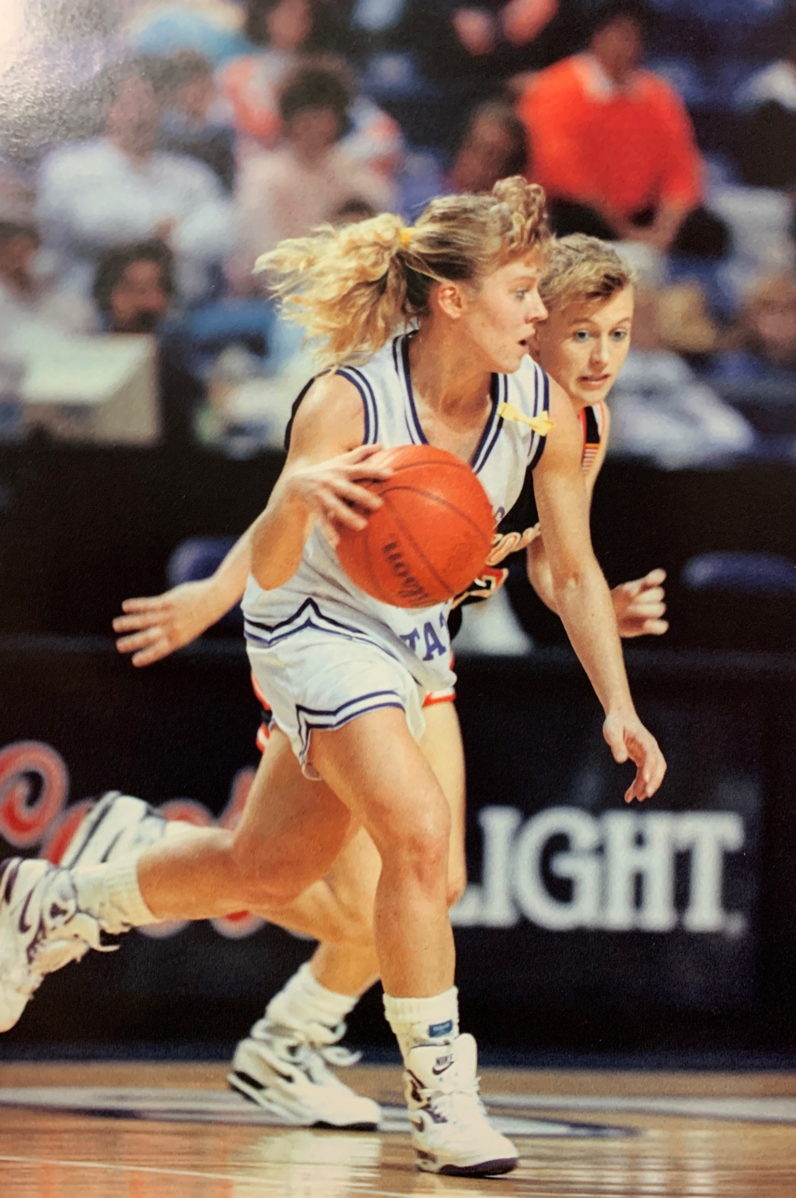
Mary Jo Miller of Tracy-Milroy was all-state in 3 sports. She played point guard at Kansas State and became an elementary school teacher.
Cathie Twomey of Golden Valley was a premier distance runner for the U of M and a Big Ten champion. Here she paces Mary Decker to a world record.

Slide 14
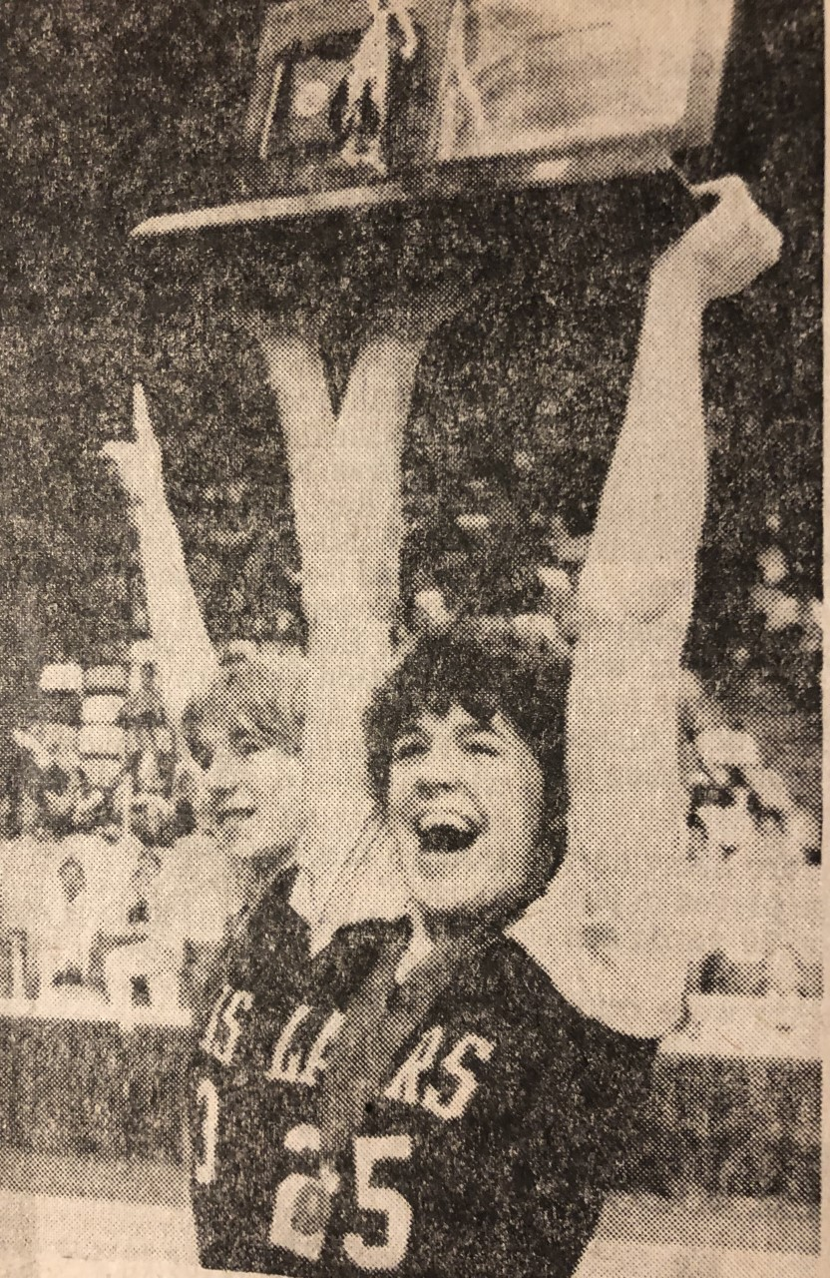
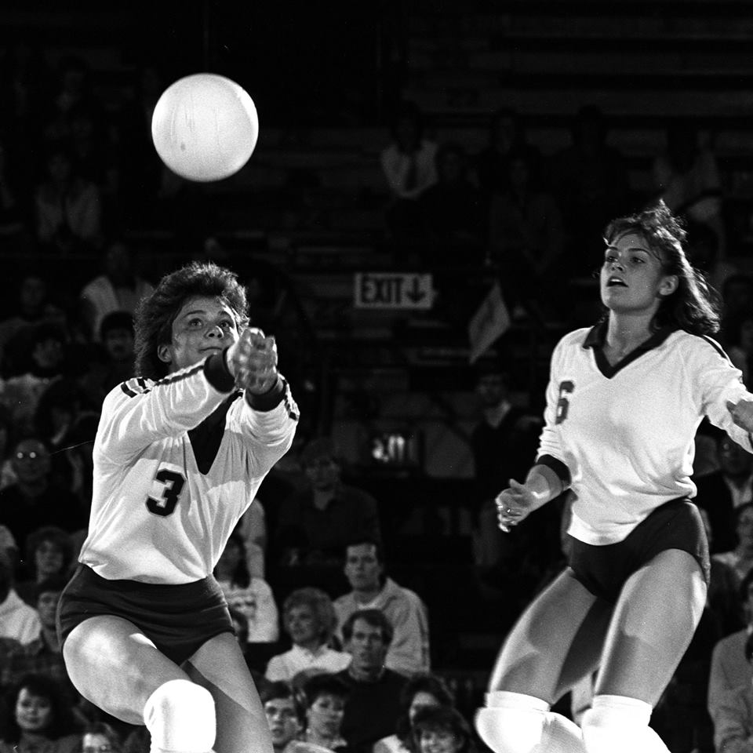
1980s Minnesota Volleyball Players
Three-sport athletes Annie Adamczak (left) from Moose Lake and Rochele Goetz (right) of Waconia both played volleyball at the collegiate level. Annie’s volleyball, basketball, and softball teams went undefeated in 1981-82.

Slide 15
At the Olympics
About 400 living people who spent their formative years in Minnesota have competed in the Winter and Summer Olympics.
More have been hockey players than any other sport. Then comes a cluster: curling is coming on like gangbusters, then speedskating, long distance running, wrestling, and cross country skiing.
There were no Olympics in 1940 and 1944 because of World War II (the Olympics happen every 4 years). The winter and summer Olympic Games were held in the same year through 1992.

Slide 16
At the Olympics

Slide 17
Still Skating Along Famously
Janet Gerhauser took a streetcar to ice arenas for figure skating practice as she attended Minneapolis Washburn High School.
She thought of her skating partner, John Nightingale, as an older brother. John attended Cretin High School. Both later graduated from the University of Minnesota.
They placed 6th in the 1952 Olympics figure skating pairs. Janet was one of only about a dozen women on the US Olympic team.

Slide 18
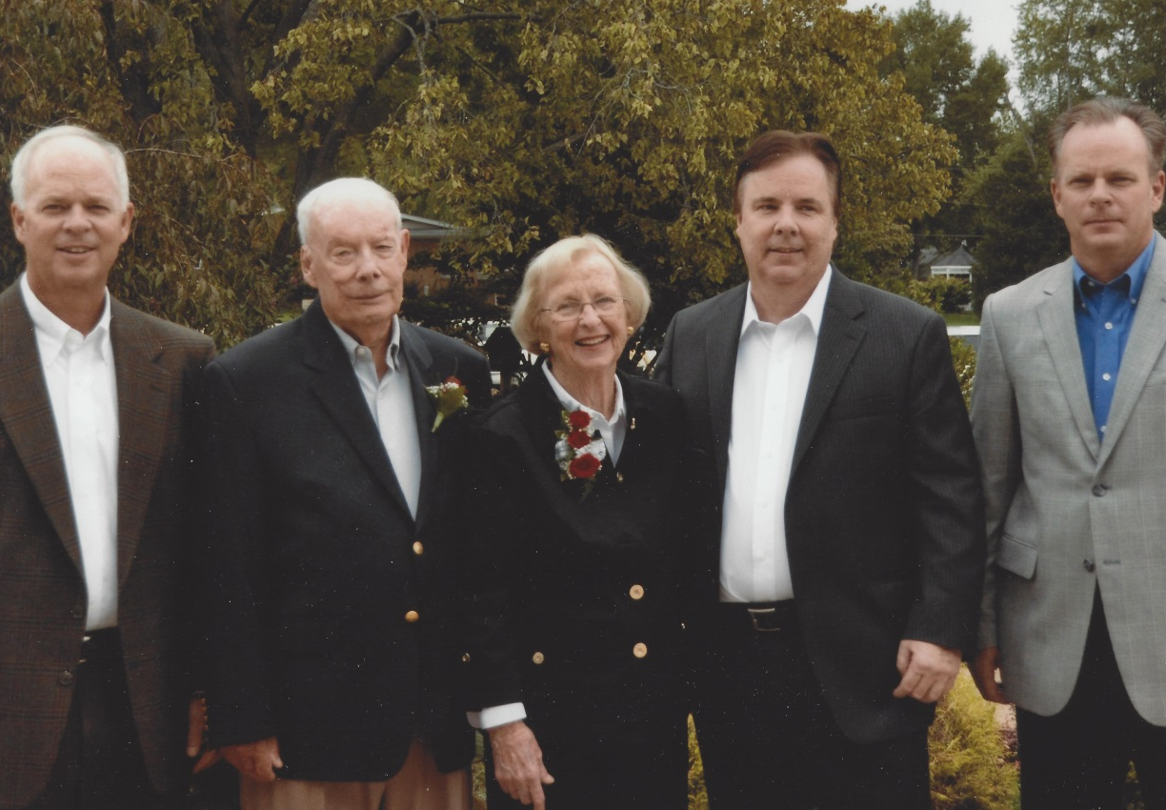
Janet Gerhauser and John Nightingale
Janet Gerhauser became an international figure skating judge.
John Nightingale had a lengthy military service career.

Slide 19
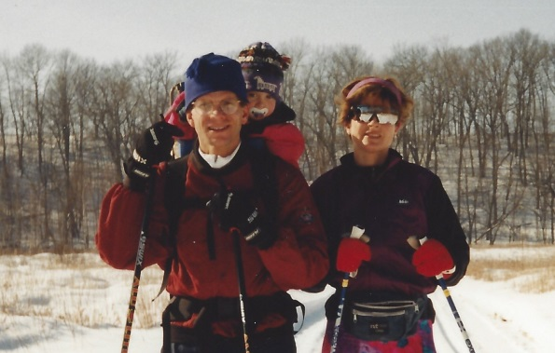
It Takes a Village
Here is a woman who cross country skied in the 2014 Olympics and won medals in 2018 and 2022.
Jessie Diggins is from Afton, Minnesota, and won the state cross country ski championship in 9th grade!

Slide 20
Jessie Diggins Today

Slide 21
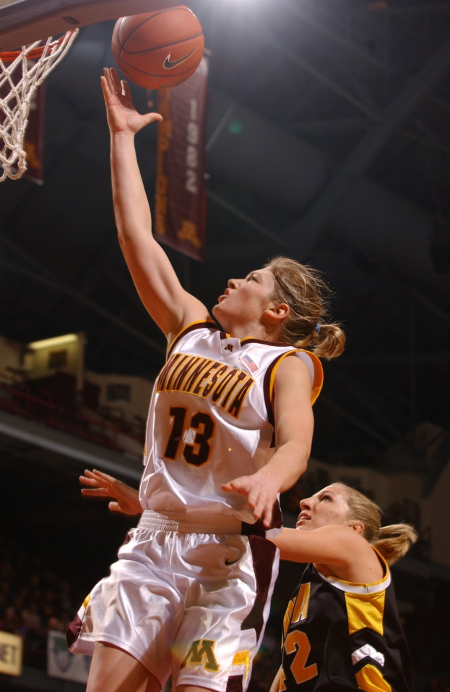
Minnesota’s Hometown Olympian
Announcing itself as Minnesota’s Hometown, Hutchinson is proud to have a close relationship with Lindsay Whalen, perhaps the most known female athlete in Minnesota.
A four-year starting point guard and two-time All-American at the University of Minnesota, Lindsay averaged over 20 points per game during her collegiate career.
Attendance increased nine-fold at women’s basketball games from 2000-04.

Slide 22
Lindsay Whalen
Originally drafted by the Connecticut Sun, Lindsay has played professional basketball for over ten years and never missed a start through the 2014 season since her second game in the WNBA.
Since 2009, Lindsay has played for the Minnesota Lynx and led the team to four WNBA Championships.
She was the leading scorer in the gold medal game at the 2016 Olympics in Rio de Janeiro and recently named the new head women’s basketball coach at the University of Minnesota.

Slide 23
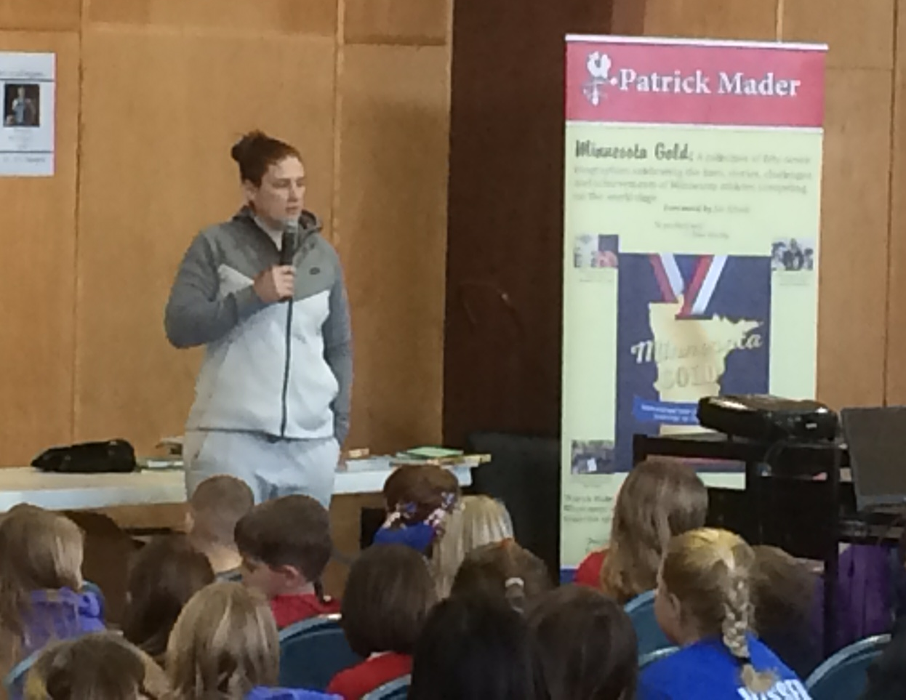
Lindsay Whalen Returns to Hutchinson

Slide 24
Inspiring a Whole New Generation of Little Girls
Briana Scurry, a graduate of Anoka High School, is a three-time Olympian and helped the U. S. to two gold medals as the team’s goalkeeper.

Slide 25
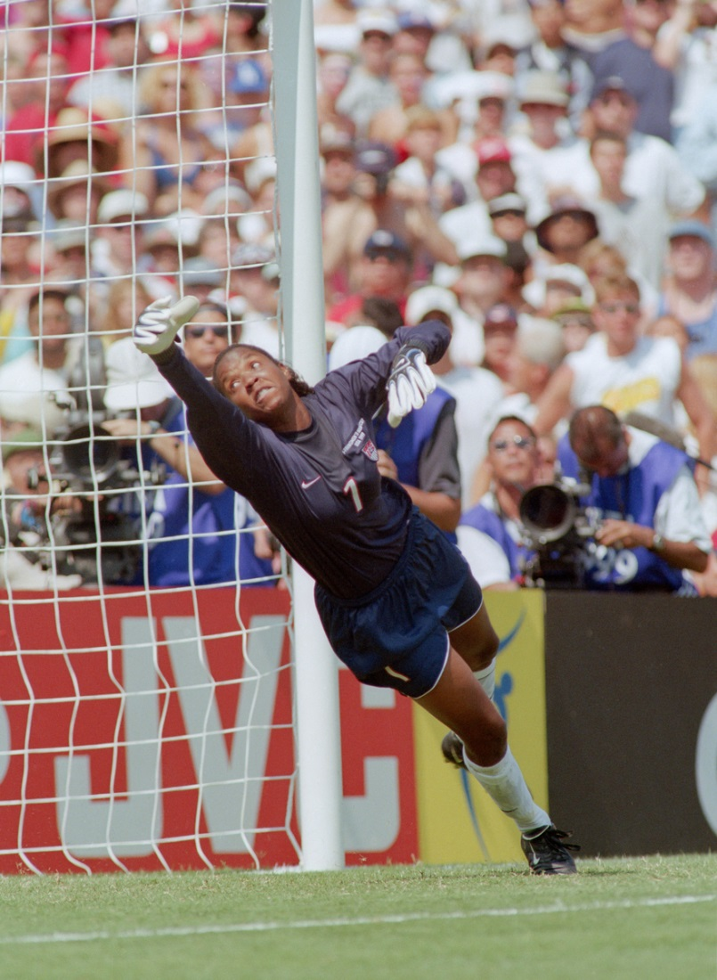
Briana Scurry
Quick, athletic, focused, and possessing great jumping ability and spectacular balance, Briana Scurry, received a full athletic scholarship to the University of Massachusetts—Amherst.
She is making a successful recovery from a traumatic brain injury.

Slide 27
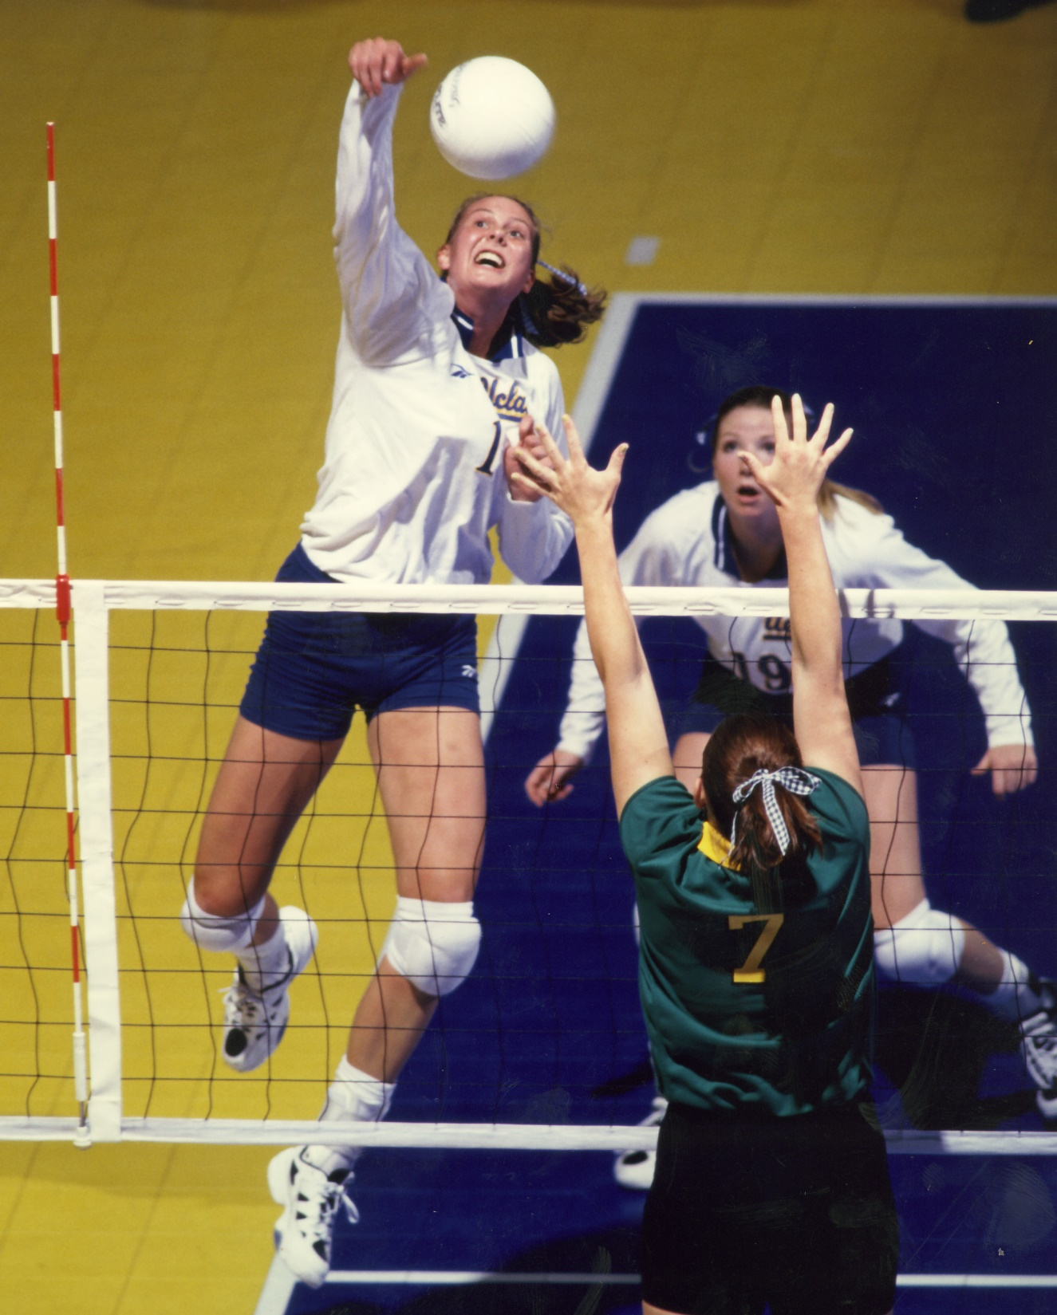
Wiz Bachman of Lakeville competed at state competitions in volleyball, cross country skiing, and track and field (high jump) before attending UCLA.
She was a member of the 2004 US Olympic volleyball team.

Slide 28
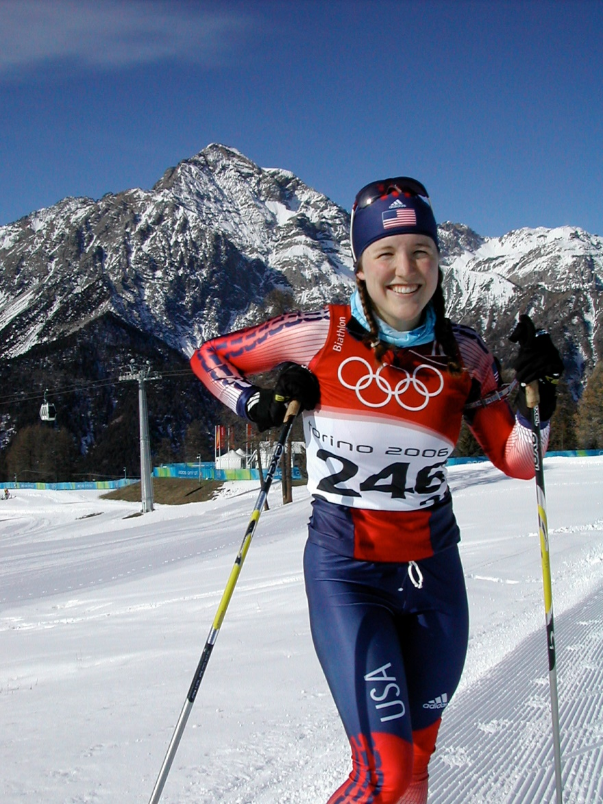
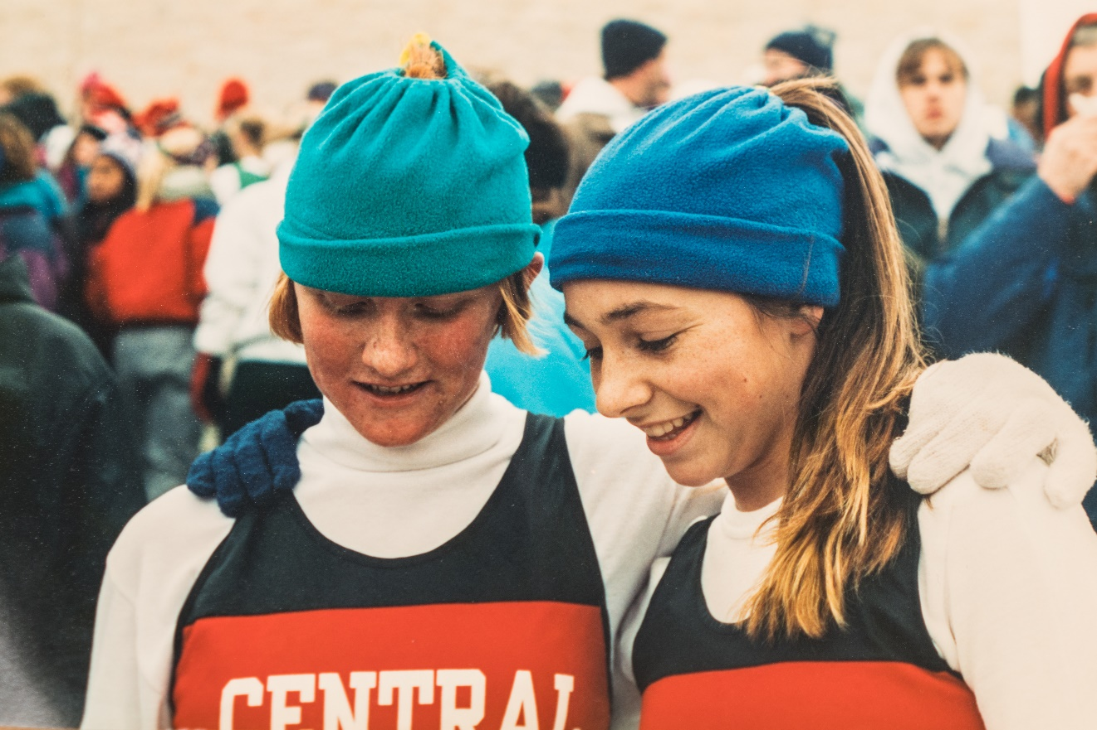
A superb golfer, swimmer, and skier, Carolyn Treacy of Duluth East was a member of the 2006 Olympic biathlon team.
Barb Jones of St. Paul Central (Lakeland) competed in state track and nordic meets and was a 2002 Olympian

Slide 29
Play at the Park
Playing at Lewis Park in Edina, Jenny Schmidgall is a firm believer in learning to play in an unstructured environment allows you to “figure it out on your own.”
A four-time Olympian, Jenny was on the inaugural US Olympic women’s hockey team in 1998 that won a gold medal.

Slide 30
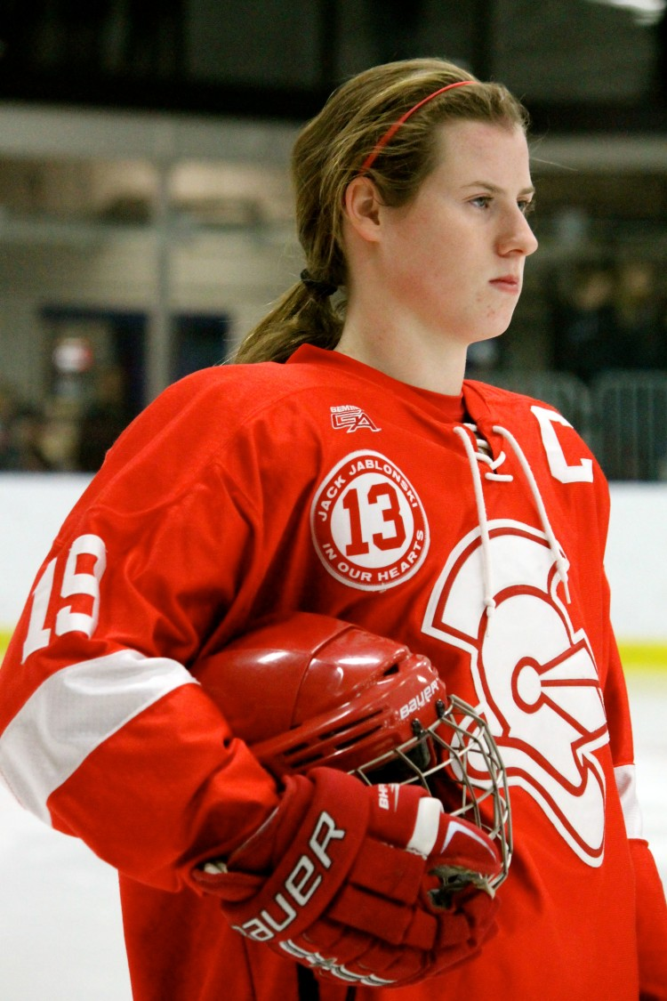
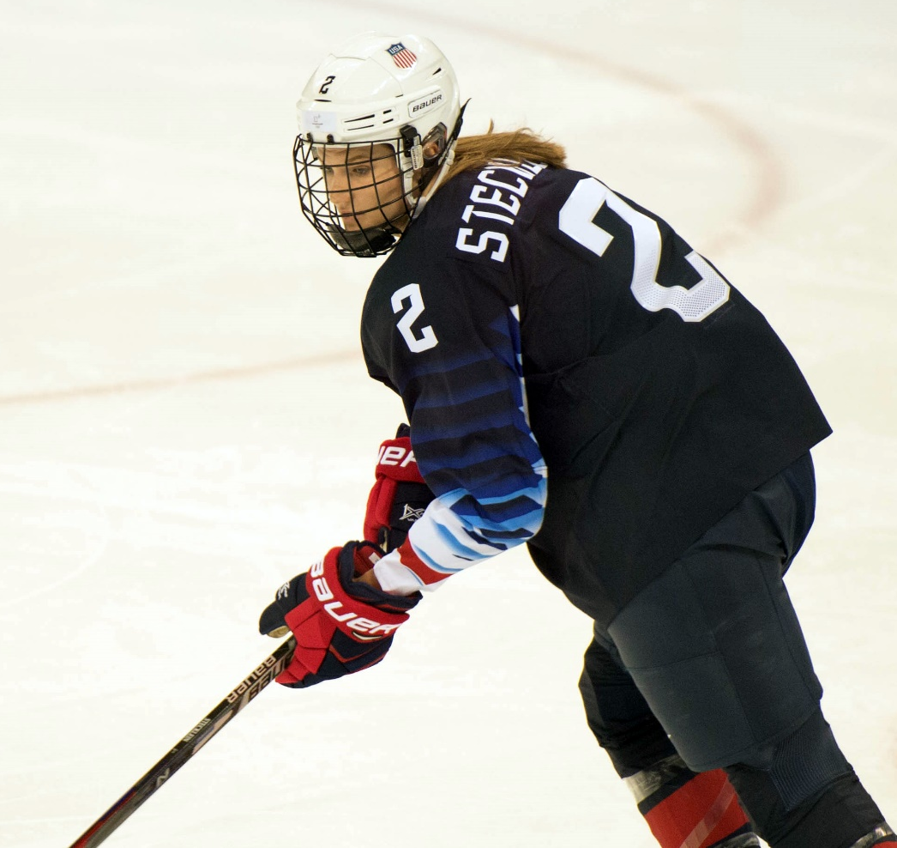
Other multiple-time Olympians
Lee Stecklein of Roseville Area HS has been on 3 Olympic hockey teams
Kelly Pannek, Benilde-St. Margaret’s
was also Ms Minnesota Soccer

Slide 31
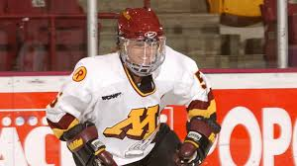
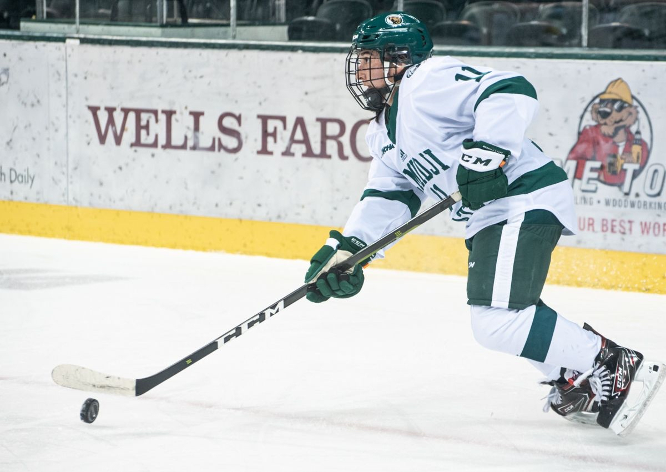
Pioneer and recent Minnesota Hockey Players
Winny Brodt of Roseville scored 62 goals in 30 games. At the U of M, she was WCHA Player of the Year.
Tina Kampa of Maple Grove is a 5’ 0” tall defense person who played at Bemidji State University.
She is now Director of Hockey Operations at Dartmouth.

Slide 32
Early high school girls’ teams often changed in public restrooms
Jan Ettle of Freeport (Albany HS) was not able to run cross country, yet she placed 6th in the 1984 US Olympic Trials
Cathie Twomey of Golden Valley paced Mary Decker to a world record run in the 2,000 meters

Slide 33
Grit and Determination

Slide 34
A True Minnesotan
A five-time cross country state champion from Dawson-Boyd High School, Carrie Tollefson was the most highly recruited distance runner in the nation when she graduated in 1995.
Two years later Carrie was the NCAA women’s cross country champion running for Villanova University, a distance-running powerhouse. She also won some track titles.
Carrie returned to Minnesota shortly after graduating.

Slide 35
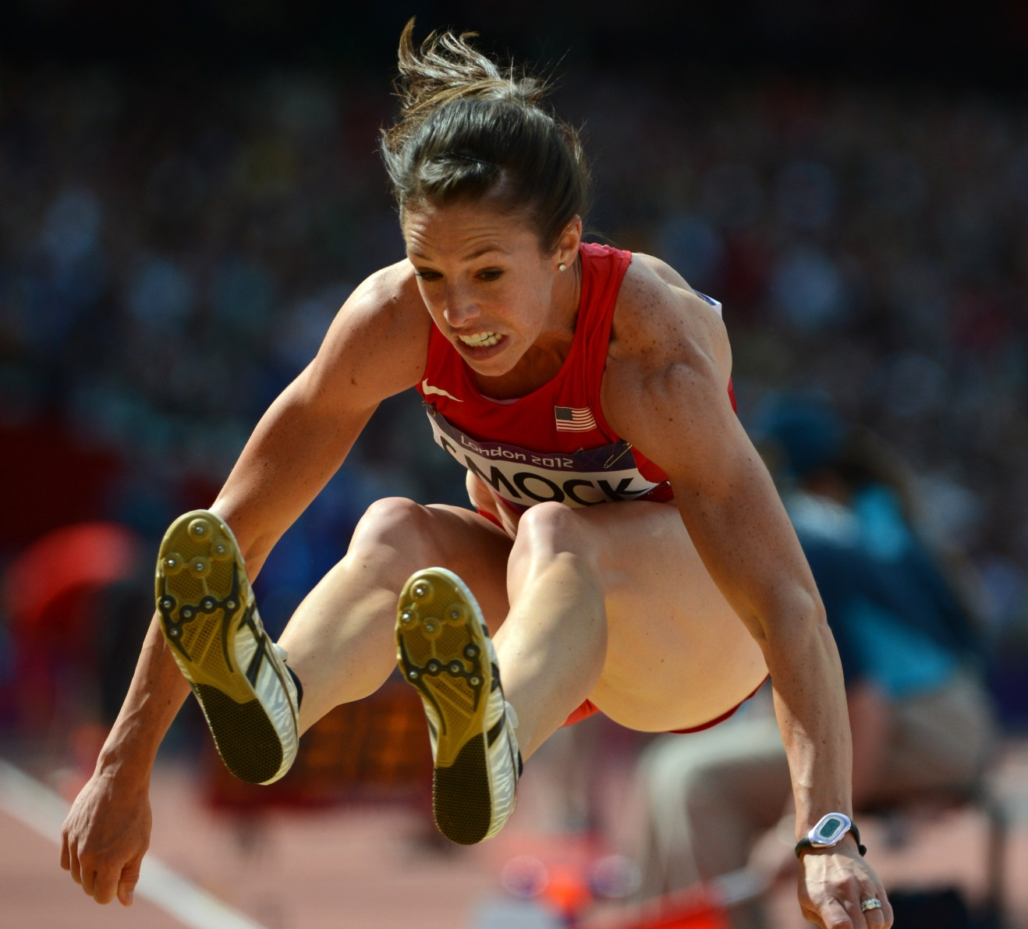
Perseverance Payoff Is London Flight
Amanda Smock, from Melrose, competed in the triple jump and finished 27th at the 2012 Olympics in London, England.
She starred in track and field and gymnastics in high school and then attended North Dakota State University.

Slide 36
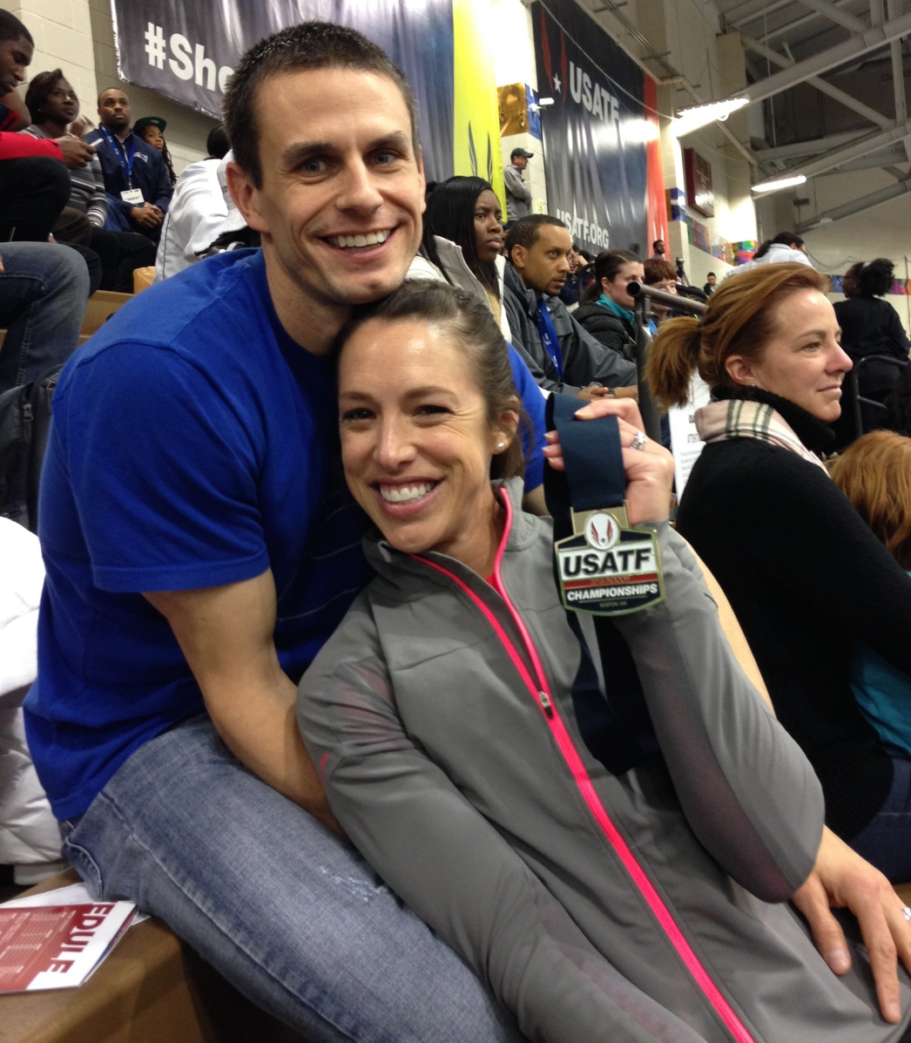
Amanda Smock
A national champion in the triple jump in both 2014 and 2015, Amanda Smock trained four more years in an attempt to make the 2016 Olympics hosted in Rio de Janeiro, Brazil.
She obtained a doctorate in exercise physiology at the University of Minnesota.

Slide 37
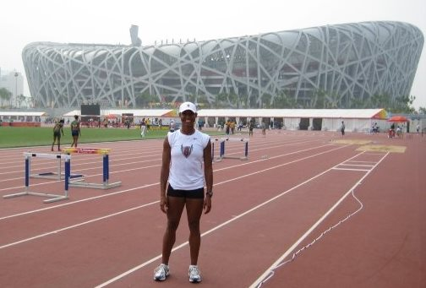
Jumping Is Part of the Journey
Shani Marks placed 28th in the triple jump at the 2008 Olympics in Beijing, China.

Slide 38
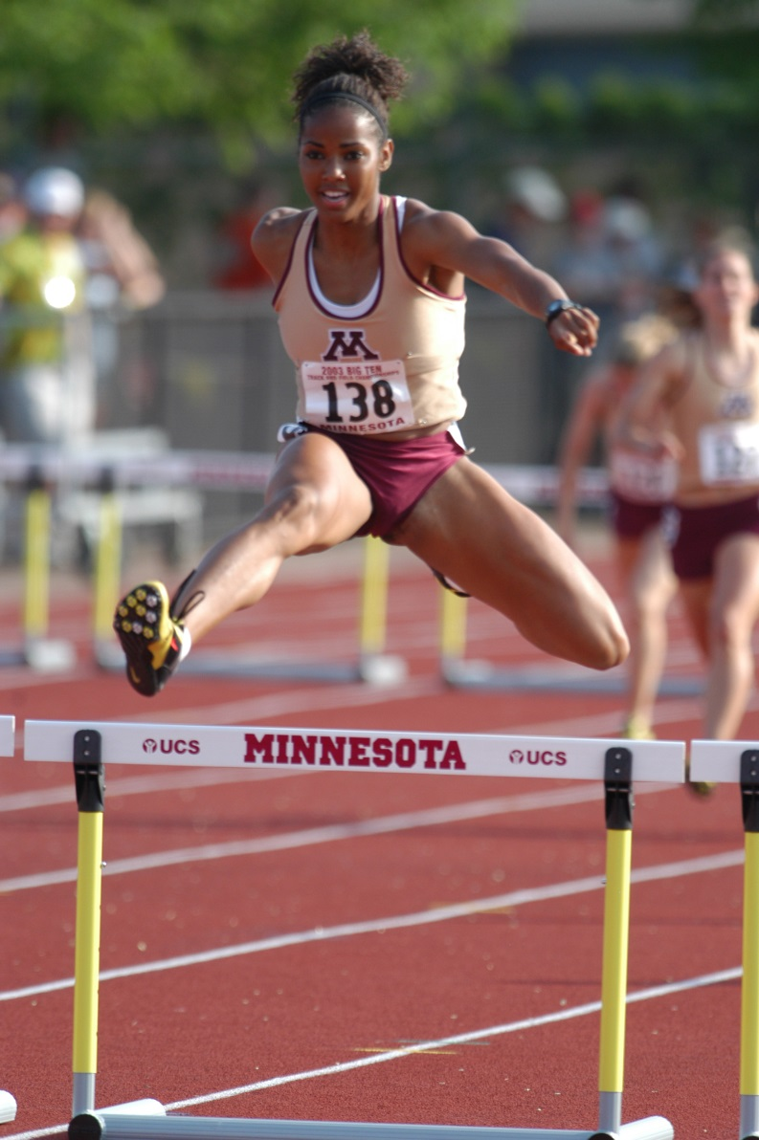
Shani Marks
Talented sprinter, jumper, and hurdler from Apple Valley,
Shani now shares her knowledge and skills as a coach

Slide 39
Cottonwood County
Kris Kuehl started to throw the discus in Storden-Jeffers High School as an alternative to running long distances.
She placed 2nd in the state track and field meet her senior year, but she drew little interest from colleges.

Slide 40
Cottonwood County
So Kris Kuehl attended Concordia College in Moorhead (art major) and became a three-time NCAA Division III champion discus thrower. Persevering through three Olympic Trials, she earned a berth on the 2000 US Olympic team competing in Australia.
Today she is a physical therapist.

Slide 41
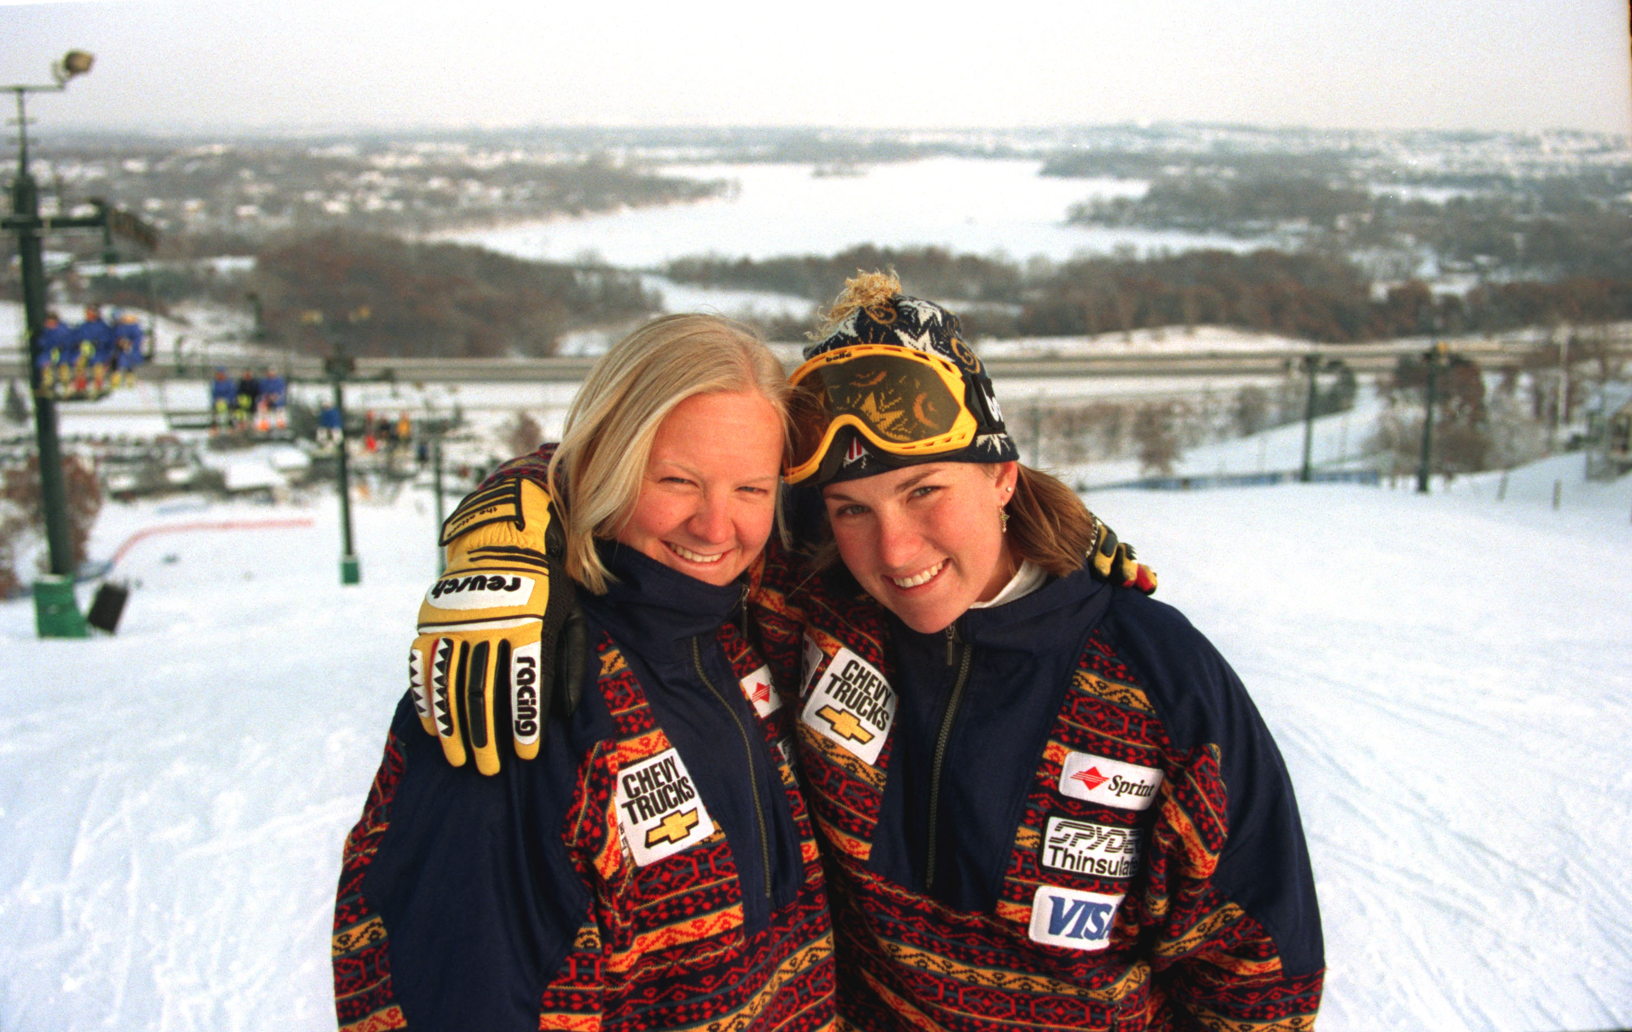
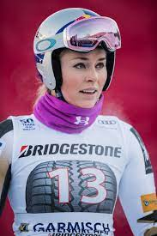
Minnesota Alpine Skiing Olympians
Tasha Nelson, Kristina Koznick, and Lindsey Vonn all started their skiing careers at Buck Hill—where Tasha and Kristina are pictured.

Slide 42
Gold Medal Family
Janis Klecker is very proud of her active family. She did not start running competitively until after she graduated from Edina West High School.

Slide 43
Janis Klecker
Inspired by her mother, Mae Horns, Janis Klecker began road racing as a college student and then competed on the University of Minnesota cross country team.
She won several marathons and qualified for the 1992 Olympic team. Janis is now a dentist.

Slide 44
Phil and Val Rogosheske
A longtime teacher and coach in the St. Cloud Public Schools, Phil Rogosheske has continued his passion for sports and is ranked in the top five nationally in his age group in swimming, race walking, nordic skiing, mountain biking, and kayaking.
His wife, Val, was one of eight women to run the first Boston Marathon officially open to women.

Slide 45
Continental Competitor
Winning a bronze medal in the 2007 World Championships is a highlight for Kara (Grgas-Wheeler) Goucher, a graduate of Duluth East High School.
She has fond memories of her teammates and coaches saying it was so fun and they were so innocent.
Kara participated in numerous student groups and organizations.

Slide 46
Kara Goucher
A 2001 NCAA national cross country champion as a member of the University of Colorado, Kara Goucher is a two-time Olympian in distance events: the 5,000- and 10,000 meter runs in 2008 and the marathon in 2012.
She was an alternate in the marathon at the 2016 US Olympic Trials.
Kara has a degree in psychology and is running professionally and served as an announcer at the 2022 World Championships.

Slide 47
Embrace What You Have
While hopping a train, 13-year-old Lindsay Nielsen’s foot got trapped and crushed in the coupling and eventually led to her left-foot being amputated.
Rarely speaking of the event—and often hiding her amputation—Lindsay returned to her love of running at age 40.
She became the first female amputee to complete an Ironman Triathlon and placed 5th in the 200-meter run at the 2000 Paralympics in Sydney.

Slide 48
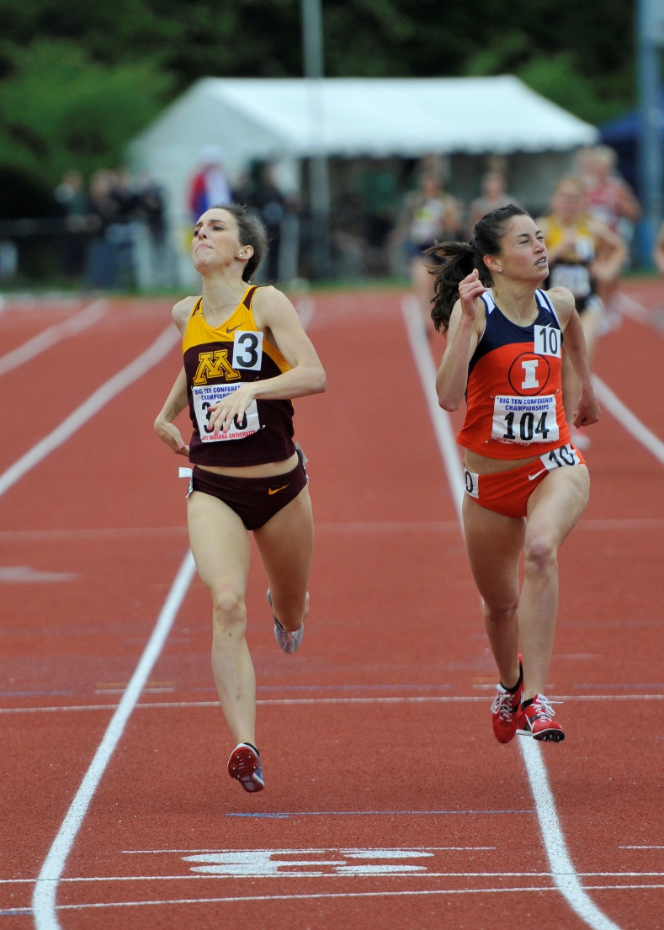
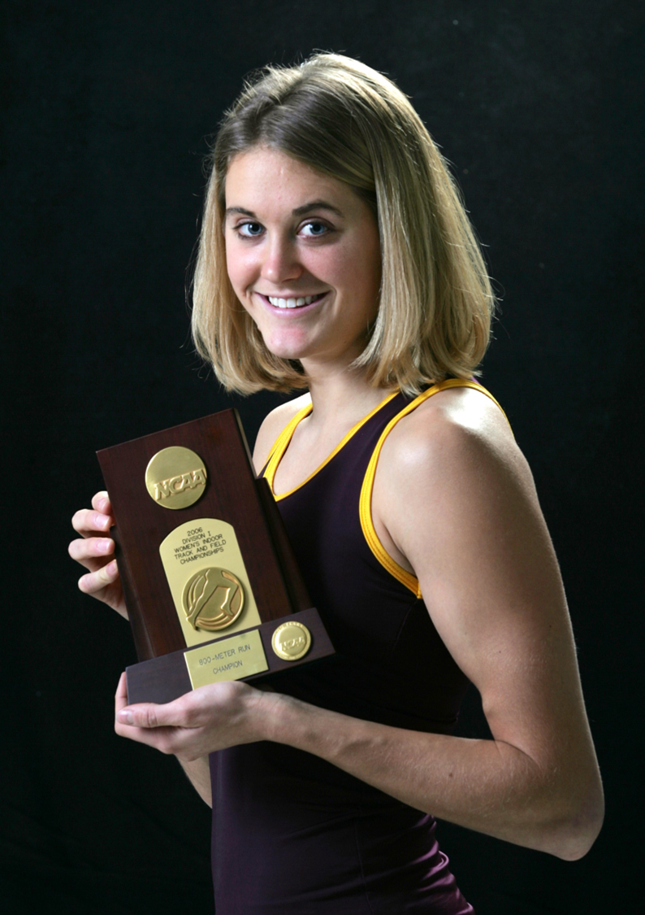
High School Champions to World Championship Teams
Gabe Anderson Grunewald Perham
Heather Dorniden Kampf
Rosemount

