Slide 1
Groves Literacy Partnerships
Becoming an Effective Literacy Leader
MNSAA Conference
November 3, 2023

Slide 2
Welcome!
Groves Literacy Partnerships®
Presenters:
Di Morri
Erin Nemetz
Introduce yourself to your neighbors:
Name
School

Slide 3
Agenda:
Who is Groves Literacy Partnerships?
Current State of Literacy in MN
Becoming an Effective Literacy Leader
School Yourself and Your Team
Analyze and adjust assessments
Analyze curriculum
Redesign schedules
Set a Culture of Literacy in your building
Notes:
Erin

Slide 4
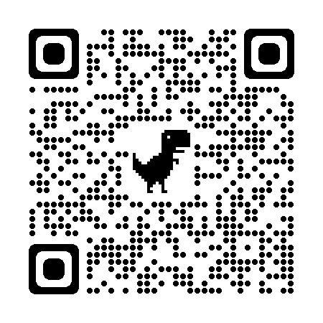
Goal of today
Leave with at least 1 thing that you can apply at school next week!
HANDOUT - Resources & Reflections
Notes:
Erin
Story- hat wearer…expert on everything hard to be expert on literacy. Our hope is you have a good handle on ELA leave with something practical you can bring to your building on Monday

Slide 5
Who is Groves Literacy
Partnerships?
Notes:
Di
We’ll begin with some background on our organization.

Slide 6
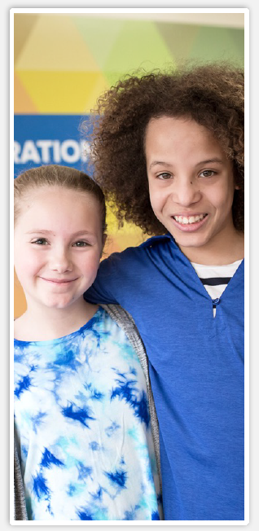
Groves Learning Organization
Groves Literacy Partnerships®
Groves Learning Organization is a non-profit organization that transforms lives through education.
We have expertise in literacy, dyslexia, study skills, and teaching the process of learning.
We understand that proven effective reading instruction benefits all learners.
We are driven to impact as many students, clients, and educators as we can.
1
2
3
4
Notes:
Di
Groves started as a school for students with language based learning disabilities 50 years ago. Our students learned to read first, then learned the process of learning and study skills as they accessed more text for all subjects. Literacy is a key component of an organization that originally served only neuro diverse students.

Slide 7
Our Mission
We build confidence, success, and purpose through transformative learning experiences.
Our Vision
To redefine the way our nation is taught, one student, one teacher, and one school at a time.
Our Values
Authenticity Collaboration Compassion
Discovery Tenacity
Notes:
Di
Mission- transformative learning experiences for teachers (GLP)
Vision - GLP strategic plan is grounded in our vision
Values - as most nonprofits, we wear our values on our sleeves. In hiring coaches, we look for collaboration and compassion as key traits. We work together with teachers and appreciate all that they have on their plates.

Slide 8
Groves Learning Organization
Our School
280+ students in grades 1-12 with dyslexia, ADHD, and/or other learning disabilities
Groves Literacy Partnerships®
Evidence-based literacy instruction
School literacy partnerships
The Learning Center
1,000+ LD students from the community
Notes:
Di
Quick explanation of our 3 strategic organizations. GLP is the youngest at 7 yrs old.
“Not many people know that GLO is made up of three arms. Most have heard of the Academy, but we also have the learning center, where students receive tutoring or come for diagnostic services. And GLP works with partner school like you to build and advance literacy instruction using evidence-based practices.”

Slide 9
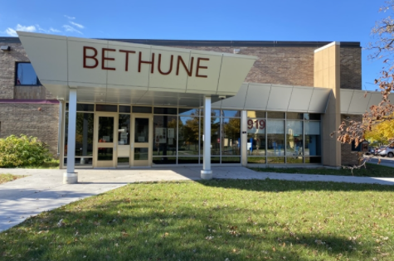
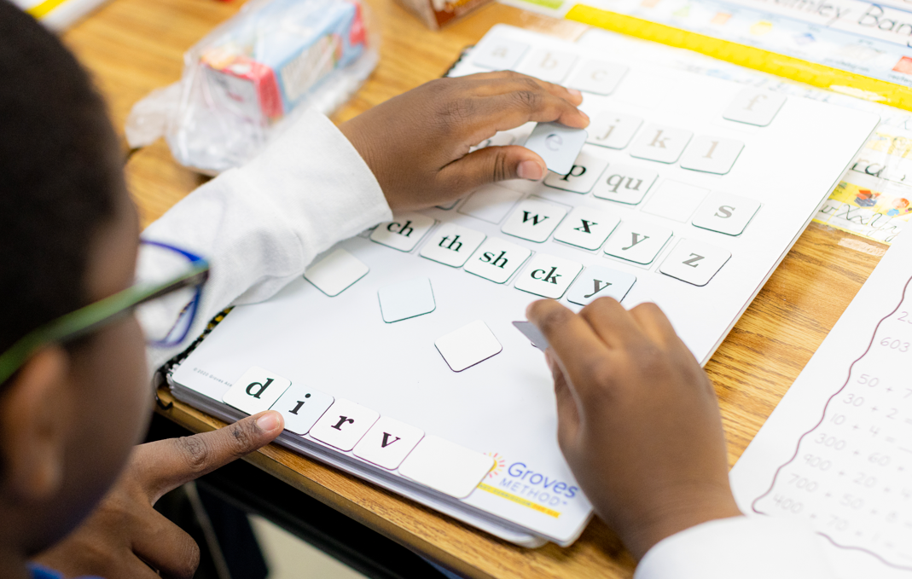
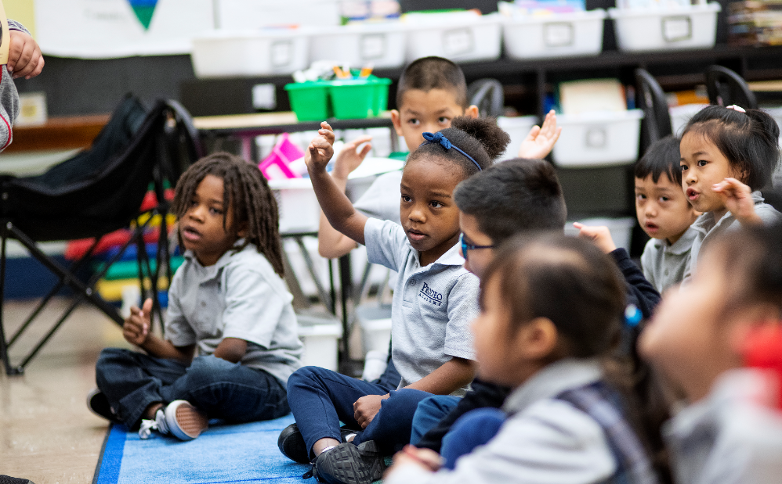
2023-24 Partner Schools
Raise your hand if you are a partner school!
Groves Literacy Partnerships®
80+ Partner Schools 550+ Classrooms
Notes:
Di
Raise your hand if you are a partner school
As of August 1, 87 schools, 567 classrooms, and over 10,000 students

Slide 10
Key GLP Statistics: Spring 2023
97.5% of students improved their reading speed and accuracy over the course of the year.
One in three students who tested as high risk in the fall were no longer high risk by spring.
489 high/moderate risk students closed the gap and are now reading at grade level.
32% of public school 4th graders were able to read proficiently in Minnesota, a significant drop from 2019. (NAEP 2022)
Notes:
Erin
2022 Reading State Snapshot Report for Minnesota, National Assessment of Educational Progress (NAEP)
“When you consider the state of literacy in MN- described in the pink box at the bottom, our partner schools have a lot to be excited about. (read statistics)”

Slide 11
Wildly Important Goal
Groves Literacy Partnerships®
Every student will be at, or above, grade level in reading
RELENTLESS FOCUS ON LITERACY!
Notes:
Di
This is the goal that GLP lives. Additionally, we will support your goal with all our work together.

Slide 12
Word Collector
Read Aloud
Notes:
Di/Erin
Reason for why we are doing this….we will connect at the end.
Pass out post it notes before reading

Slide 13
Vocabulary Wall
Groves Literacy Partnerships®
Notes:
Activity
Post its-
Maggie Cool Writing on Poster Boards

Slide 14
Current Opportunities with Reading Instruction
Notes:
Erin

Slide 15
Our Nation’s Reading Report Card
Groves Literacy Partnerships®
If a child with a reading difficulty is not identified by the start of 3rd grade….
there is only a 25% chance that that student will ever read at grade level in his public school career.
68% of our nation’s 4th graders do not read proficiently.
37% do not have basic reading skills.
Notes:
Erin
This data is from the 2022 NAEP assessment
You have likely heard some grim statistics about literacy in the US. It’s important to digest these numbers- think about what it means for almost 7 out of 10 adults to go through life without reading proficiency. How would your life be different without reading? We know that the window for addressing these issues in school begins to close around 3rd grade. We’re not sharing these statistics to depress anyone, we only want to feel a sense of urgency.

Slide 16
Putting Things into Perspective
Groves Literacy Partnerships®
Notes:
Di
Zooming in to our own state- if every student who is not reading at grade level were to make a human chain, it would reach from Rochester to Duluth.

Slide 17
School Yourself
and
Your Team
Notes:
Di

Slide 18
School Yourself on the Science of Reading
Groves Literacy Partnerships®
True or False?
The Science of Reading is a specific program or pedagogy.
FALSE
Notes:
Erin

Slide 19
School Yourself on the Science of Reading
Groves Literacy Partnerships®
Collection of research
Focuses on Five Key Literacy Skills based on National Reading Panel
Ever evolving
Notes:
Di

Slide 20
School Yourself on the Science of Reading
Groves Literacy Partnerships®
True or False?
The science of reading includes phonics only.
FALSE
Notes:
Erin

Slide 21
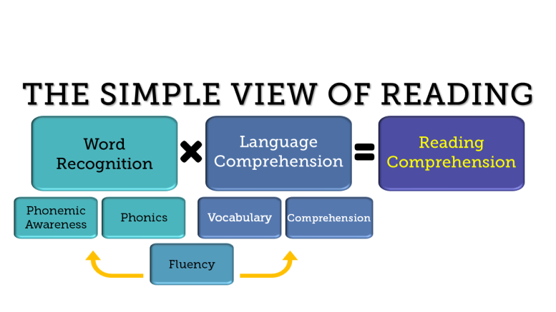
School Yourself on the Science of Reading
Groves Literacy Partnerships®
Simple View of Reading (Gough & Tunmer, 1986)
Notes:
Di

Slide 22
School Yourself on the Science of Reading
Groves Literacy Partnerships®
True or False?
Learning to read is a natural and easy process.
FALSE
Notes:
Erin

Slide 23
School Yourself on the Science of Reading
Groves Literacy Partnerships®
Reading is not natural. It has to be explicitly taught.
Notes:
Erin

Slide 24
School Yourself on the Science of Reading
Groves Literacy Partnerships®
True or False?
Balanced Literacy Framework, Whole Language Framework, Three Cueing System, Lucy Calkins, and Fountas and Pinnell are aligned with the Science of Reading
FALSE
Notes:
Di

Slide 25
School Yourself on the Science of Reading
Groves Literacy Partnerships®
In recent years, many researchers, educators, school have moved away from instructional practices and curriculum that …
don’t align with the science of reading.
Now what?
Structured Literacy Curriculum Based on the Science of Reading
Professional Learning for teachers on SoR
Notes:
Erin

Slide 26
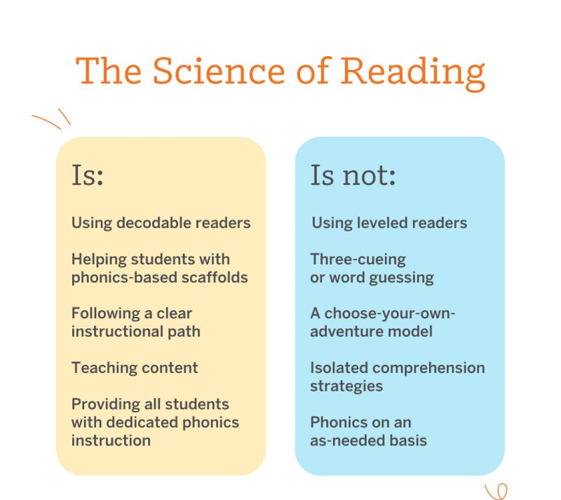
Remember…
Notes:
Erin

Slide 27
Read Act
Groves Literacy Partnerships®
Passed into law in May of 2023
Sets key literacy goals for all students:
Every child reading at or above grade level based on goals
By SY 26-27, evidence based structured literacy instruction in place
Encouraged to adopt MTSS
Screening for students on dyslexia
Progress monitoring for students not on grade level
All staff trained in structured literacy by 2027
Notes:
Di

Slide 28
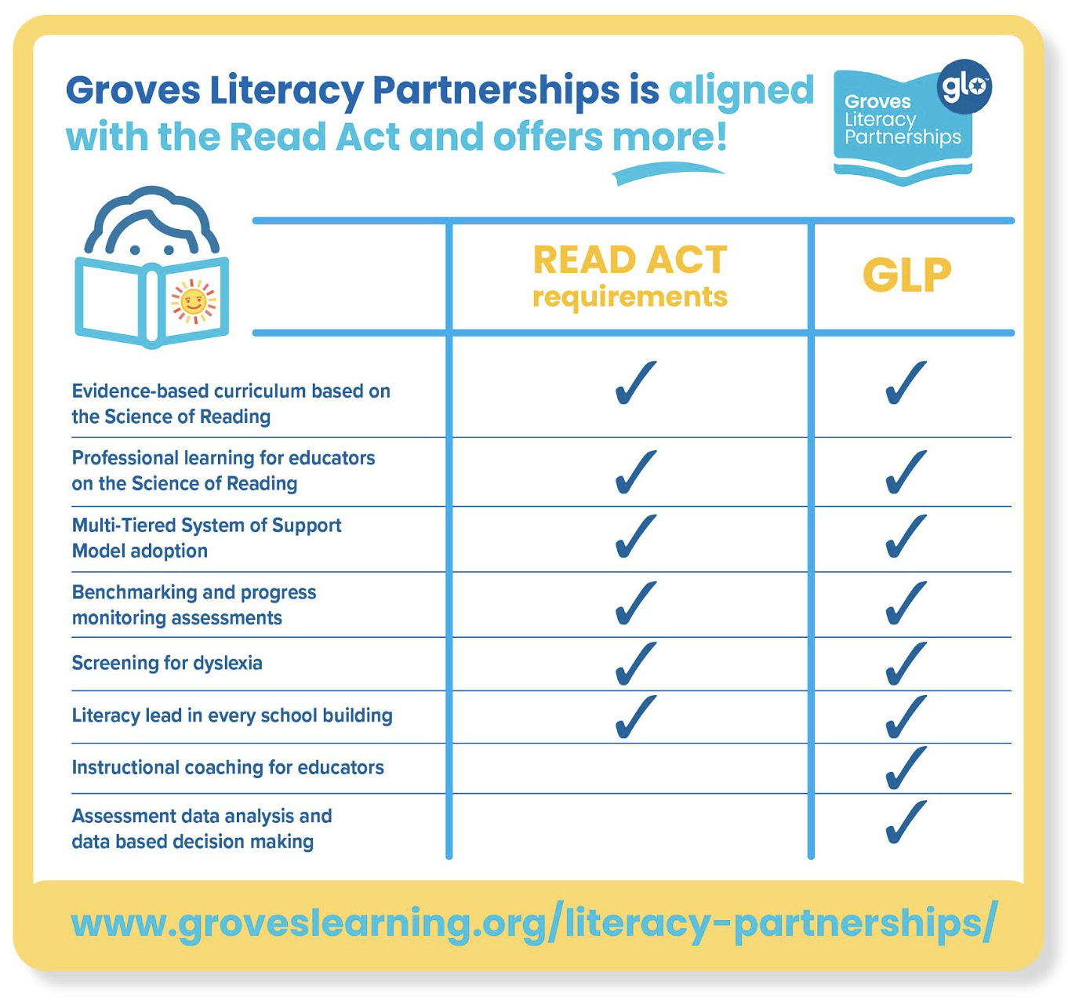
Groves Literacy Partnerships®
Notes:
Erin
ntionist and parents

Slide 29
Ways to Stay Informed as a School Leader
Groves Literacy Partnerships®
Join the Reading League MN
Reading League Newsletters and Publications
Article Recommendations:
Teaching Reading is Rocket Science - Moats
Podcasts
Emily Hanford Series
Melissa and Lori Love Literacy
Science of Reading - Amplify
Key Researchers
Louisa Moats, David Kilpatrick
Notes:
Di

Slide 30
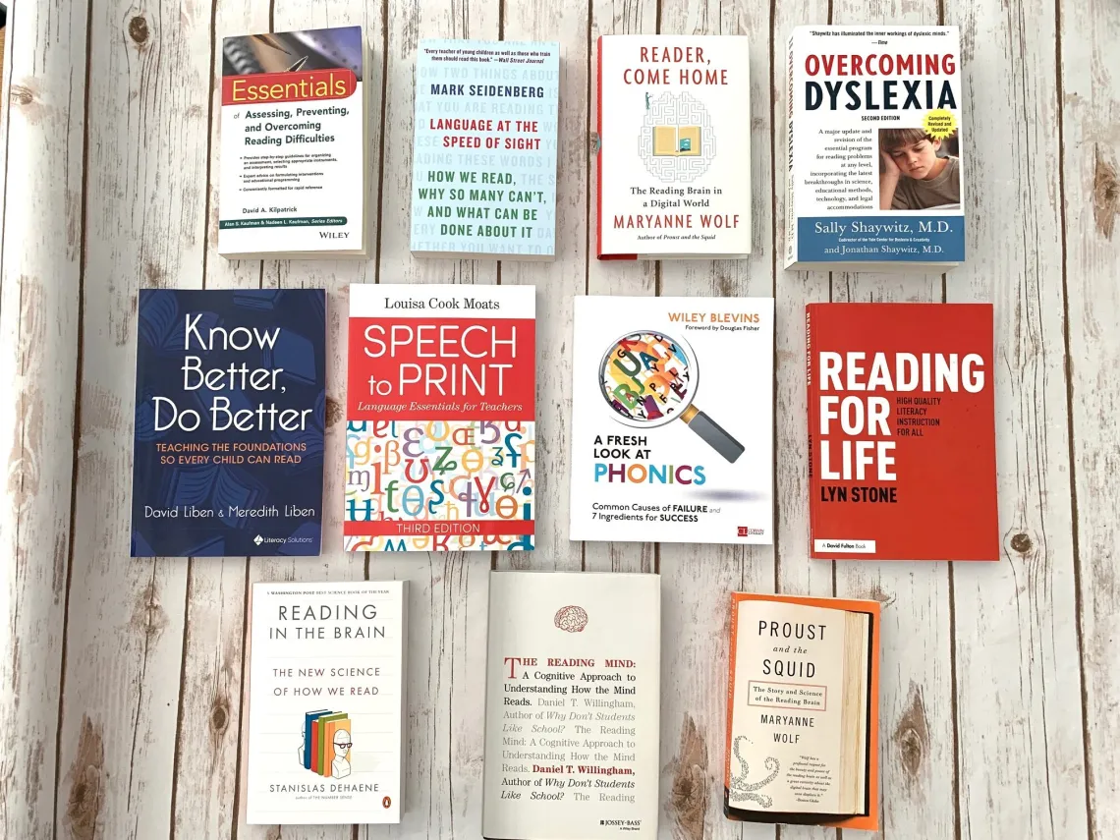
Provide Professional Learning for your Team
Groves Literacy Partnerships®
Create a literacy lead or team
Book Study
Share articles and podcasts
The Reading League - Defining Guide
Provide professional learning on the science of reading
GLP offers 2 hour PD sessions
Notes:
Erin
Good leaders make leaders. Your handout includes suggestions.

Slide 31
Share with your group
How do you plan to stay informed about the science of reading?
How do you plan to bring the science of reading to your teachers?
REFLECTION SHEET
Think &
Share
Notes:
Erin

Slide 32
Analyze and Adjust Assessments
Notes:
Di

Slide 33
Analyze and adjust assessments
Groves Literacy Partnerships®
Why do we assess?
Evaluate students and school wide progress
Inform instruction (small group and pull out intervention)
Assessment Programs
aimswebPlus, FastBridge, and more
Types of Assessments
Benchmarking
Progress monitoring (every other week - at risk students)
Curriculum Based Assessments (Unit assessments)
Notes:
Di
Why do we assess? To get a temperature of how students are doing in the building
3x a year
PM those below grade level

Slide 34
Share with your group
Did you have an “ah-ha!” moment about assessments?
REFLECTION SHEET
Think &
Share
Notes:
Di

Slide 35
Analyze curriculum
Notes:
erin

Slide 36
School Yourself on the Science of Reading
Groves Literacy Partnerships®
We have a problem: EdWeek Research Center (2020) reported that district or school leaders select 92% of the reading programs used in classrooms; however, the most popular programs selected are unsupported by the science of reading research.
Notes:
Erin

Slide 37
Do you have evidence based structured literacy curriculum?
Groves Literacy Partnerships®
MN READ ACT is going to provide a list of approved structured literacy curriculums - January 1, 2024
Reading League Curriculum Evaluation Tool
EdReports
Notes:
Erin

Slide 38
Share with your group
Share with your group what curriculum you currently use in your school. What is working well and what would you like to improve?
REFLECTION SHEET
Think &
Share
Notes:
Erin

Slide 39
Redesign Schedules
Notes:
Di

Slide 40
Redesigning Schedules
Groves Literacy Partnerships®
Scheduling enough time for ELA
Recommend 90-120 mins
Scheduling for Tier 1 Full Group and Tier 1 Small Group
Pull Out Intervention should not occur during Tier 1 instruction
Time for teacher collaboration
Notes:
Di

Slide 41
Set a Culture of Literacy
Notes:
Erin

Slide 42
School Leaders Set a Culture of Literacy
Groves Literacy Partnerships®
“Good leaders must communicate vision clearly, creatively, and continually.
However the vision doesn’t come alive until the leader models it”
- John C. Maxwell
Notes:
Erin

Slide 43
Culture of Literacy
Groves Literacy Partnerships®
# 1 Set a School Wide Goal or Vision
Notes:
Erin

Slide 44
Wildly Important Goal
Groves Literacy Partnerships®
Every student will be at, or above, grade level in reading
RELENTLESS FOCUS ON LITERACY!
Notes:
Di
This is the goal that GLP lives. Additionally, we will support your goal with all our work together. You can set a goal like this for your school

Slide 45
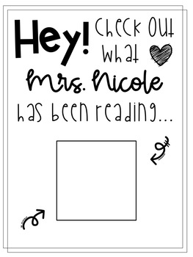
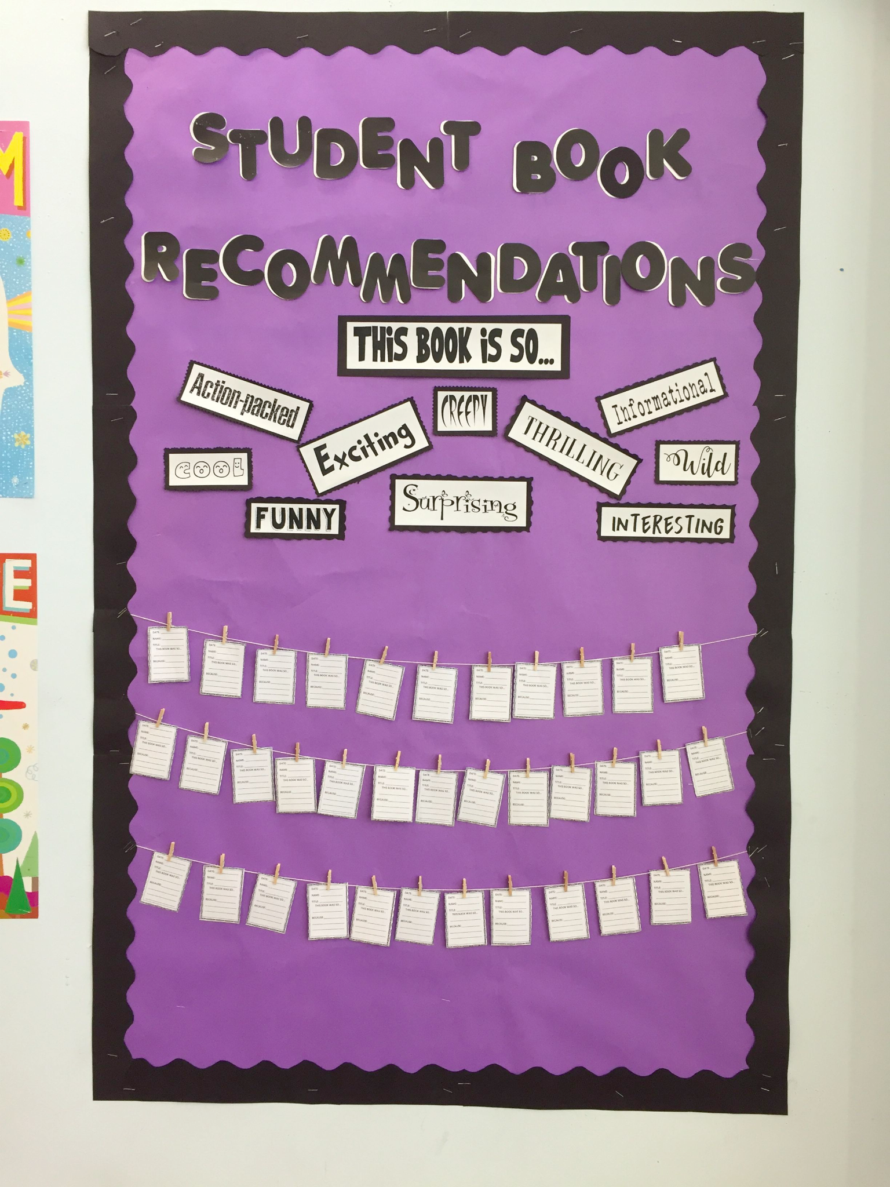
Culture of Literacy
Groves Literacy Partnerships®
#2 Publicly Celebrate Literacy
Word of the Day - School Announcements
What I’m Reading Door Sign
Book Reading Goals per Classroom - Competition
Have an interactive school community reading board - Book Recommendations
Notes:
Erin

Slide 46
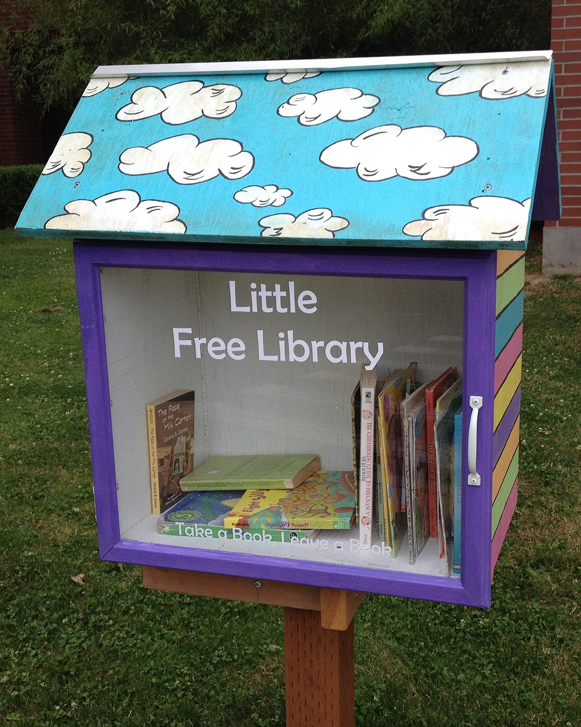
Culture of Literacy -
Groves Literacy Partnerships®
#3 Literacy Focus/Projects
Go to classrooms and model a love for literacy -
Mystery Reader
Organize literacy events
Put a Little Free Library box for in front of your school
Create a Literacy Team to lead the effort!
Notes:
Di
Family literacy nights, book exchanges, reading contests, author/character dress up days are great opportunities for schools to promote positive reading habits and create a stronger culture of literacy in their community.
Family literacy nights, book exchanges, reading contests, author/character dress up days are great opportunities for schools to promote positive reading habits and create a stronger culture of literacy in their community.

Slide 47
Word Collector
Activity
Notes:
Erin
Mystery reader, pass out slips of paper, finds a rich word….add to it. Setting the stage for

Slide 48
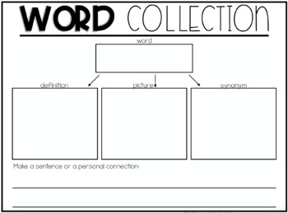
Read A Loud
Groves Literacy Partnerships®
Use Rich Text
Interactive Read Aloud
Model Metacognition
Vocabulary and Comprehension
Notes:
Erin
Review of data to collection tools is part of the decision tree
Review of communication - we do have these tools to support schools. Make sure we remind people of what those are and going to use them - on the LMS ; communication with parents about how we are being systematic with the steps

Slide 49
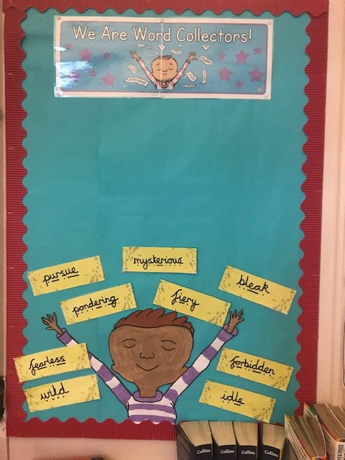
Create a school wide
Word Collector
Bulletin Board
Groves Literacy Partnerships®
Notes:
Di

Slide 50
Share and Exit Ticket
What have you done in your school to promote a culture of literacy?
What is one thing you are going to
try when you go back to school?
REFLECTION SHEET
Think &
Share
Notes:
Erin

Slide 51
Conclusion
Groves Literacy Partnerships®
BOOK DRAWING!
Jump in and try something new from the goal list you created
Partner with us!
Notes:
Di
Book drawing
We encourage you to implement something that you learned today in your school
If you are interesting in becoming a partner school or having us provide PD to your school email us or connect with us after this session, We would love to partner with you! We offer 2 hour PD sessions for non-partner schools.

Slide 52
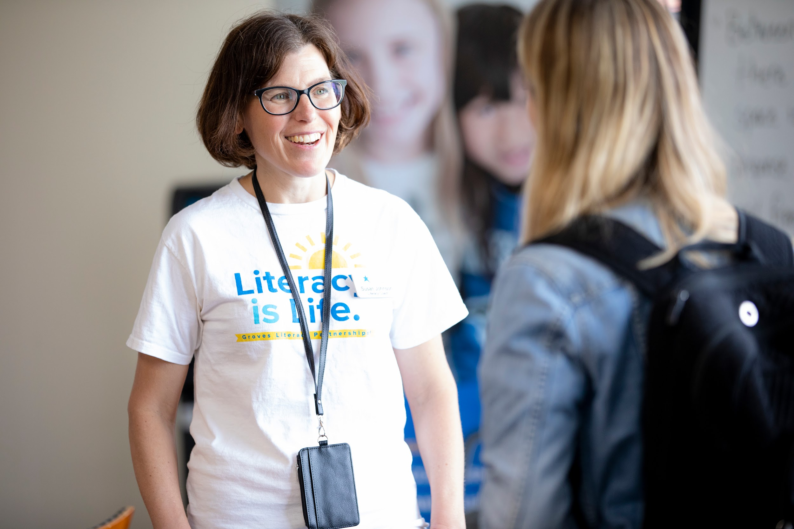
Question and Answer Time
Groves Literacy Partnerships®
Notes:
Please let us know if you have any questions

Slide 53
Thank you!

