Slide 1
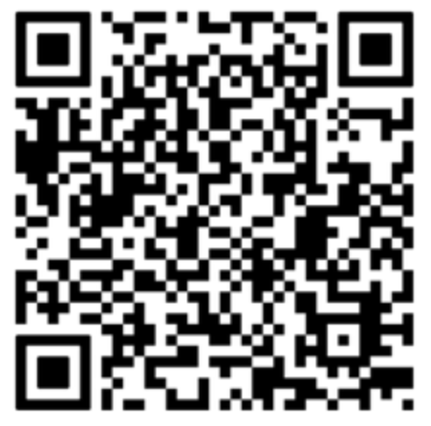
Focusing on intentionality in assessments, differentiation, and pacing to drive student success.
Individualized Learning Plans: What Teachers Need to Know

Slide 2
Introduction
Shea Bruce, M.A.
Director of Curriculum and Instruction at St. Pascal Regional Catholic School
9th year in education, 8th at St. Pascal Regional
Former Kindergarten and third grade teacher
K-12 Reading License
Alum of University of St. Thomas and St. Mary’s University
sbruce@stpascalschool.org

Slide 3
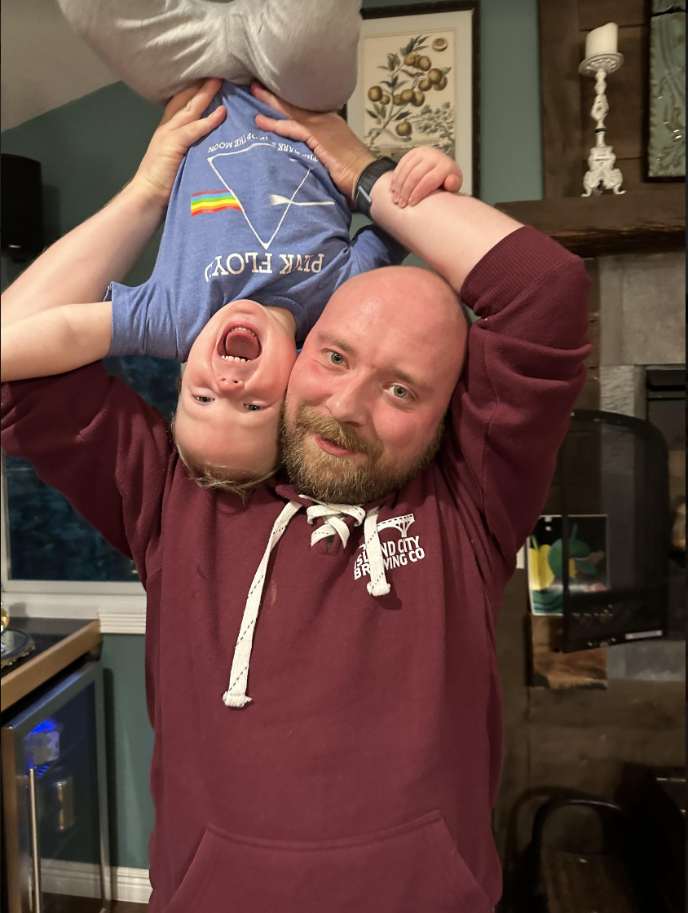
My Guiding Lights
Jacob & Liam
My faith
Family & Friends
Crossword puzzles
Books
Scary movies & Bob’s Burgers

Slide 4
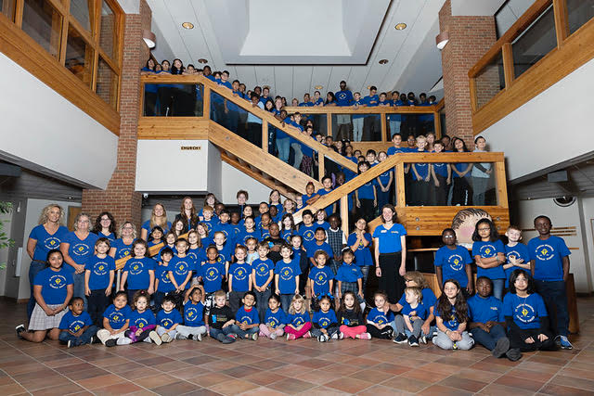
My Other Guiding Lights
St. Pascal Regional Catholic School
We Believe, Learn, Love, and Connect

Slide 5
Agenda
Looking back on individualized learning
The “why” behind ILPs
Diving into NWEA MAP Test strands
Writing SMART strategies
Thinking through your curriculum
Call to action/next steps

Slide 6
Individualized Learning…not a new concept!
Differentiation, spiraling, scaffolding, intervention time, WIN, ect.
I’ve done it:
Stations
Spiraled homework
Small groups, volunteers
I didn’t understand the WHY and I wasn’t as focused as I should have been

Slide 7
Intentionality
predicates
success.

Slide 8
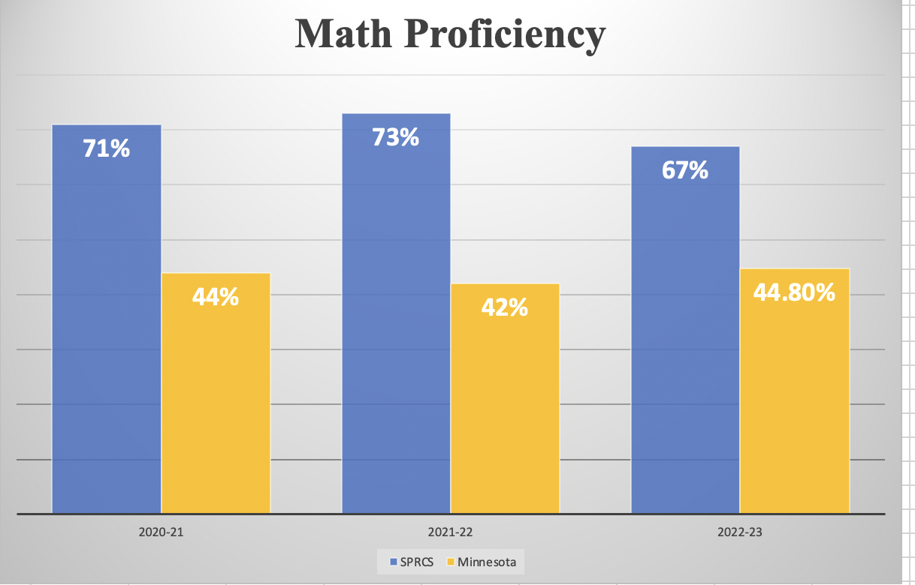
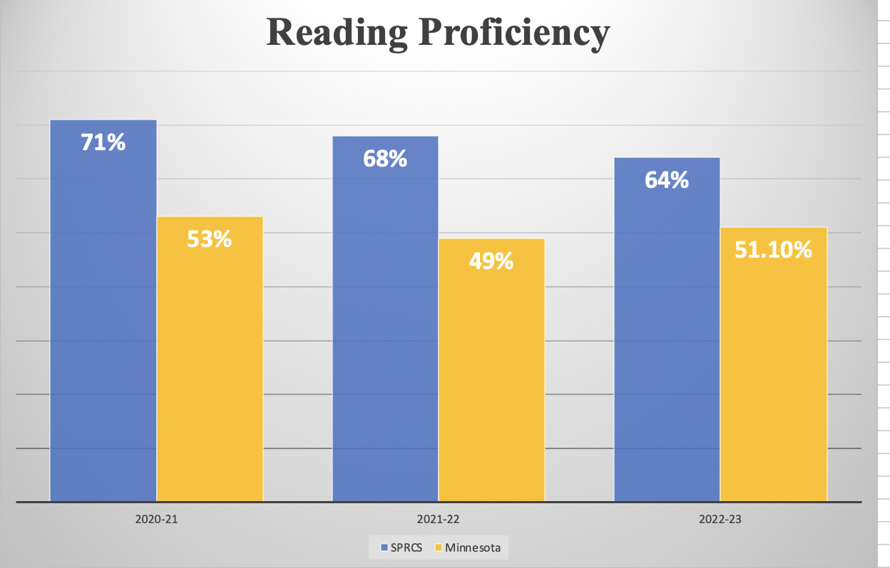
And we are successful

Slide 9
We are intentional about…
What data we look at: which test scores and assessments tell the best story?
How we differentiate instruction: what students are ready for what concepts?
How we share this information with families: What can they do at home to continue their student’s learning?

Slide 10
Assessments
Curriculum-based measures
Formal and informal observations
Blended Learning Platforms
Exit tickets / End-of-unit assessments
NWEA MAP - Fall, Winter, Spring

Slide 11
Differentiated learning
“Strands” within MAP test
Math: Numbers & Operations, Algebra, Geometry & Measurement, Data Analysis
Reading, K - 2: Foundational Skills, Literature & Informational Text, Vocabulary Use & Functions, Language & Writing
Reading, 3-8: Literature, Informational Text, Vocabulary

Slide 12
Intentionally choose Whole Class & Personal Strands
AKA: “Focus Strands”
Whole-class strand: whole-picture view of your class. Which strand scored the lowest on average?
Personal strand: laser focus. Which strand did each student score the lowest on?
Each student will have 4 “focus strands” - 2 for math, 2 for reading.

Slide 13
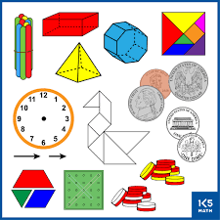
Intentional about differentiation
Third grade whole-class strand:
Geometry & Measurement
…but which part?

Slide 14
NWEA MAP Learning Continuum

Slide 15
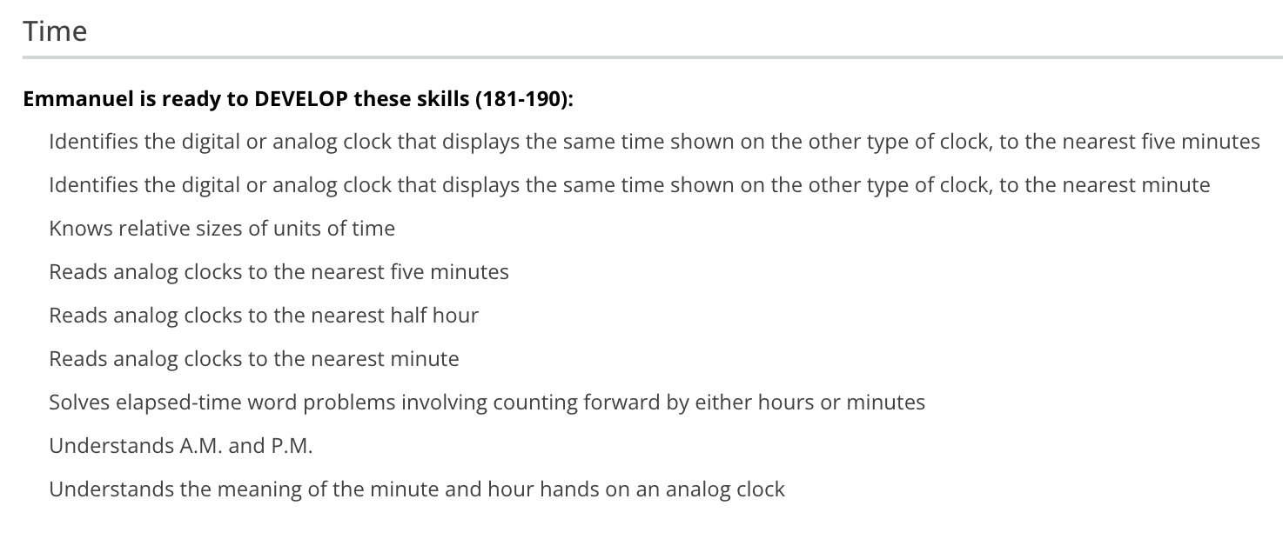
Intentionally choose a skill

Slide 16
Does my curriculum teach this skill?
Yes - before the next testing window
Yes - after the next testing window
No - it’s a lower grade level skill
No - it’s a higher grade level skill

Slide 17
Does my curriculum teach this skill?
Yes - before the next testing window
Do not write on the ILP, you will teach it explicitly and intentionally to every student
The assessments you are already planning should check for mastery

Slide 18
Does my curriculum teach this skill?
Yes - after the next testing window
A great idea to teach: plan for it, write it on the ILP
Use small groups
Give students “bonus problems” that include this skill
Include in Morning Meeting or “5 minute games”
Volunteers, tutors

Slide 19
Does my curriculum teach this skill?
No - it’s a lower grade level skill
A great place for an intervention: write it on the ILP
“Missing building block”
Small group, one-on-one
Progress monitored, assessed weekly
Moved on as soon as mastery is achieved

Slide 20
Does my curriculum teach this skill?
No - it’s a higher grade level skill
A great idea to teach: plan for it, write it on the ILP
Extension activities
Small groups
Tutors

Slide 21
Intentionally choose a skill
Does my curriculum teach this skill?
Yes, after the next testing window - not until March!

Slide 22
Write an intentional strategy
Skill: Telling time
Strategy: Once a week, in a small group, Manny will practice telling time with a manipulative clock. He will tell time to the hour and half hour until mastery, then telling time to the minute will be introduced.

Slide 23
This strategy is SMART!
Once a week, in a small group, Manny will practice telling time with a manipulative clock. He will tell time to the hour and half hour until mastery, then telling time to the minute will be introduced.
When/how often - grouping - specific materials - specific skill - leaving room for mastery and growth

Slide 24
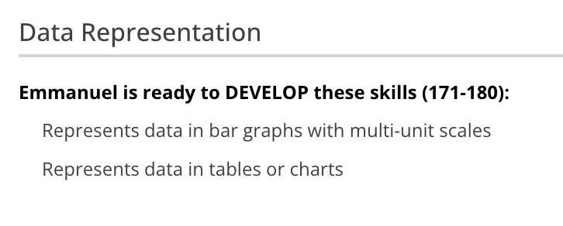
Personal Strand
Does my curriculum teach this skill?
No - our curriculum is severely lacking in Data Analysis!

Slide 25
SMART Strategy
On his weekly homework, Manny will get math problems that require him to read and analyze bar graphs . He will be called on to share his answers with the class.
He will receive a math packet with extra practice pages with this skill.
On iReady, he will be given assignments to practice this skill at his own pace.
Specific - timely - intentional - leaves room for mastery and growth
Small group is still an option, just not the only option!
Since the curriculum is lacking, spiraling is key

Slide 27
More Examples
ELA: K-2, 3-5, 6-8
Math: K-2, 3-5, 6-8
Whole folder
ILP template

Slide 28
Intentionally share learning with families

Slide 29
Your curriculum is a guide
All students deserve, need, will get, grade-level curriculum
You should teach your curriculum as well as this individualized learning

Slide 30
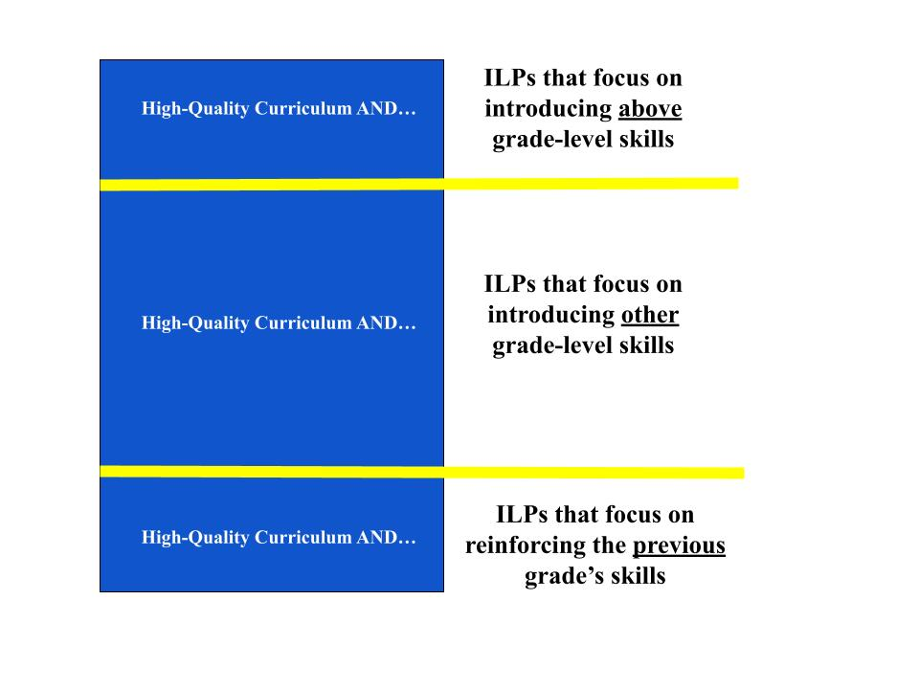
Learn

Slide 31
Learn

Slide 32
Intentional about your planning
Curriculum pacing
Need to know when you are getting to all these concepts
Daily schedule
Tight transitions and pacing to fit it all in
No wasted time!
10 minutes is better than no minutes!

Slide 33
My call to action for you
Scope and Sequence
Using your curriculum, plan out your whole year
Add in review and testing dates
Special dates in your school year
Calendar template
Learning continuum
Print out from MAP
Compare with your S&S to see when skills will be taught

Slide 34
Whole-Class Strand
Next step:
Print out your NWEA MAP test scores
Determine your class’s lowest strand, on average
Refer back to your learning continuum to find the specific skills in that strand
Choose one that you “don’t usually get to” and find a way to fit it into your schedule

Slide 35
Send it to me!
sbruce@stpascalschool.org

Slide 36
Q & A

