Slide 1
The essentials for successful implementation and use of NWEA MAP data to drive targeted academic success for the teaching team
Individual Learning Plans: What Do Administrators Need to Know

Slide 2
Introduction
Inna Collier Paske, M.S. & M.A.Ed.
Principal at St. Pascal Regional Catholic School (SPRCS)
6th year as a principal at SPRCS
Former K-12 School Counselor, ESL Teacher
icollierpaske@stpascalschool.org

Slide 3
SPRCS Pillars

Slide 4
Community We Serve
From Radius Report 4/9/2021 | 1 mile | 3 miles | 5 miles
Ethnicity (non-white) | 65% | 60% | 51%
Households w/ kids under 18 years old | 34% | 33% | 30%
Median Income | $48,839 | $52,788 | $57,466
Income under $49,999 | 51% | 47% | 43%

Slide 5
Community We Serve

Slide 6
We believe in Academic Excellence.
Using high quality curriculum
Teaching grade-level standards
Scaffolding and enrichment when needed
Differentiation vs. universal design in interventions
Growth mindset
Lifelong learning mentality

Slide 7
SPRCS NWEA MAP Test Data

Slide 8
Learn More
“Examining COVID-19 learning recovery: A case study in individualized learning plans” By Risa Sackman, Felix Fernandez and Liza Rodler

Slide 9
Agenda
ILP Objectives & Form
ILP Process
Setting Up Teachers for ILP Success by an Administrator
Benefits of ILP Process
Next Steps

Slide 10
Example & ILP facts
ILP Objectives & Form

Slide 11
ILP Objectives
Academic Goals: Create SMART math and reading goals for each student.
Social-Emotional Growth: Set affective goals for students in SEL ILPs.
Family & Student Engagement: Share and review ILPs with families during conferences.
Dynamic Plans: Review and adjust ILPs twice a year (winter & spring).
Easy Access: Store ILPs in a shared Google Drive folder.
Implementation Monitoring: Observe teachers to ensure ILPs are actively used.

Slide 12
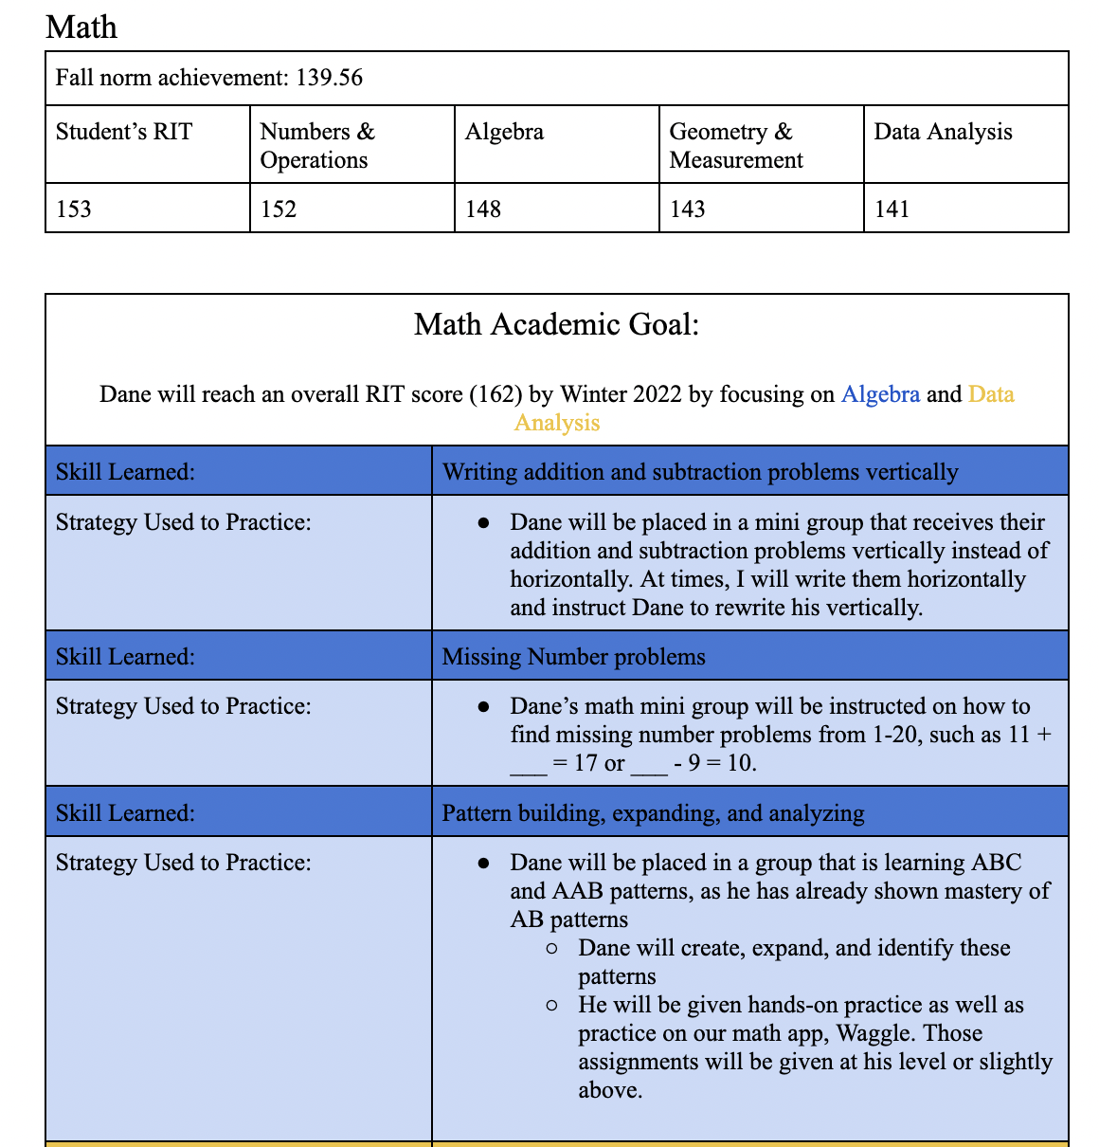
Example of an ILP
ILP Templates

Slide 13
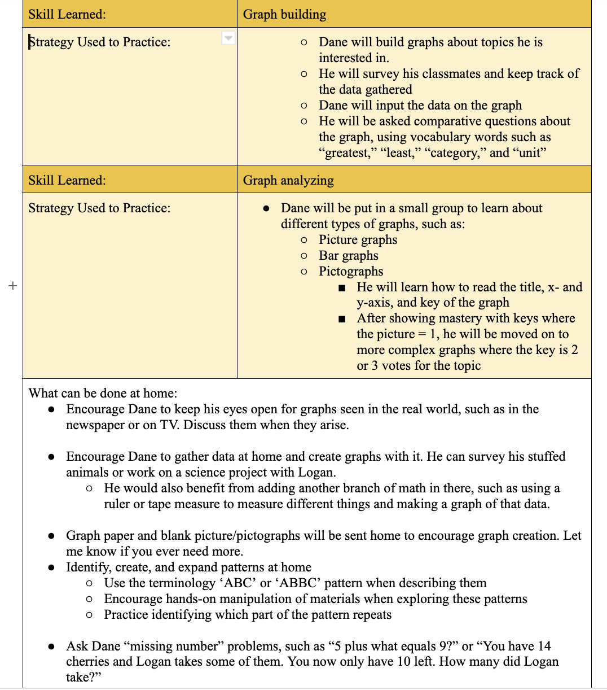

Slide 14
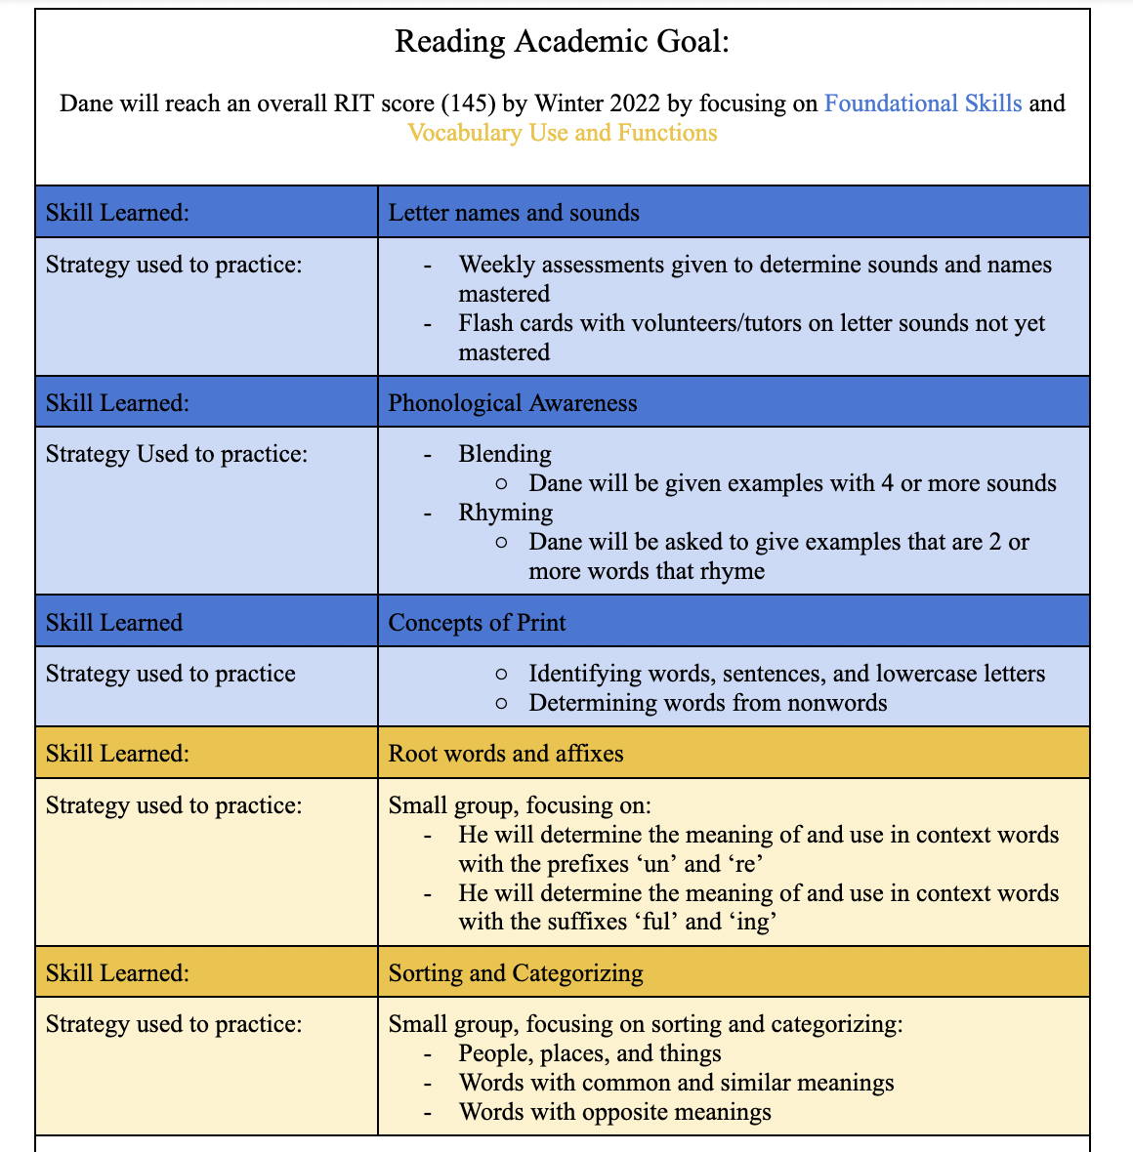
Example of an ILP
ILP Templates

Slide 16
ILP Form Facts
Our ILPs are based on NWEA MAP data.
ILPs are stored in the School Shared Google Drive.
They have two goals for math and reading. Goals are based on the individual projected NWEA MAP scores.
The skill is chosen from the learning continuum.
Strategies reflect differentiation for each student.
At the end there is a recommendation of what families can do at home to help with that specific skill.
After winter and spring testing teachers write goal reflections.

Slide 17
Key Advantages to Using NWEA MAP data as a foundation for ILPs
Objective Benchmarking
Personalized Learning
Growth Monitoring
Data-Informed Decisions
Parent Engagement
Accountability and Transparency
High Test Scores

Slide 18
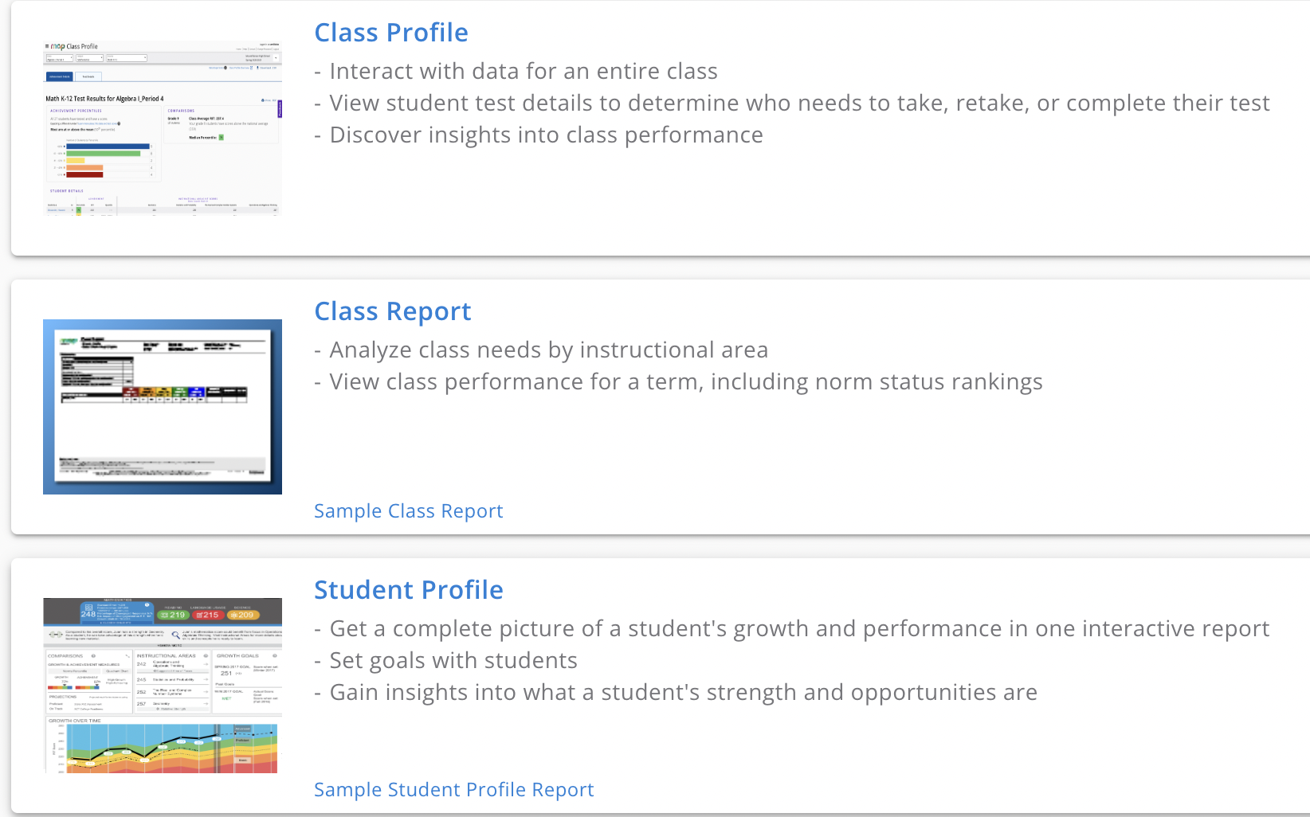
NWEA Reports We Use

Slide 19
Why to Use Google Drive for ILPs
Accessibility: Anywhere, Anytime Access
Collaboration: Real-time Teamwork
Resource Sharing: Easy Sharing of Materials
Organization: Structured Document Management
Version Control: Track and Revert Changes
Security: Protect Student Data
Cost-Efficiency: Free Teaching Tool
Integration: Seamlessly Works with Google Tools
Efficient Feedback: Streamlined Feedback
Data Backup: Reliable Resource Backup
Bonus: Google Docs has a spell check & mail merge capabilities

Slide 20
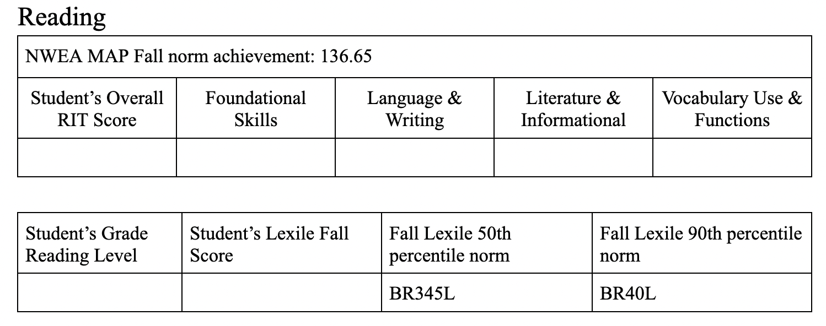
Reading Data
Go to MAP Growth Reports -> Class profile

Slide 21
Student NWEA MAP Achievement Norms

Slide 22
Determining classroom goal and individual goal
Check every strand of how many students are below Fall achievement norm. The strand that has the most students who are below the norm will be the classroom strand.
The strand that is the lowest besides the classroom strand should be the individual strand.

Slide 23
Examples of strategies:
Small group instruction
Working one-on-one
Modified assignment during a whole class instruction
Individualized packets, etc.
Write what can be done at home to practice those skills.
Go to MAP Growth Reports (click to watch how to access reports) -> Student profile for focus skill

Slide 24
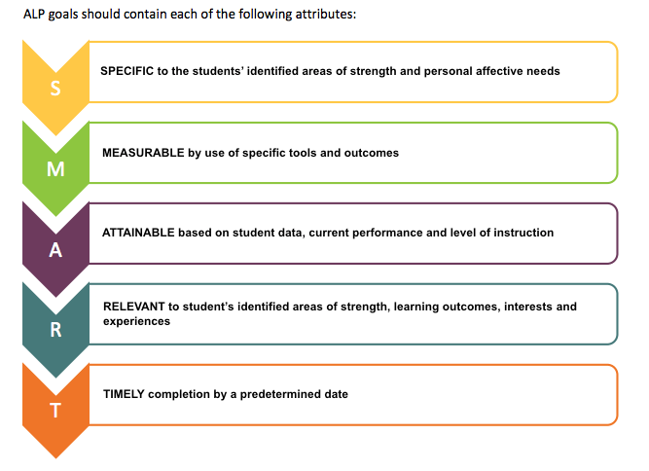

Slide 25
Family Connection
Student success is 30% what happens in school and 70% what happens at home.
ILP Cover Sheet for Home
This Photo by Unknown Author is licensed under CC BY-NC-ND

Slide 26
Goal Reflection Example

Slide 27
ILP Objectives, Flow, & Considerations
ILP Process

Slide 28
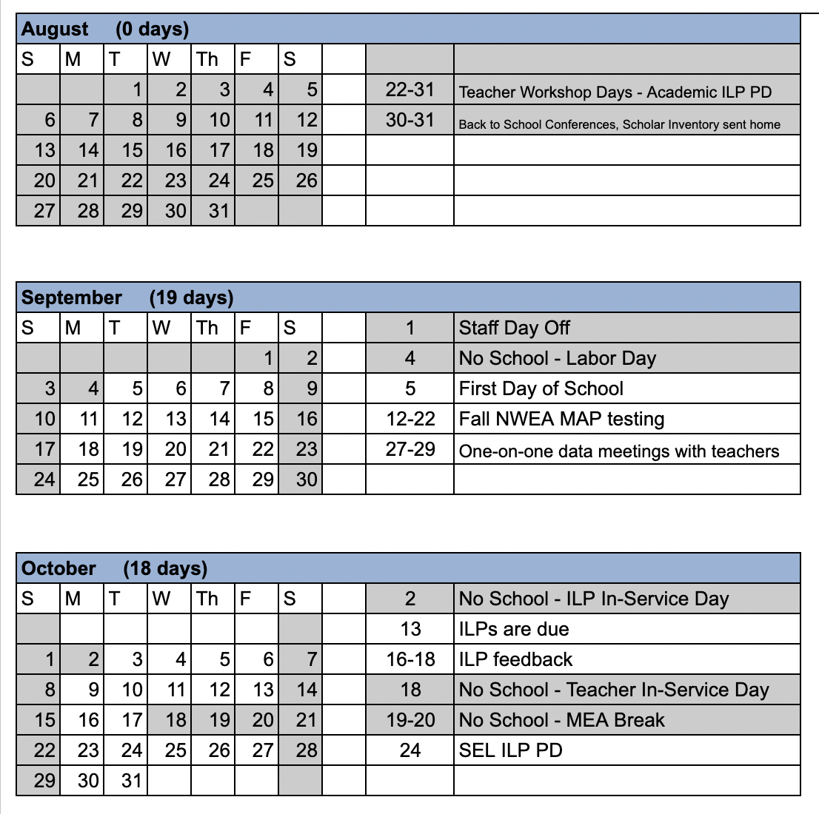
ILP Process Calendar

Slide 29
ILP Process Calendar

Slide 30
ILP Considerations
Give teachers access to ILP process templates for their grade-specific ILP template.
Plan to have three ILP work-days throughout the year.
Have a floating sub to help teachers finish ILPs, and sub for them when meeting with teachers one-on-one to go over the data (3 times a year).
Provide PDs how to write ILPs, differentiation vs. universal design.
Give feedback on their ILPs once they are written.
Keep teachers accountable how they implement their ILPs through observations.

Slide 31
One-on-one data meetings, reflections, & evaluations
Setting Up Teachers for ILP Success by an Administrator

Slide 32
One-on-One Meetings
45-60 minutes per teacher (3 times a year)
Require a whole classroom data analysis sheet already done prior to the meeting by the administrator.
After winter and spring testing teachers must do self-reflections prior to the meeting.
The process requires growth mindset and problem-solving attitude for both parties.
Next steps and follow up is crucial.

Slide 33
Grade Data Analysis Example

Slide 34
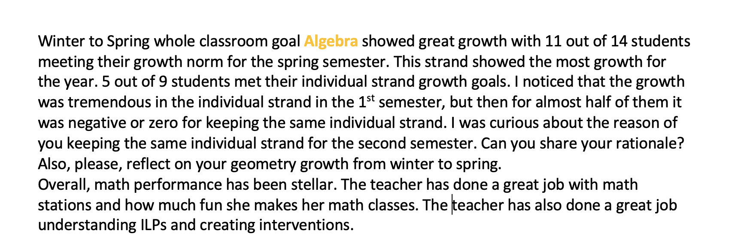

Slide 35
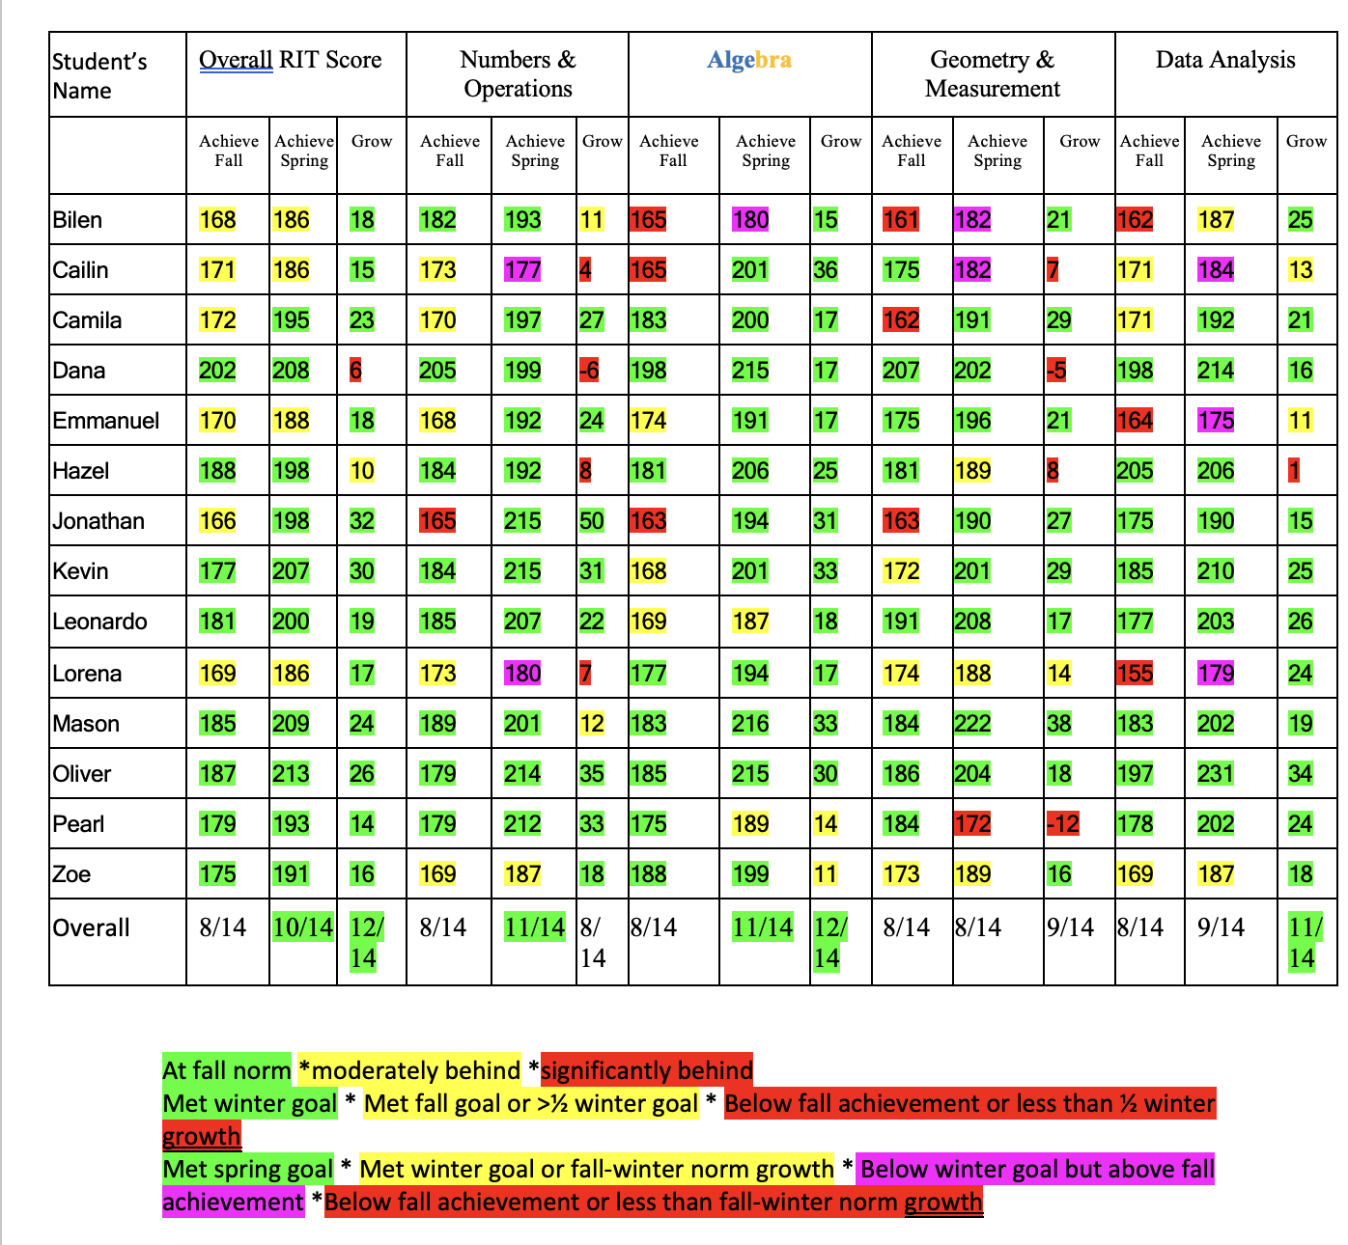

Slide 36
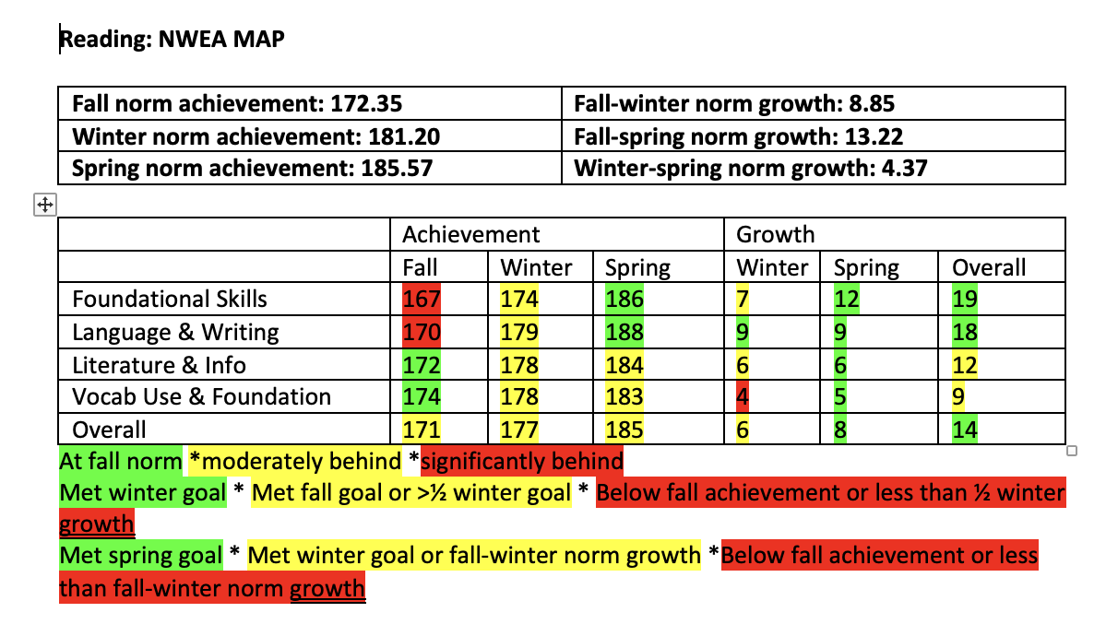

Slide 37
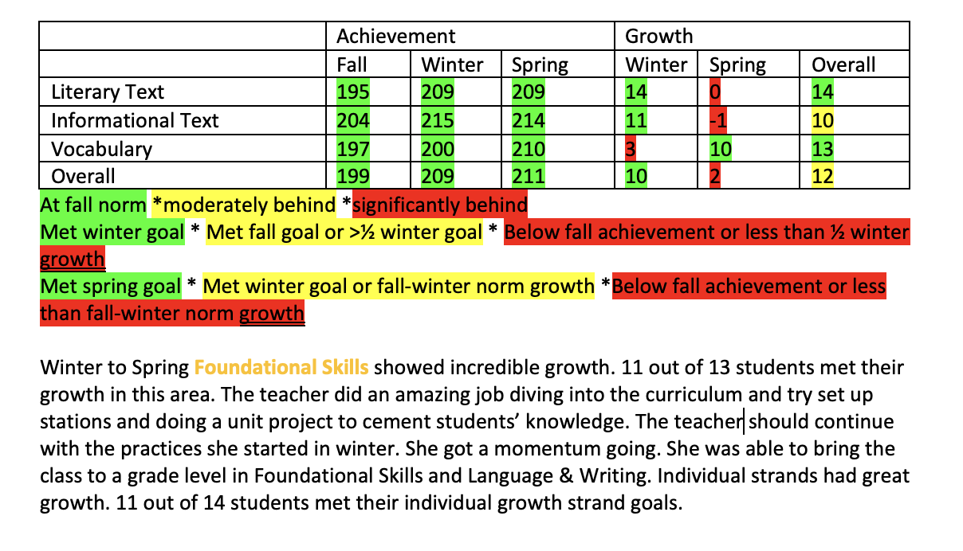

Slide 38
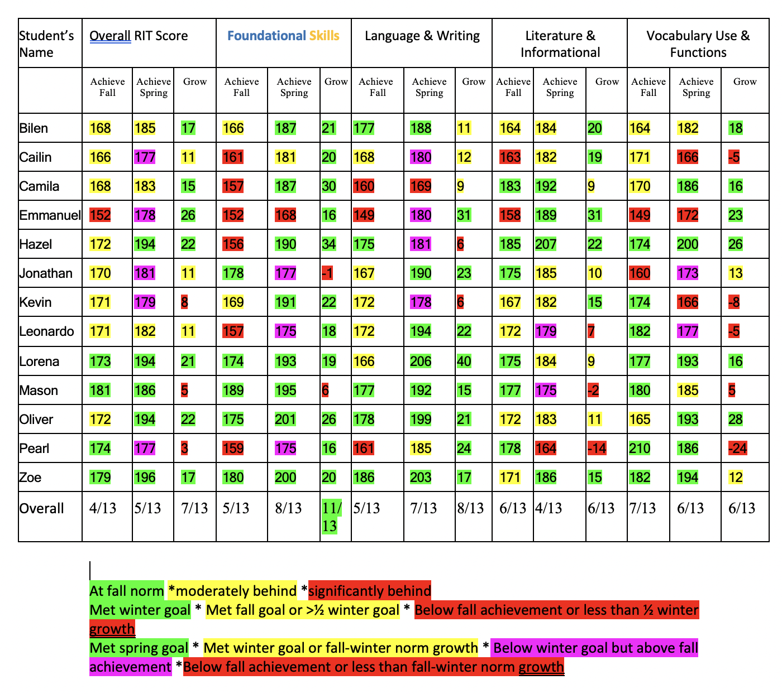

Slide 39
Teacher Reflection Example
My scores showed that I needed to try something new in ELA. I am a big fan of small groups and stations. They seemed to come so easily in math. They aren’t as easy or concrete with ELA. I was told they couldn’t/shouldn’t be done. I took that as a challenge and through trials found groups that worked, stations that were independent, and repeated these skills over and over. The MAP testing data helped me a lot to create these groups. Though we are supposed to have individual goals, I found attaining to every single student in a different way to be a nearly impossible task. For big topic learning I grouped students, it made sense to have peers work on a skill together if they both need practice with the same skill. Then, when I notice certain students still aren’t getting it or they need practice with the prefix not the whole word I focus in on that skill specifically with that one student. Sometimes through an individual homework assignment, other times one on one with me. It varied depending on the need. Starting with the groups allowed me to find the individual skills.
This spring I made official a document that I half created after winter scores. It’s my ILP calendar. During the ILP creation process I create a calendar of all of the things that I say that I am going to do with students or groups. I spread the activities out throughout the days. I rotate the days between math (Mon/Thurs) and reading (Tues/Fri). Then when I actually do them I cross them off and add notes to the document. I found this extremely helpful for tracking the ILP work and what needed to get done!

Slide 40
Benefits of Individual Learning Process for Supervisors:
Improved Test Scores: Data-driven proof of enhanced student performance.
Targeted Troubleshooting: Pinpointing skill or motivation issues for specific teacher support.
Enhanced Feedback: Tailored, actionable feedback for teacher growth.
Increased Student Engagement: Clear goals boost student investment.
Satisfied Parents: Personalized attention for all students.
Real-time Data Access: Instant, informative updates for parents.

Slide 41
Next Steps
Identify Enthusiastic Teachers:
Find interested teachers willing to pilot ILPs this year.
Feedback with NWEA MAP Data:
Provide feedback using NWEA MAP data through a whole-classroom review.
Teacher Self-Reflection:
Encourage teachers to reflect on their ILP process and its impact.
Staff Presentation:
Utilize data to present the results to the entire staff, gauging buy-in.
Questions and Support:
Reach out for any inquiries or assistance.

