Slide 1
The essential questions surrounding NWEA MAP test data interpretation, SMART goal setting, and tailored strategies for student success
Overview on Individual Learning Plans for Teachers and Administrators

Slide 2
Introduction
Inna Collier Paske, M.S. & M.A.Ed.
Principal at St. Pascal Regional Catholic School (SPRCS)
6th year as a principal at SPRCS
Former K-12 School Counselor, ESL Teacher
icollierpaske@stpascalschool.org

Slide 3
Introduction
Shea Bruce, M.A.
Director of Curriculum and Instruction at St. Pascal Regional Catholic School
9th year in education, 8th at St. Pascal Regional
Former Kindergarten and third grade teacher
K-12 Reading License
Alum of University of St. Thomas and St. Mary’s University
sbruce@stpascalschool.org

Slide 4
Agenda
The Essential Questions behind ILPs:
The “Why” behind ILPs
What are ILPs?
Which NWEA Reports do we use?
Who takes responsibility for the different steps of the process?
Where are ILPs stored?
When are ILPs written and shared with stakeholders?
How are the SMART strategies decided?

Slide 5
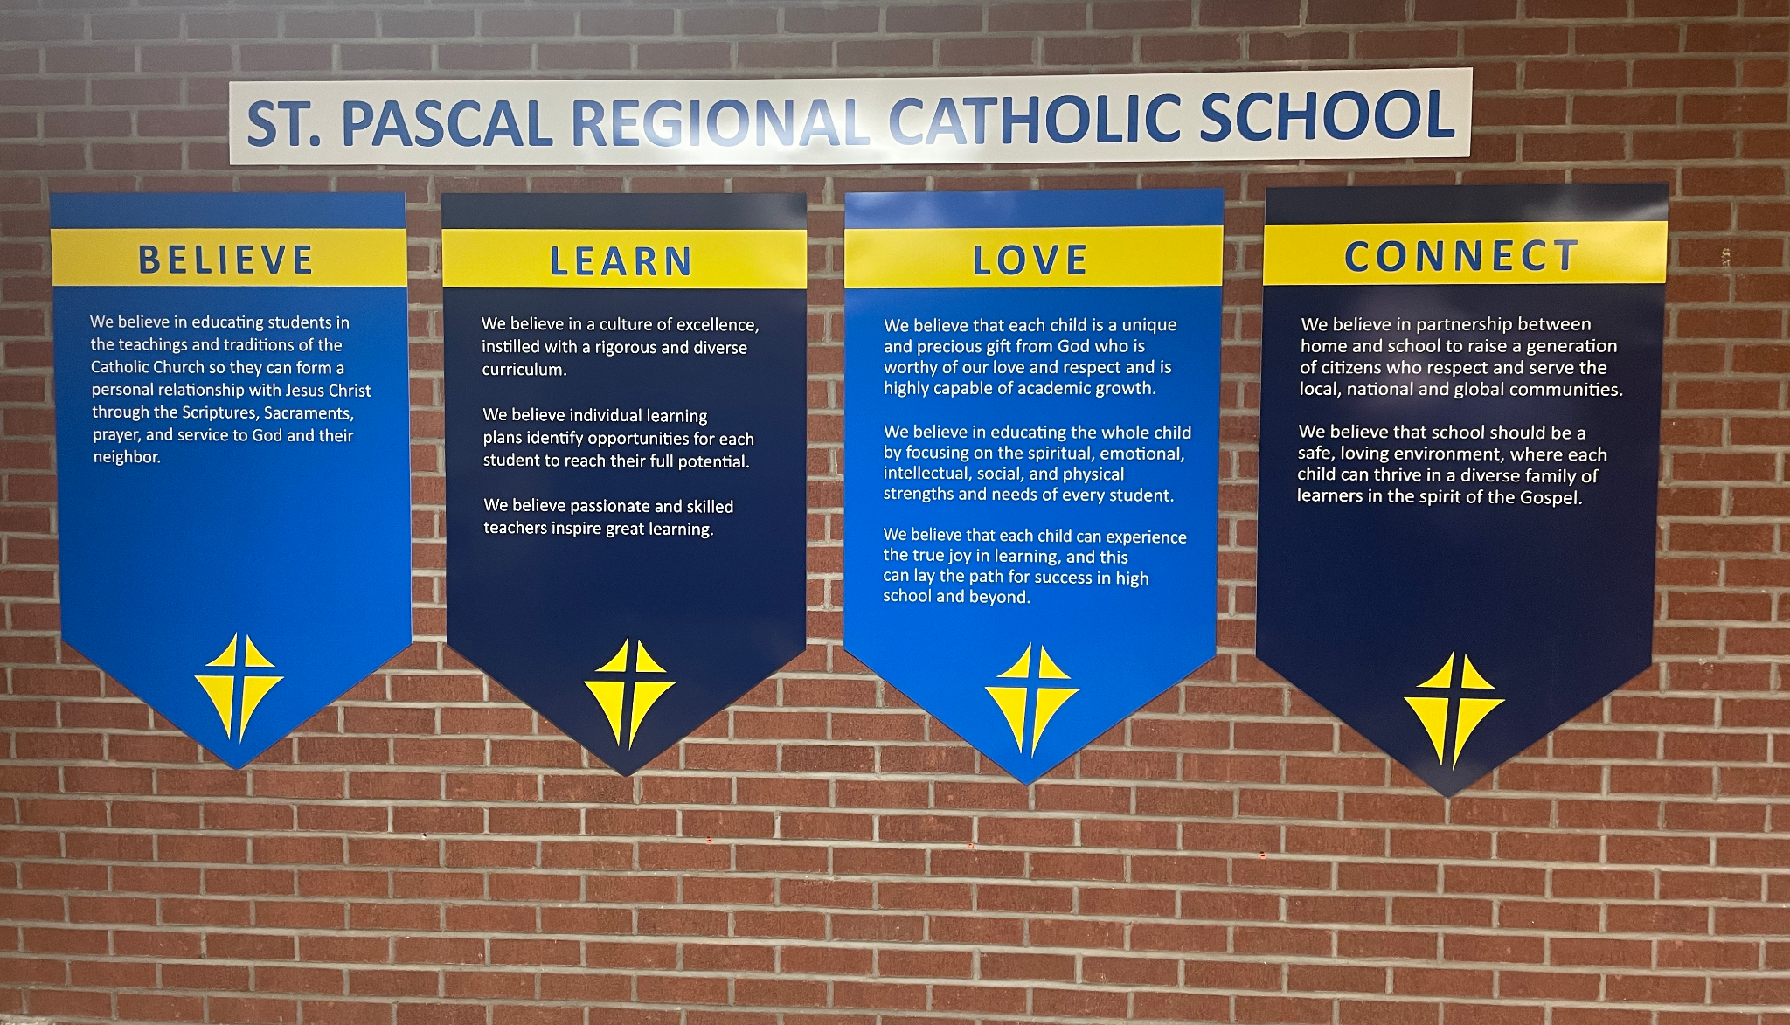
SPR - Pillars

Slide 6
Using high quality curriculum
Teaching grade-level standards
Scaffolding and enrichment when needed
Differentiation vs. universal design in interventions
Growth mindset
Instilling a life-long learning mentality
We Believe in Academic Excellence

Slide 7
Learn

Slide 8
Why?
Internalizing data and improving scores on the NWEA MAP test
Knowing what to teach next
Where students’ “missing building blocks” are
Ensuring differentiated instruction for all students in all grade levels
High-quality curriculum and the introduction of other skills
Connecting and communicating with families about their student’s learning
How can they help?

Slide 9
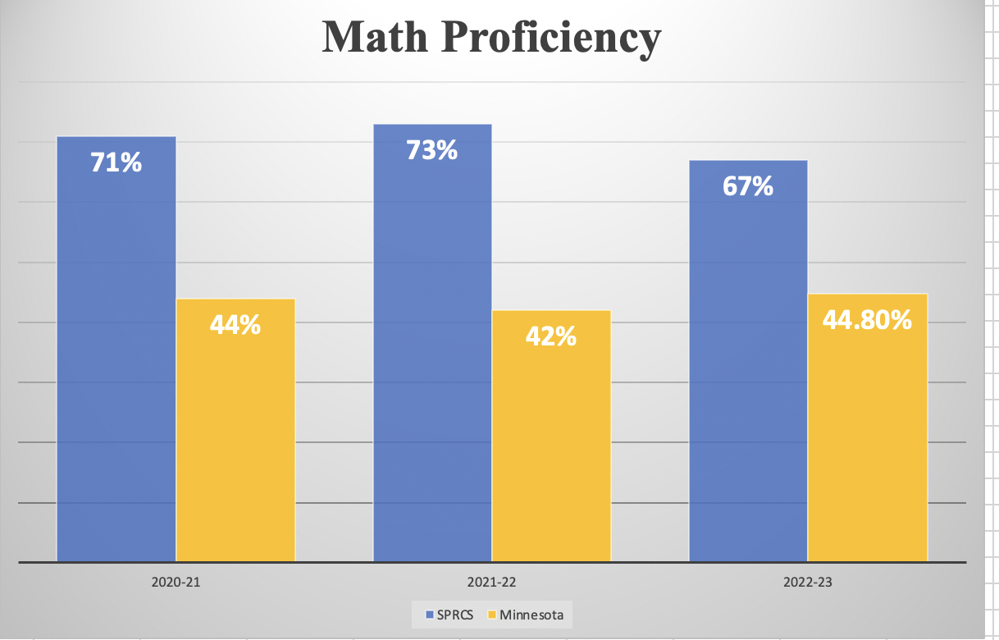
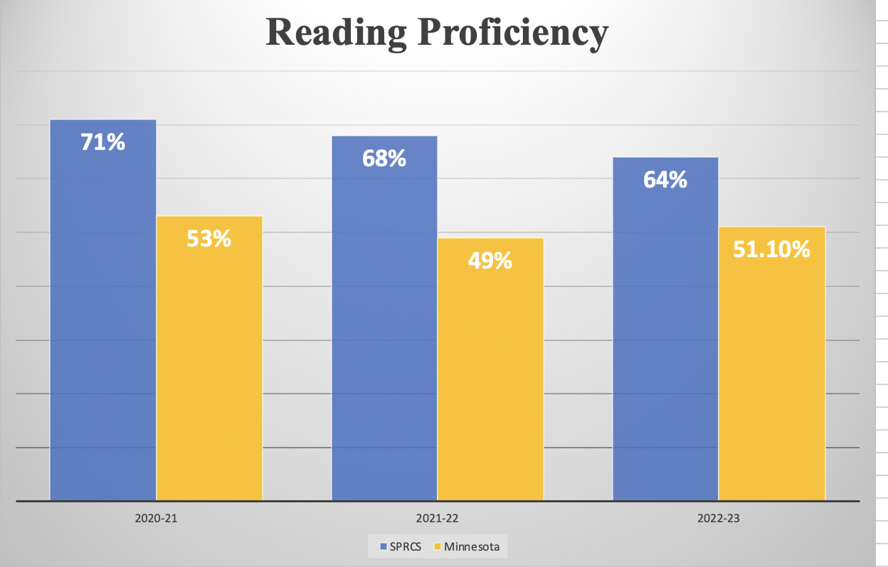
St. Pascal’s NWEA Test Data

Slide 10
What is an ILP?
Written document with SMART differentiation strategies the teacher will introduce between testing windows

Slide 11
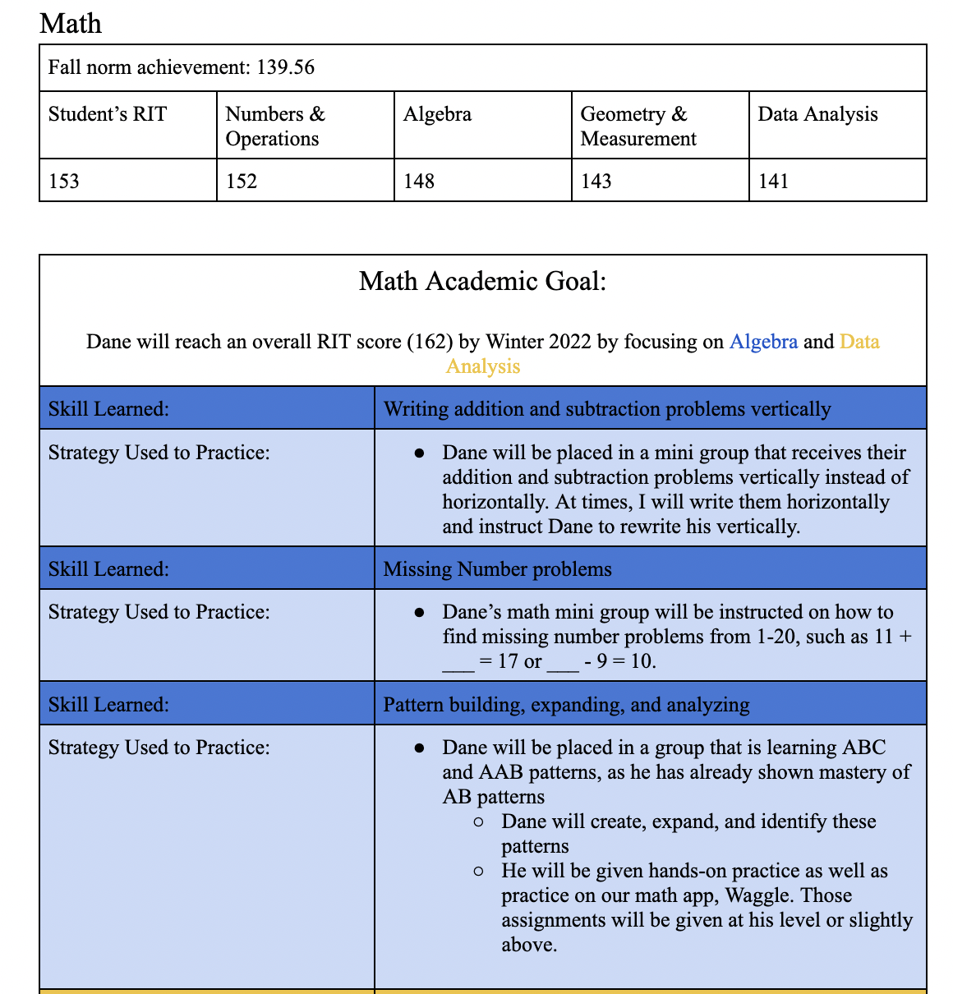
Example of an ILP

Slide 12
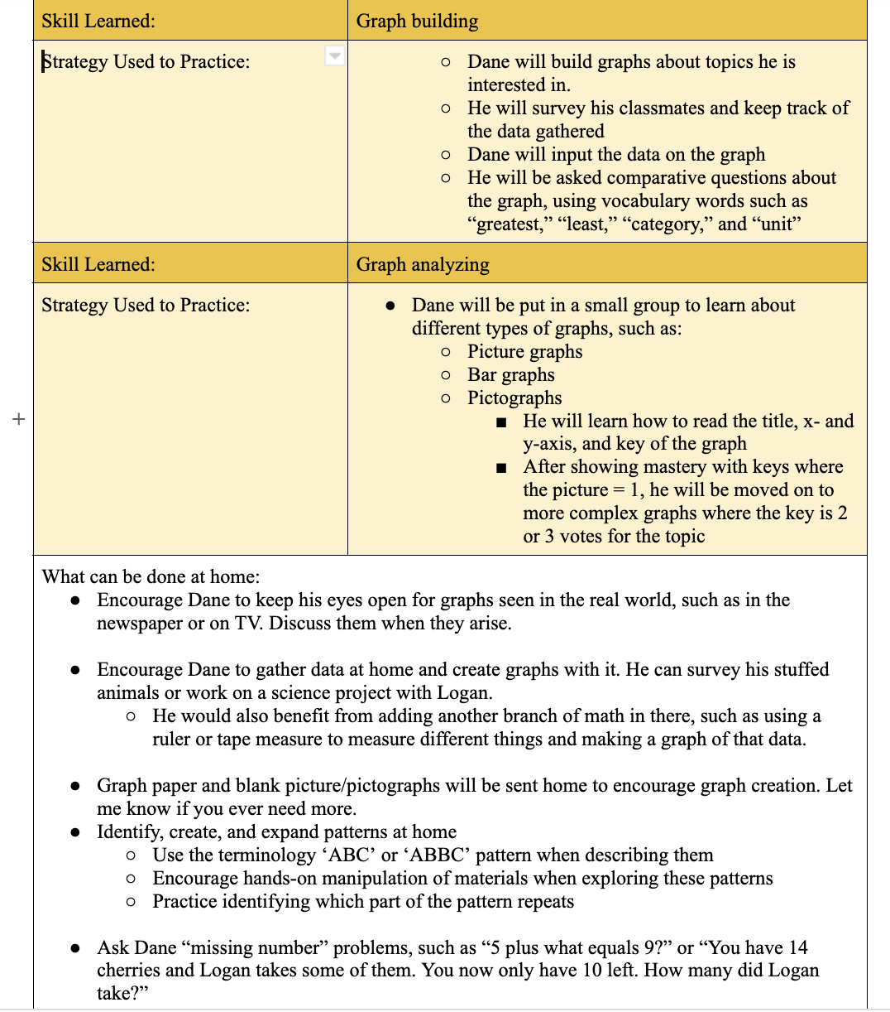
Example of an ILP, continued

Slide 13
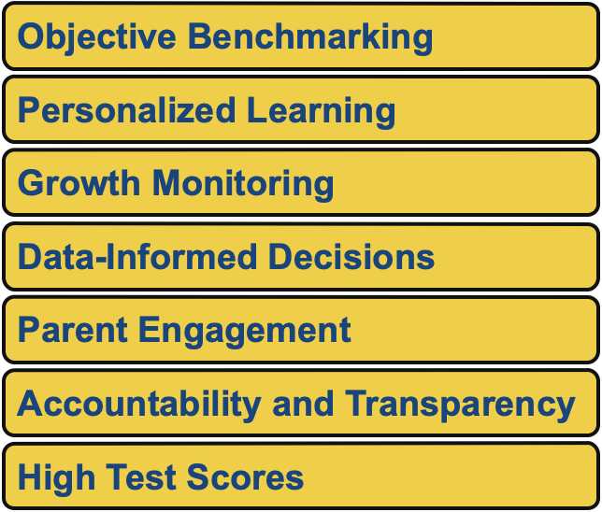
Why use NWEA Test data?

Slide 14
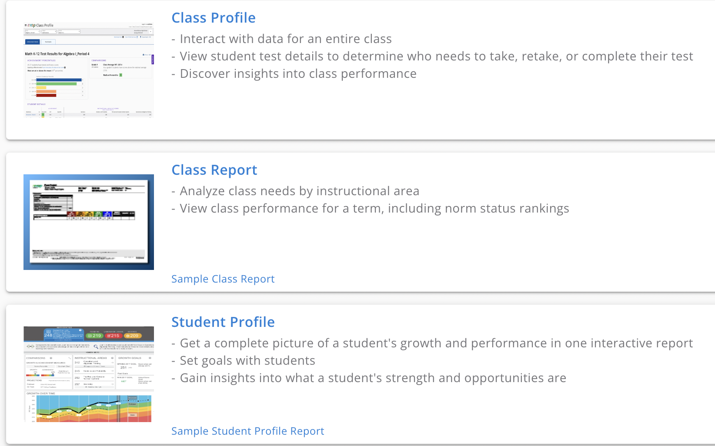
Which NWEA reports do we use?

Slide 15
Who is Responsible?
Administration
Scheduling professional development and ILP work days
Internalizing data, sorting it, and sharing it with teachers
Supporting teachers when they identify learning and curriculum gaps
Teachers
Internalizing data and their curriculum
Writing and implementing ILPs
Reflecting on which teaching practices worked and which did not

Slide 16
Who is Responsible?, continued
Students
Reading and understanding their ILP (middle school)
Having a growth mindset about learning
Attending school and participating in class
Families
Attending parent/teacher conferences to learn about the ILP
Encouraging learning at home by following teachers’ instructions on what can be done
Keeping an open connection between school and home

Slide 17
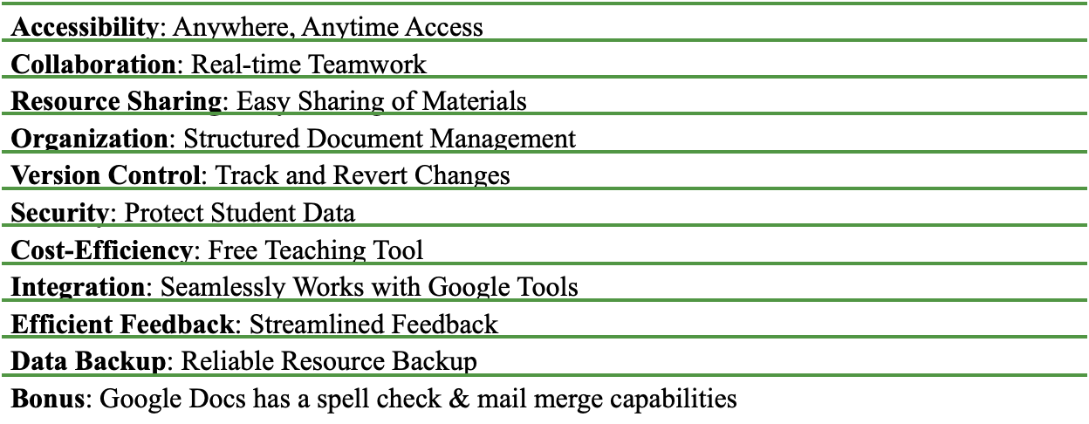
Where are ILPs stored? - Google Docs

Slide 18
When are ILPs written?
NWEA Testing Window - Fall (September), Winter (January), Spring (May)
Teachers and administrators meet and discuss data
Teachers write the SMART strategies and implement them
After the next testing window:
Teachers and administrators meet and discuss the new data - what stories does it tell?
Teachers write reflections about their teaching practices
Teacher write new SMART strategies and implement them

Slide 19
When are ILPs shared?
Teachers share ILPs with:
Students - after they are written, in a one-on-one conference (Middle school)
Families - during Fall and Spring parent/teacher conferences
Tutors and volunteers - when they are utilized within the school
Specialist teachers - cross-curricular learning is added when needed

Slide 20
How are SMART Strategies decided?
NWEA’s Learning Continuum is accessed

Slide 21
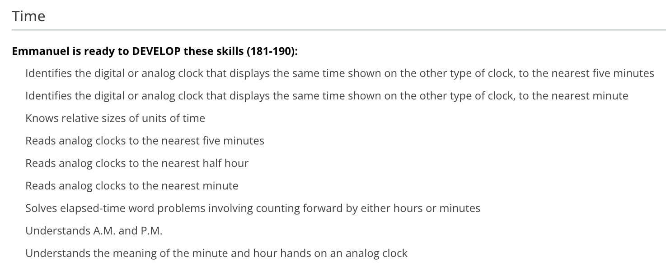
Skills are chosen

Slide 22
SMART Strategies are written
Skill: Telling time
Strategy: Once a week, in a small group, Manny will practice telling time with a manipulative clock. He will tell time to the hour and half hour until mastery, then telling time to the minute will be introduced.

Slide 23
How do you know…?
Which skills to pick?
How to write a SMART strategy?
How this aligns to your curriculum?
What these SMART strategies look like from K-8?
Shea’s Session, 1:00
How this will fit into your school year?
How to understand data trends?
How to decide which strands to focus on?
Inna’s session, 10:00

Slide 24
Q & A

Slide 25
Contact us:
Inna Collier Paske, Principal
icollierpaske@stpascalschool.org
Shea Bruce, Director of Curriculum and Instruction
sbruce@stpascalschool.org

