Slide 1
Welcome To The Table
Tabletop Exercising for
School Incidents

Slide 2
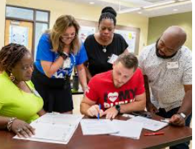
Today’s Deliverables
Discuss Table Top Exercise Concept (TTX)
Discover how to implement TTX in your own school context
Learn how TTX work can assist in further refinement of your Emergency Operations Plan (EOP)
Work through several TTX examples
Provide TTX resources

Slide 3
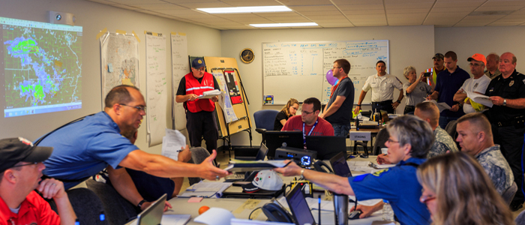
The Role of Exercises
Exercises enable the school community to test and validate plans and capabilities
Clarify roles and responsibilities
Identify both capability gaps and areas for improvement

Slide 4
Continuum of Exercises

Slide 5
Policy, Procedures, and Training
To provide you with the tools to exercise potential incidents with your school staff
To give you experience in critical thinking and decision-making

Slide 6
Table Top Exercises (TTX)
Designed to engage team members to work together as they manage the response to an incident
Clarification of roles, responsibilities, and expectations
Improve coordination between internal and external teams

Slide 7
You Are Invited To The Banquet!
Many are invited
Some will come
Others will not
Barriers
Alternatives
Options

Slide 8
Full Meal Deal vs. Charcuterie Board

Slide 9
Who is missing?
Whose voice is missing?
Whose perspective is needed?
What am I blind to?
What am I deaf to?
Where can I get clarity?
How do I access help?

Slide 10
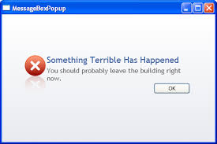
Common Complications
Scenarios that are not realistic
Timing and complex injects
Safety issues not addressed
Considerations of uniqueness of school facility or student population
Stray from actual school EOP
After action review not conducted

Slide 11
Identify Threats and Hazards
Bus crash
Tornado
Severe weather
Drugs
Weapons
Student fights
Medical event
Food borne issue
Intruder
Hostile parent
Biohazard/chemical release
Concerning event outside the building
Communications

Slide 12
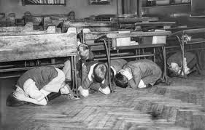
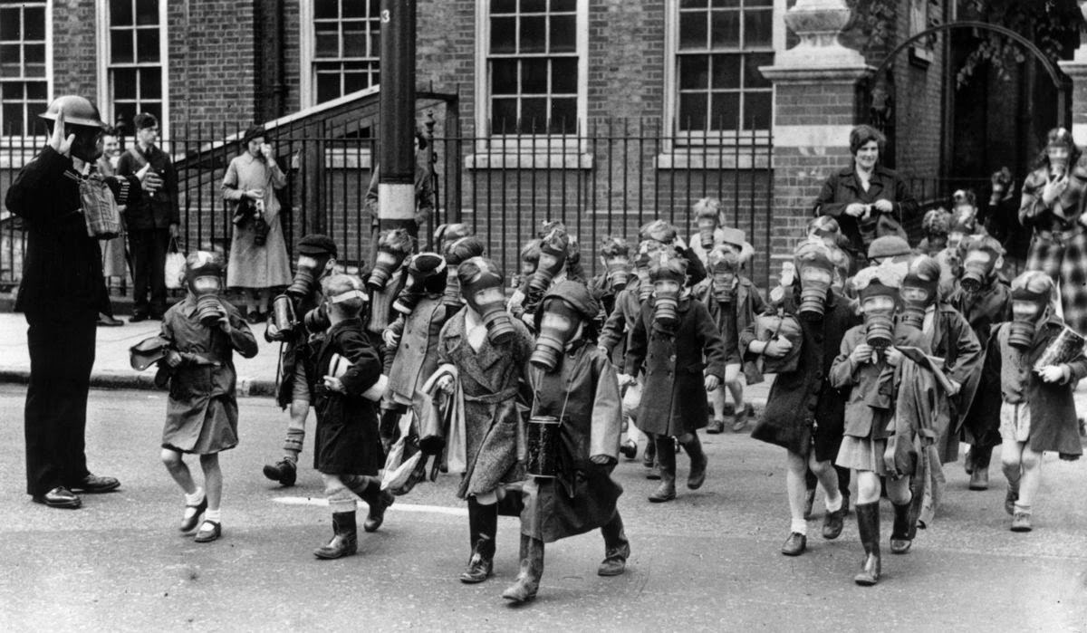
Additional Scenario Topics
Bomb threat
After school incident
Missing student
Evacuation
Accountability
Reunification

Slide 13
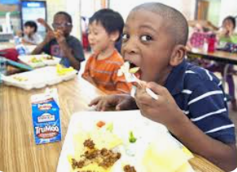
Table Manners Matter
Why taking small bites is the secret…
The Gift of Presence…Walk with them

Slide 14
TTX Design Components
Objectives: develop these BEFORE writing the scenario
Scenario: realistic for your school
Issues: scenario facts provided should be limited to cause participants to identify issues that may impact actions

Slide 15
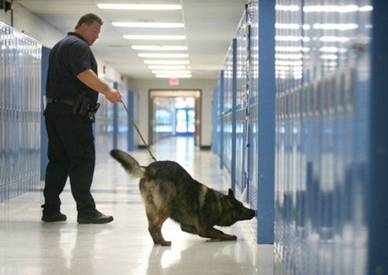
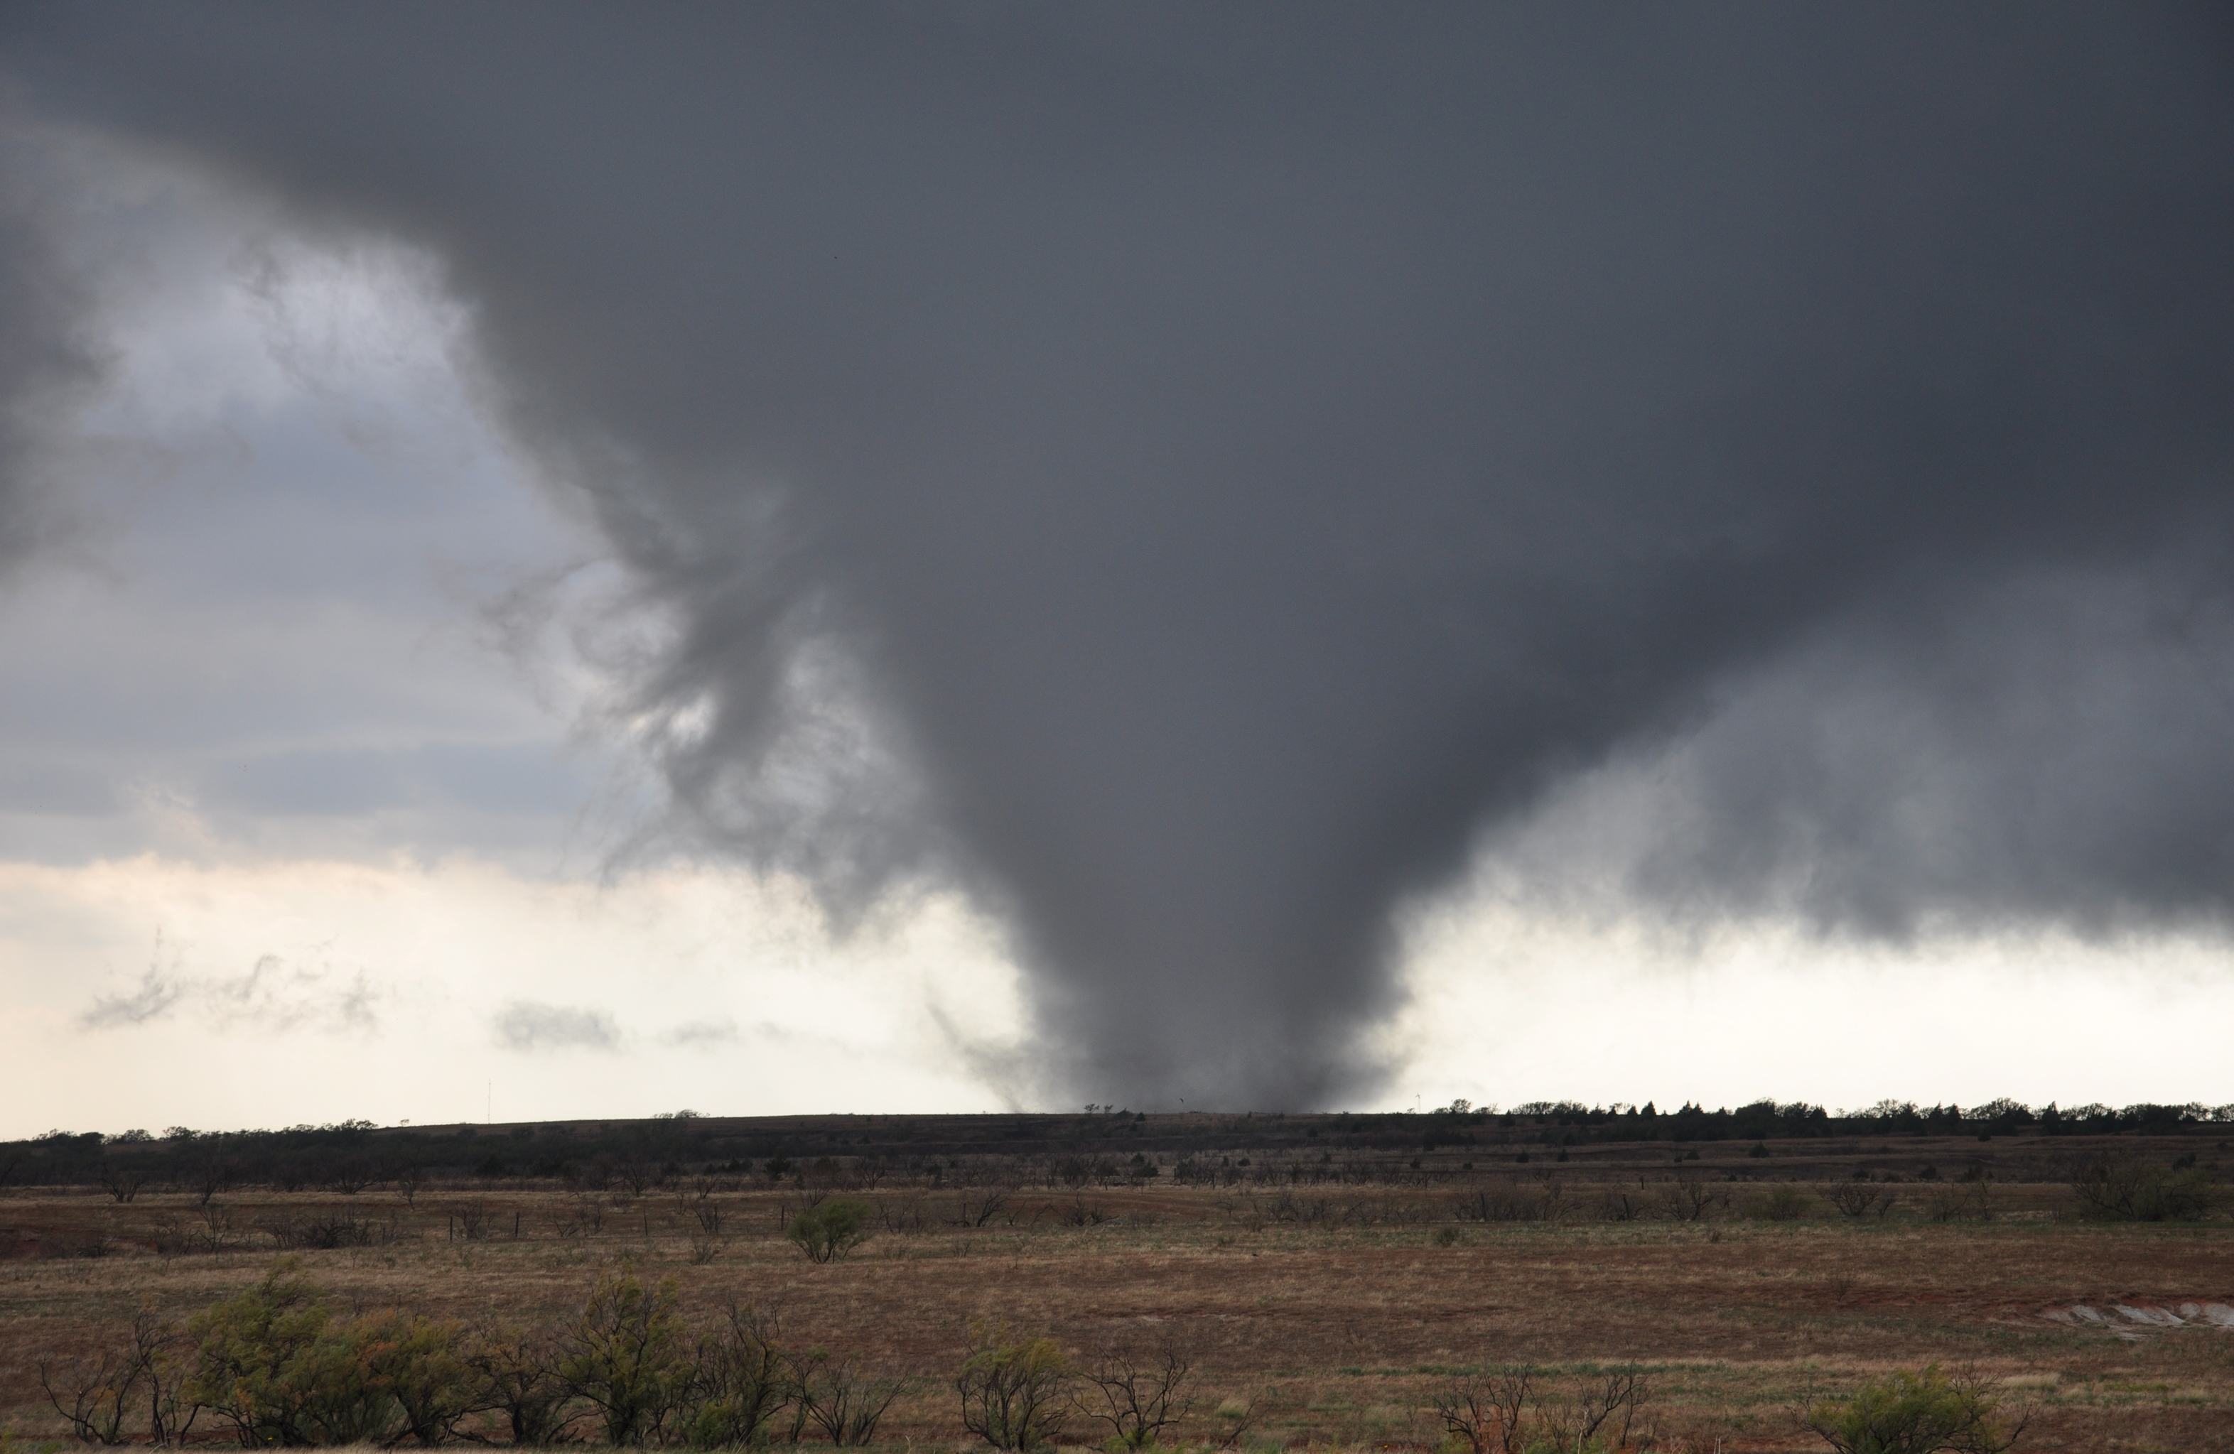
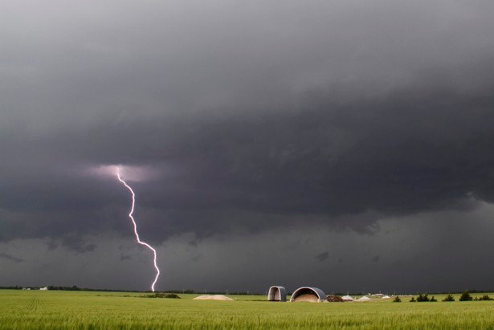
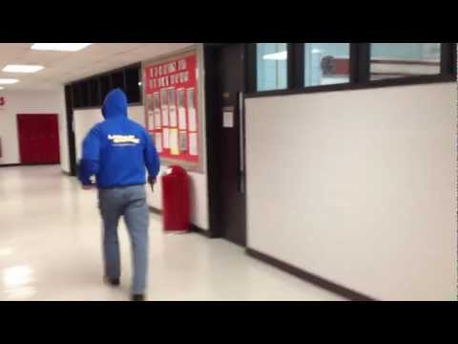
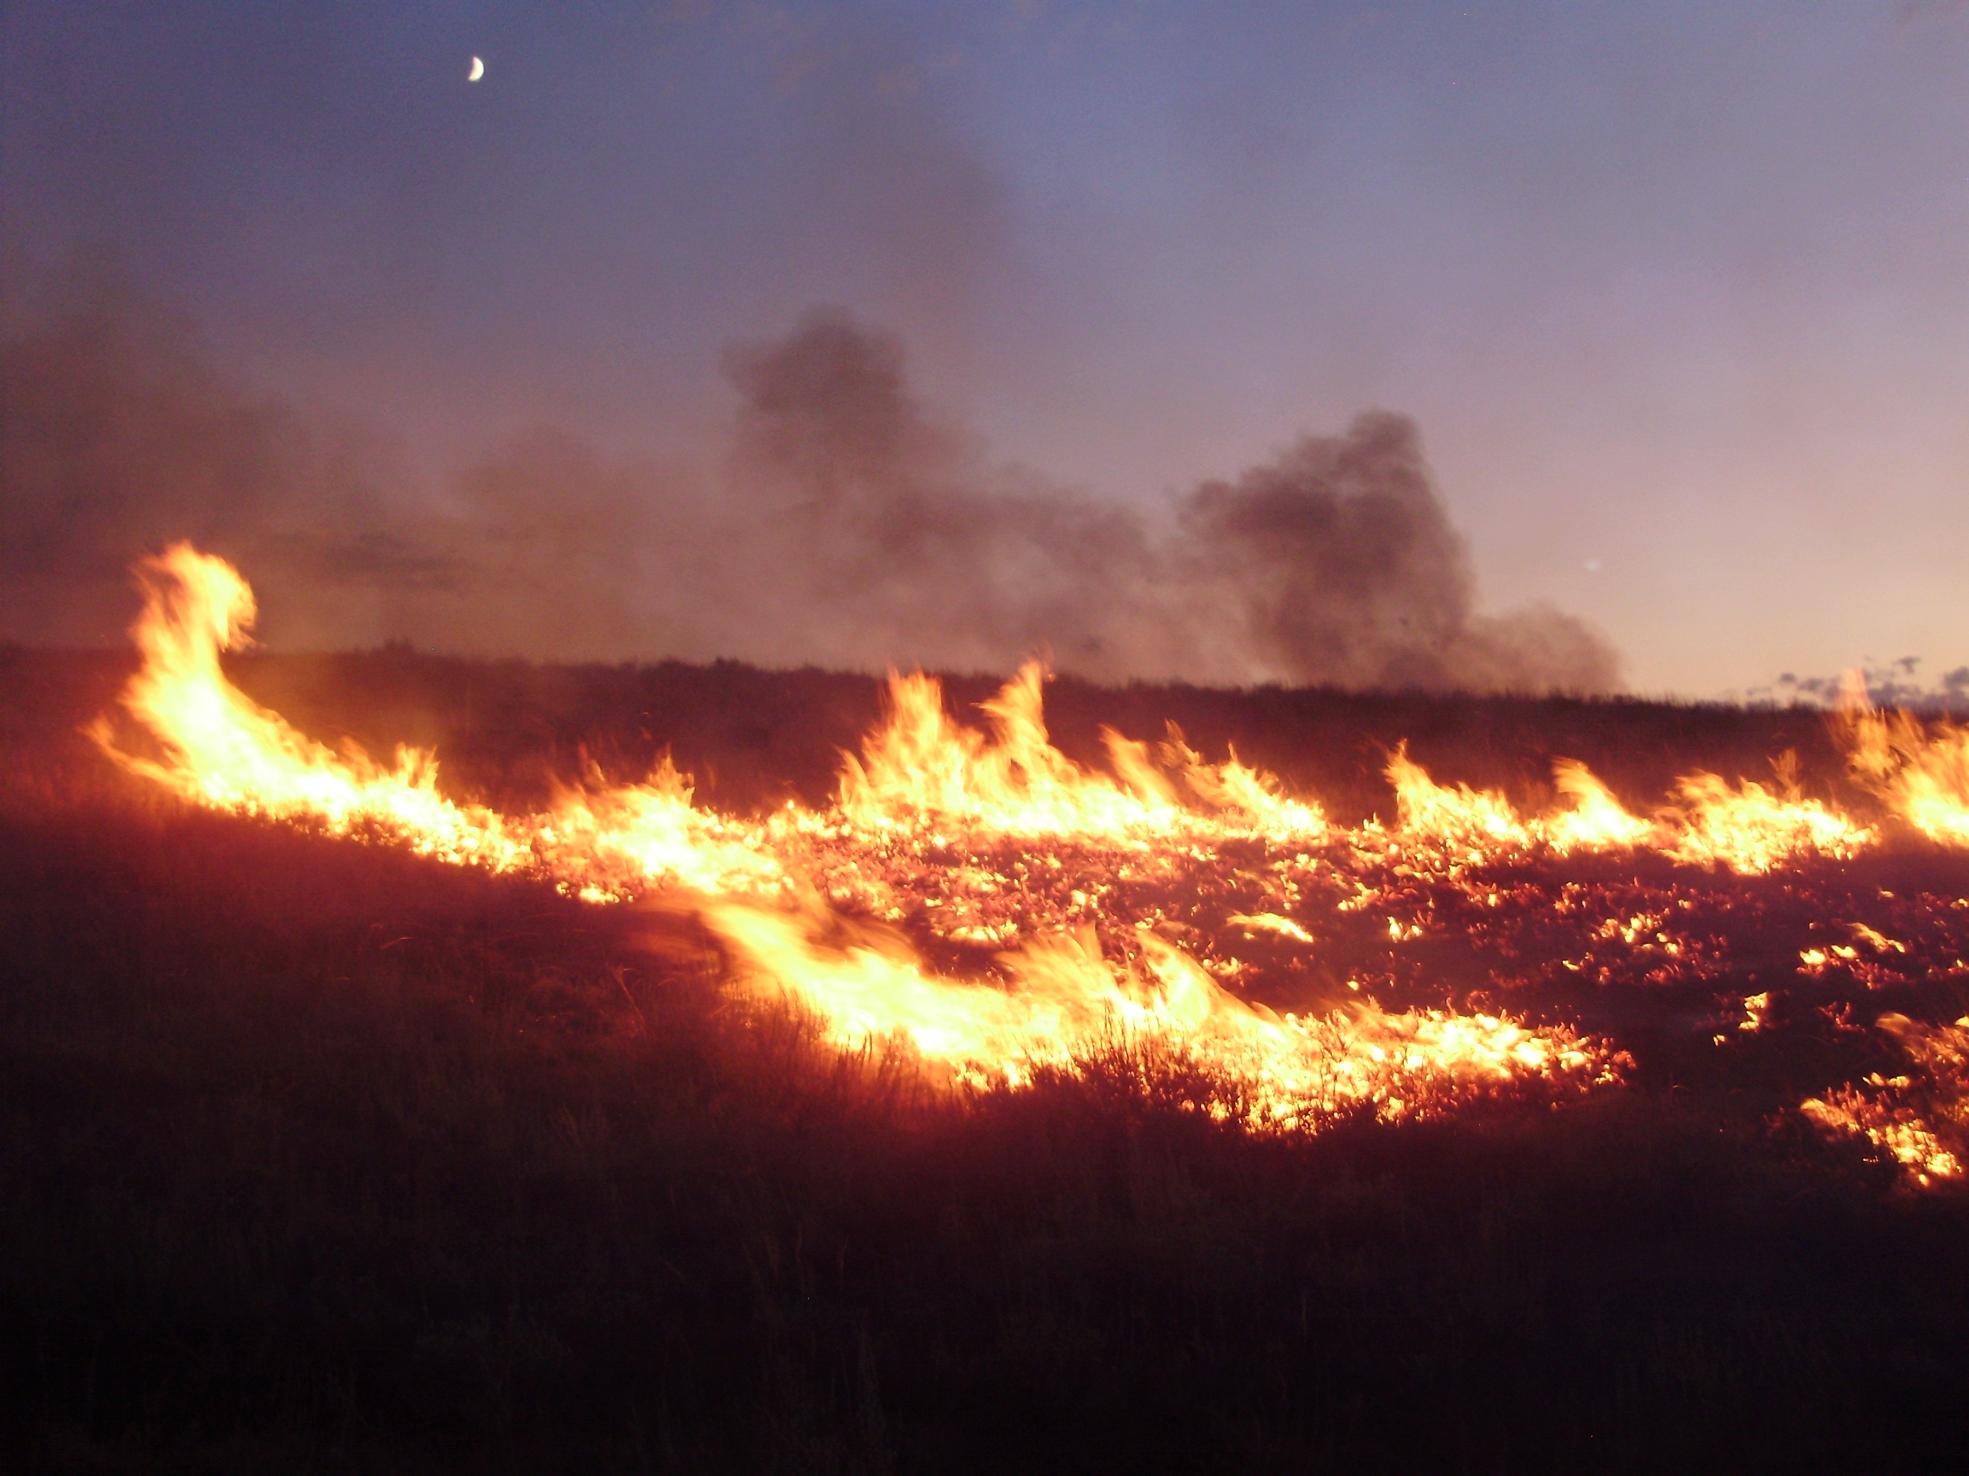
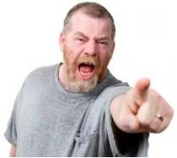
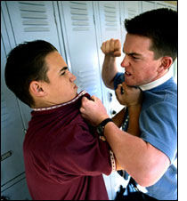
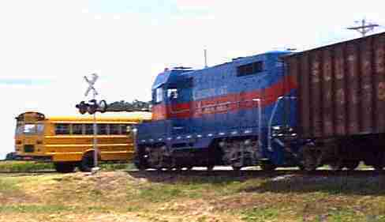
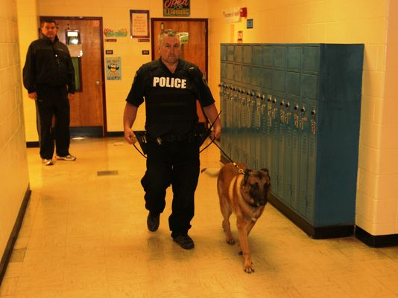

Slide 16
Let’s try this!

Slide 17
TTX Exercise Discussions
Before:
What are the initial actions?
Who is involved?
Who is affected?
Who is responsible for responding to the situation?

Slide 18
TTX Exercise Discussions
During:
What additional problems does this cause?
Is the situation escalating or de-escalating?
What information do you need?
Who else needs to know?
How will you deliver this information?

Slide 19
TTX Exercise Discussions
After-Action:
What was the plan?
What were the strengths? Weaknesses?
What was learned?
How do you improve?

Slide 20
TTX 10-Minute Small Groups
Arrange yourselves into small groups
Assign roles to individuals in your group
Emergency Operations Plan
Discussion guidance

Slide 21
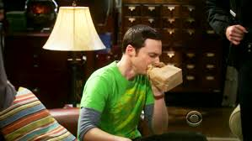
Facilitator Tips
ALL opinions are worthy of consideration and discussion

Slide 22
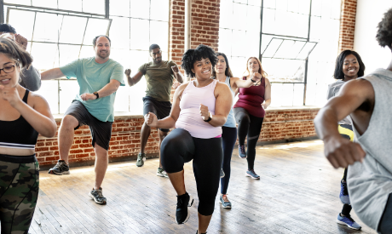
TTX 10-Minute Exercise Scenarios
Missing Bus Riders
Tornado Warning
Power Outage
Robbery Gone Awry
TTX Exercise Self-Evaluation Form

Slide 23
Are You Satisfied?
Was this TTX challenging and helpful?
Would this TTX be a benefit for your school’s staff development?
Are you ready to “Welcome to the Table?”

Slide 24
TTX 10-Minute Exercise Engagement
TTX at staff meetings and in-service training sessions
Utilize prepared TTX scenarios or develop your own
Staff members create scenarios (from their own unique perspective and experience)
Effective and efficient use of valuable staff training time

Slide 25
TTX 10-Minute Exercise Resources
Maryland Center for School Safety
https://schoolsafety.maryland.gov/Pages/RES-Training-TTX.aspx
Minnesota School Safety Center
https://dps.mn.gov/divisions/hsem/mn-school-safety-center/Pages/default.aspx

